Slide 1
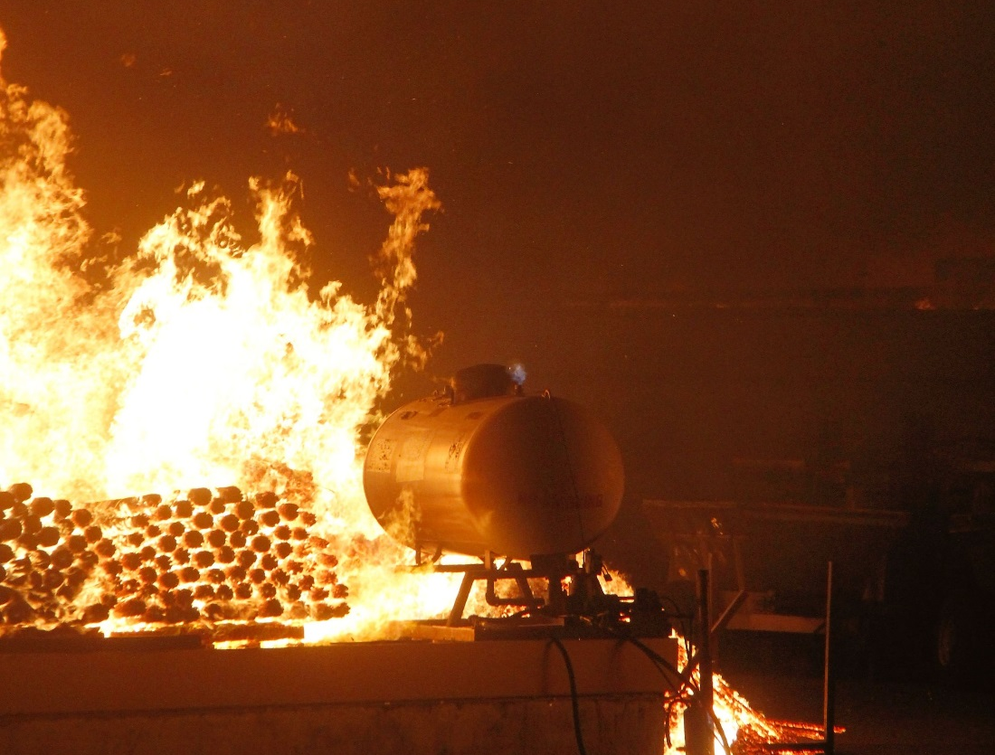
Washington State’s
EPCRA app
Essential chemical storage information made mobile for emergency responders
EPCRA Contact: sadie.whitener@ecy.wa.gov
App Developer: david.sage@ecy.wa.gov
Notes:
Thank you so much for recognizing the Washington Department of Ecology with this award.
Washington State is well known for being a leader in technology. We believe that spirit of innovation is just as important to the environmental work we do at Ecology as it is to Amazon or Microsoft.
Last year, we had the chance to break new technological ground with our agency’s first mobile app. We wanted to make the chemical storage information our agency already collects instantly available to the first responders who need it.

Slide 2
EPCRA - Emergency Planning and Community Right-to-Know
Created by 1986 federal law
Companies report storage of hazardous materials
Ecology collects reports for State Emergency Response Commission
Notes:
What is this chemical data? For decades, Ecology has collected chemical storage information from Washington facilities reported under the federal Emergency Planning and Community Right-to-Know Act.
We keep the database updated and make the information available to state emergency planners and local fire and police departments.

Slide 3
Why an EPCRA app
Instant access
Updated information
Data available offline
Mapping
Facility emergency contacts
Notes:
Although we made that data available, it was often kept in paper records, or stored on a desktop computer.
That meant firefighters, police and other responders didn’t always have the information when they needed it. Taking that data and putting it into a smartphone application made all kinds of sense.

Slide 4
New technology
First EPCRA mobile app in nation
Available on Android and iPhone
Notes:
It wasn’t plug and play – we had a few challenges getting our database to play nice with the mobile app. But our EPCRA reporting staff and our IT folks in Ecology’s hazardous waste program put their heads together and made it happen.
We launched the app last year. It was the first - and is so far still the only - EPCRA app in the nation.

Slide 5
Trial by fire
June 28, 2015 – Sleepy Hollow wildfire in Wenatchee burns agricultural warehouses
Notes:
As some of you may remember, Washington faced a historic drought last year that led to devastating wildfires in our state.
Our team was putting the finishing touches on the app last June when a major wildfire erupted just outside the city of Wenatchee in central Washington.
Embers from that wildfire blew into a recycling center near the center of the city, and soon there was a major commercial fire burning in Wenatchee’s warehouse district. Our Spills responders were called in, and they brought the new EPCRA app with them.

Slide 6
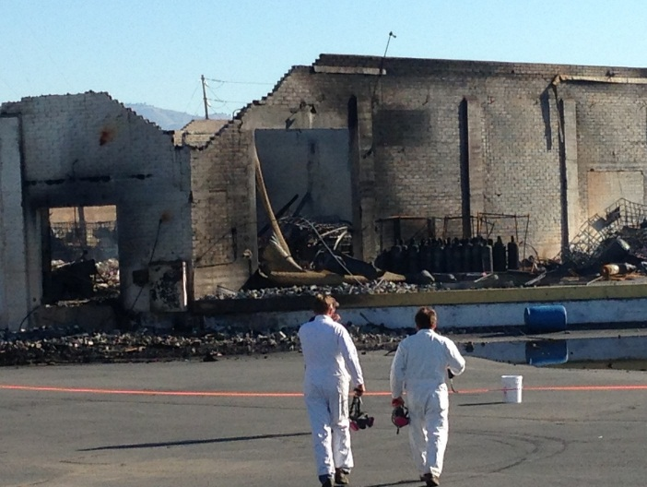
“This is a game-changer for us. Having this paid off for us, improving the safety of responders and the public.”
– Dave Byers, Spills response manager
Notes:
Several fruit packing plants were destroyed in the fire.
Our responders knew tanks of ammonia were stored at the site, but the EPCRA app told them that one warehouse also held a toxic fumigant called methyl bromide. Knowledge is power – and knowing what chemicals are on site and where they are stored is crucial information for emergency responders.
Our Spills response manager called the app a “game changer” for his team.

Slide 7
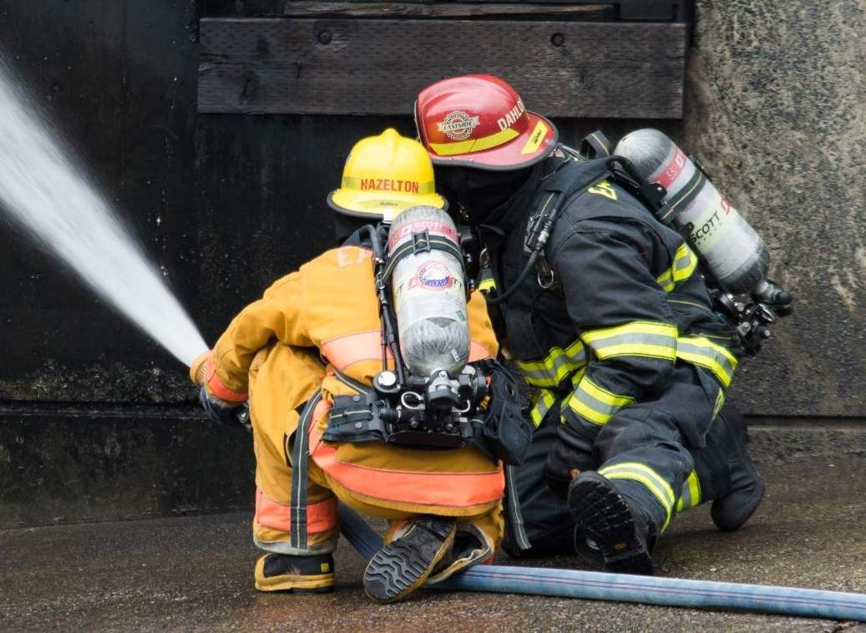
Reaching responders
“It’s all about safety and being as prepared as possible.”
- Chief Bill Whealan,
Washington Emergency Response Commission
Notes:
Since that first real-world test in Wenatchee, we’ve invited all emergency responders in our state to download the app.
I’m proud to say that more than 500 fire departments and other emergency responders now have it on their phones as a resource. That means they will be better prepared next time they face a chemical threat.
Thank you again. It is an honor to be recognized by our peers.

