Slide 1
ICIS-NPDES Plugin Design Preview Webinar
ICIS-NPDES Full Batch
OpenNode2 Plugin Project
Presented by Bill Rensmith
Windsor Solutions, Inc.
3/15/2012

Slide 2
Agenda
Project Background
  About OpenNode2, flows, and plugins
  About this Project
  Project Timeline
ICIS-NPDES Full Batch Plugin Design
  Staging Tables
  Stage 1: Data Preparation
  Stage 2: Submission
  Stage 3: Result Processing
  Implementer Responsibilities
  Options for non-OpenNode2 States
Q & A

Slide 3
About OpenNode2
Open source Exchange Network node software
OpenNode2 can:
  send data to other Network partners
  make data available for others to query
Most widely used node software on the Network
Available at http://code.google.com/p/opennode2

Slide 4
About Flows and Plugins
Each type of data on the network is a “flow”
  There is a flow for each regulatory area (air, waste, etc…)
  ICIS-NPDES is one of many available flows
  EPA defined the rules for sending data via the ICIS-NPDES flow
Each flow is implemented as a Plugin in OpenNode2
  Plugins are the software that contain the functionality needed to support a specific flow
  The OpenNode2 Google code site has plugins for most major regulatory flows to EPA

Slide 5
About this Project
15 ICIS-NPDES “Full Batch” states
  Will submit their NPDES data to EPA via the Exchange Network
The ICIS-NPDES Full Batch flow is complex
  46 different data families
  149 tables (complex data types)
  1195 fields (simple elements)
  963 business rules
To reduce implementation challenge, EPA and ECOS wanted to make available tools to simplify flow implementation for states.

Slide 6
About this Project (cont’d)
In September 2011, EPA and ECOS engaged Windsor to develop full batch data flow plugin for OpenNode2
  Ubiquity of OpenNode2 made it a good choice to reach the widest potential audience of states
  To reduce cost, only developing for the .NET version of OpenNode2 (most commonly used version)
Pilot with Washington Dept. of Ecology
  Summer 2012
Does not include implementation of plugin at other states

Slide 7
Project Timeline
1/5/2012 – Plugin design completed
2/8/2012 – Staging tables released to Google Code
3/13/2012 – Beta Plugin release to Google Code
6-8/2012 – Test/Implement in WA
8/23/2012 – Final Plugin release to Google Code
12/2012 – Release of ICIS v4 Plugin
  Adds support for compliance and enforcement modules

Slide 8
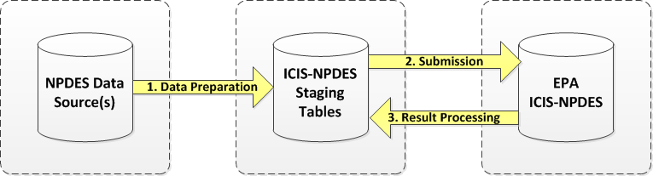
Overall Submission Workflow

Slide 9
Workflow Lifecycle
Data Preparation Stage
  State-specific Extract, Transform and Load (ETL)
  Change Detection Process
Submission Stage
Result Processing Stage
  Retrieve Accept/Reject Report and Parse/Store Results
  Store Accepted Records
Full lifecycle must complete before repeating
Checks in place to prevent out-of-sequence execution

Slide 10
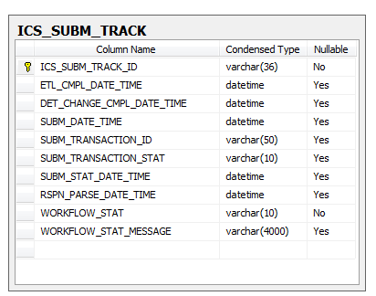
Workflow Lifecycle Tracking
Workflow Tracking (ICS_SUBM_TRACK)
Data Preparation
Submission
Result Processing
Overall Status

Slide 11
ICIS-NPDES Staging Tables
Two sets of staging tables:
  ICS_FLOW_LOCAL – Agency’s NPDES data to send to ICIS
  ICS_FLOW_ICIS – Copy of data successfully sent to ICIS

Slide 12
Stage 1: Data Preparation
ETL Step
  Refresh “local” tables with latest data from agency NPDES database

Slide 13
Stage 1: Data Preparation (cont’d)
Three Ways to Load Agency Data:
  Full Data Synchronization
    Transfer ALL agency NPDES data to “Local” staging database. Just keep it up-to-date with a regular refresh.
    Could be implemented as a full purge/rebuild or incremental refresh.
    Let the plugin figure out what is new, changed, or deleted and therefore what needs to be sent.

Slide 14
Stage 1: Data Preparation (cont’d)
  Incremental Data with Automatic Change Detection
    Agency only populates data it wishes to send to ICIS.
    Requires that agency can track what data is new or changed since last successful submission to ICIS.
    Must turn of “Auto generate deletes” in ICS_PAYLOAD staging table.
    Let the plugin figure out what to send.
  Incremental Data with Manual Change Detection
    Same as #2 but agency sets Transaction Codes in ETL.
    Does not rely on the plugin to figure out what to send.
    Does not leverage any of the plugin’s built-in change detection
    Fewer database components required, but much more complicated to implement for the agency.

Slide 15



Stage 1: Data Preparation (cont’d)
Detect Changes Step
  Database routine compares “Local” data with “ICIS” data to determine what needs to get sent.
  Sets Transaction Codes (N, C, R). Leave Transaction Code blank if data is already in sync with ICIS.
  Inserts records into “Local” for Deletes (D, X).

Slide 16
Stage 2: Submission
Plugin builds payload for all modules/records that have a Transaction Code set.

Slide 17
Stage 2: Submission (cont’d)
Submission Settings in ICIS-NPDES plugin:
  Organization, Contact Info, and Author
    Gets inserted into XML header
  ICIS User ID
    The ICIS user performing the submission
  Notification Email Addresses
    Semicolon separated list
    Added to XML header, instructs EPA to send processing emails
  Validate XML
    Yes/no

Slide 18
Stage 3: Result Processing
Download, Parse and Store Results Step:
  When processing is complete, Node downloads and parses Accepted and Rejected Transactions into a Result Tracking Table.

Slide 19
Stage 3: Result Processing (cont’d)
Store Accepted Transactions Step:
  Accepted Records are copied from “Local” to “ICIS”.
  Performed by a stored procedure executed by the plugin.

Slide 20
Stage 3: Result Processing (cont’d)
Submission Settings in ICIS-NPDES plugin:
  Notification Email Addresses
    Semicolon separated list
    Notifications sent from OpenNode2 upon successful parsing/storing.

Slide 21
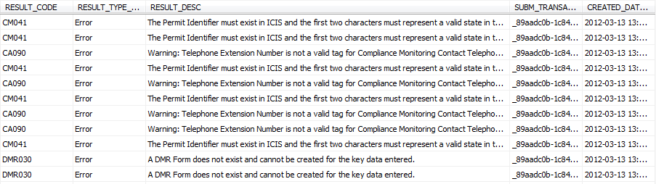
Stage 3: Result Processing (cont’d)
How do I audit successes/failures?
  All feedback from ICIS is stored in result tracking table (ICS_SUBM_RESULTS)
  Only stores the accepted transactions from the most recent submission
  Stores all errors received for a given business key

Slide 22
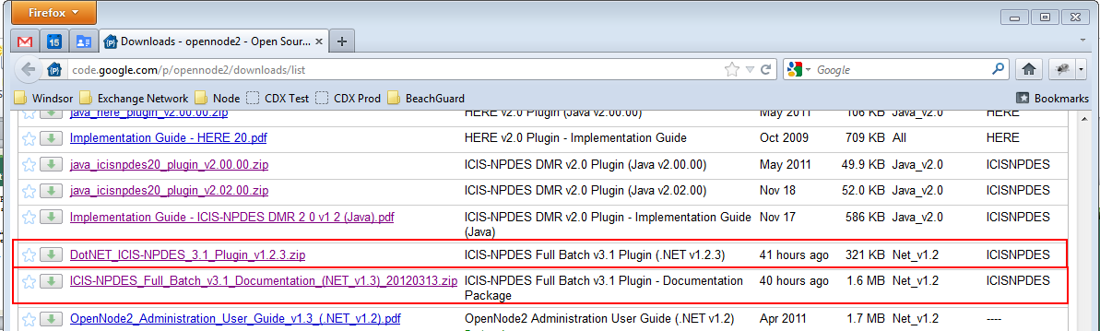
What Can I Download?
http://code.google.com/p/opennode2/

Slide 23
What Can I Download? (cont’d)
Plugin
  Plugin.zip – this is what you upload to OpenNode2
  Database scripts – for SQL Server and Oracle
    Creates needed tables, procedures, views…
Documentation
  Plugin Implementation Guide PDF
    Just the facts. Describes how to install and configure the plugin and database components.
  Plugin Design Specification PDF
    All the nitty-gritty details of the plugin design. Very useful to understand the details of how the plugin components work.

Slide 24
Implementer Responsibilities
Set up staging tables in state environment
Map source systems to staging tables
  Mapping to ICIS-NPDES lookup values
Develop data extraction and transformation routines to copy data from state database to staging tables
Set up node and plugin
Flow data to CDX Test environment
Monitor for errors and refine transformation logic
Migrate to production

Slide 25


Questions and Answers
http://code.google.com/p/opennode2
bill@windsorsolutions.com

