Slide 1
Delaware Source Water Protection Polygons
Douglas Rambo, P.G.
Delaware Department of Natural Resources and
Environmental Control
Source Water Protection Program

Slide 2
Delaware Source Water Protection Polygons
In 1999 EPA Region III approved Delaware’s Source Water Assessment Plan (SWAP) detailing the methodologies used to delineate wellhead protection area (WHPA) polygons for approximately 1,200 wells (500+ water systems).
Delaware has delineation criteria for drinking water sources in confined and unconfined aquifers.
In 2003 DNREC participated in a pilot project with the GWPC to explore transfer of SWA data to EPA for incorporation into the WATERS database.

Slide 3
Delaware Source Water Protection Polygons
The CADMUS Group analyzed the Delaware Source Water Program Database and created a XML Schema that allowed for the merging of our geospatial (ESRI Shapefile) data and data from our program’s MS Access database.

Slide 4
Delaware Source Water Protection Polygons
Methodologies
  Confined aquifer well WHPA’s consist of a circular fixed radius with a minimum 150-foot radius.
  Unconfined aquifer wells pumping less than 50,000 gallons/day also get delineated with a fixed radius delineation of at least 150-foot radius.
  Unconfined aquifer wells that pump greater than 50,000 gallons/day require delineation using groundwater modeling software (i.e. EPA WhAEM or Schlumberger Water Services’ Visual MODFLOW).

Slide 5
Delaware Source Water Protection Polygons
  Special Cases
    New Castle County = more stringent than State with a minimum of 300-foot radius area around a public well.
    City of Dover East Wellfield = 7 high volume unconfined aquifer wells each buffered by a 1-mile radius

Slide 6
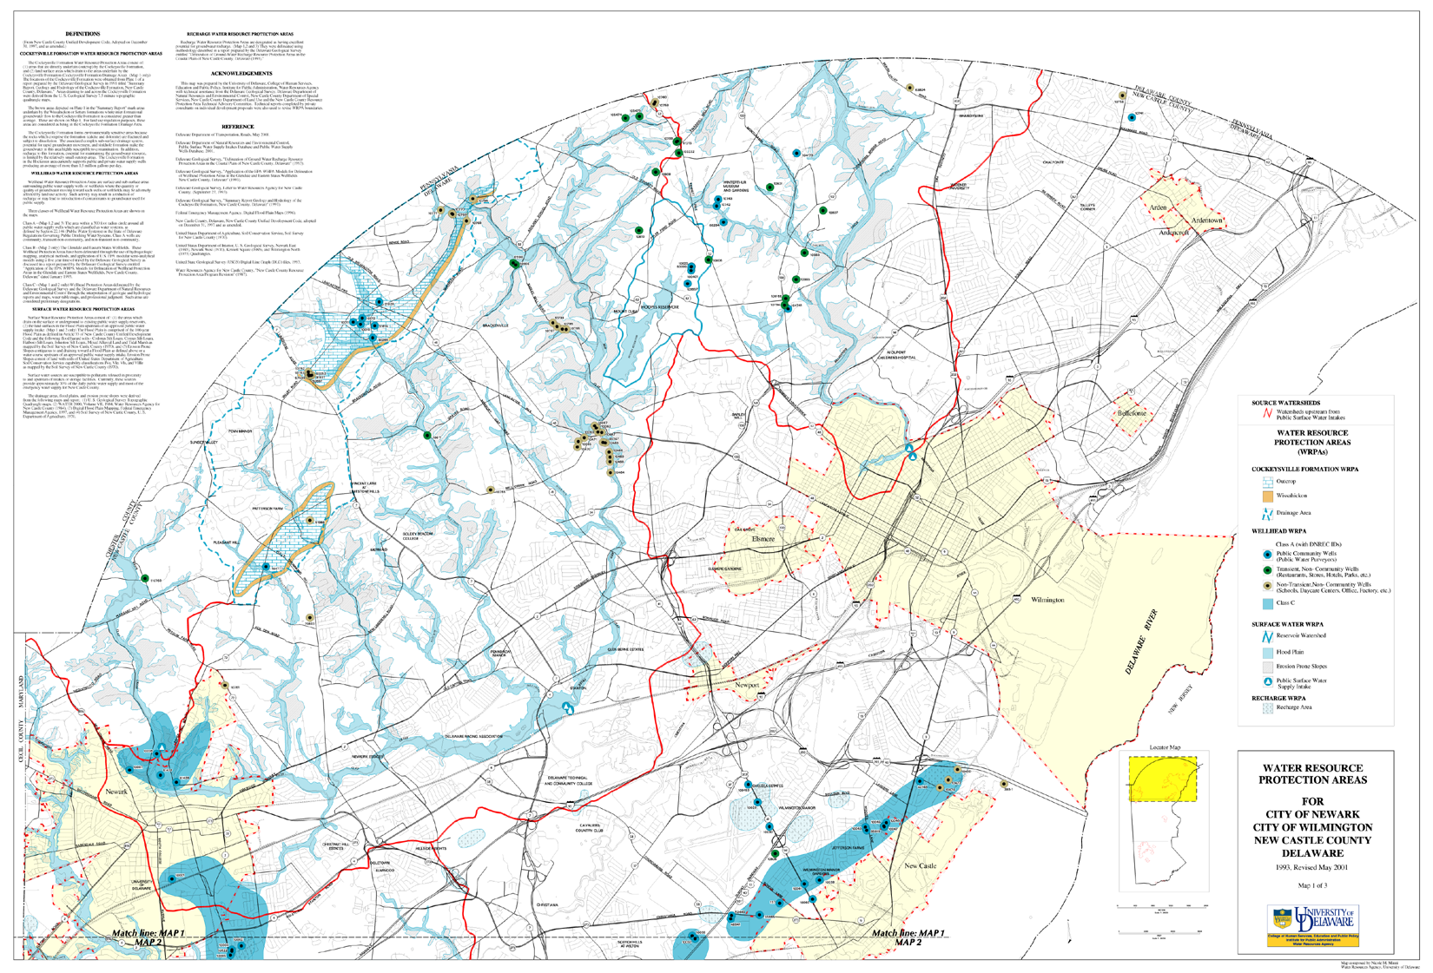

Slide 9
Delaware Source Water Protection Polygons
The Source water Program provides an ESRI shapefile to the DNREC Office of Information Technology as well as source data from our program database.
Future improvements
  Delineation information is now being stored in ESRI Personal Geotadabases by water system with detailed source information tied to the polygon.
  A DNREC contractor has developed a routine to compile the delineation information from all of the individual Geodatabases into a single ESRI Shapefile. This may reduce the need to send both shapefile and database data through the node.

Slide 10
Delaware Source Water Protection Polygons
Michael Townshend
Delaware Department of Natural Resources and
Environmental Control

Slide 11
Delaware Source Water Protection Polygons
Contractual staff tasked with writing an application to generate the instance document of the Source Water programs tabular data.
  Future version could generate the instance document and save it to a BLOB field in our Node database.
  Once in the Node database we can submit to CDX or another node
  The data can also be retrieved using a Node Client.

Slide 12
Delaware Source Water Protection Polygons
Sharing the spatial component
  Obtain regular updates from program staff.
      Or have program staff run models that update shared data.
  Host the spatial data in location accessible by public facing ArcGIS Server.
  Create an ArcGIS Server Map service that enables the Web Feature Service(WFS) Interface
      For more information on WFS:
      http://www.opengeospatial.org/standards/wfs

Slide 13
Delaware Source Water Protection Polygons
Accessing the Spatial Data
  WFS is an open standard
  ArcGIS Desktop includes built in tools for importing data from WFS Services.

Slide 14
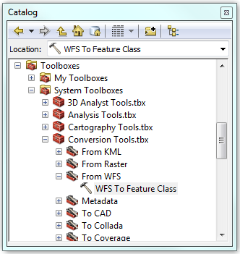
Delaware Source Water Protection Polygons

Slide 15
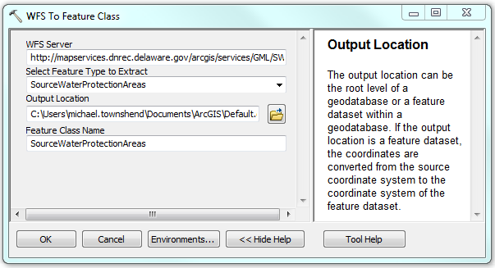
Delaware Source Water Protection Polygons

Slide 16
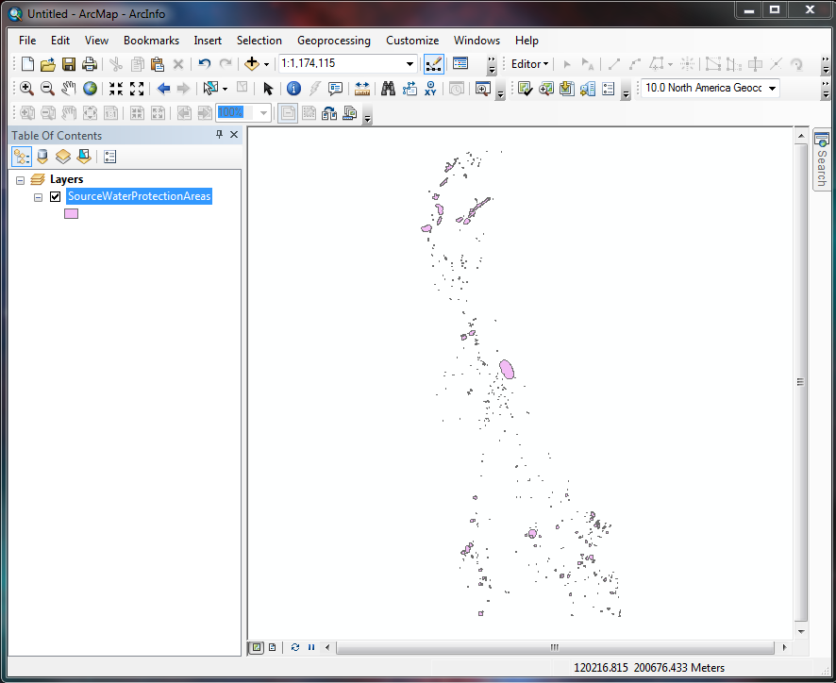

Slide 17
Delaware Source Water Protection Polygons
Any client that supports WFS can consume the service:
http://mapservices.dnrec.delaware.gov/arcgis/services/GML/SWAP/MapServer/WFSServer?request=GetFeature&typename=SourceWaterProtectionAreas

