Slide 1
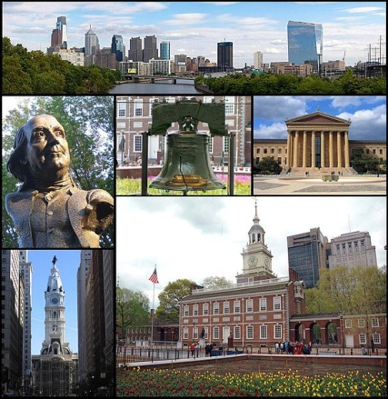
The Exchange Network Browser
Mike Matsko: New Jersey DEP
Exchange Network National Conference
May 30, 2012

Slide 2
Topics
What is the EN Browser?
EN Browser Features
How It Works
Demonstration
Governance IPT
Acknowledgements

Slide 3
What is the Exchange Network Browser?
National Tool for Accessing Data on the Exchange Network
Integrated with Exchange Network Discovery Service (ENDS)
Interacts with and retrieves data from publishing Nodes (Query / Solicit)
Retrieved data (XML) can be:
  Transformed (HTML, CSV, GML) for easier viewing
  Geocoded and mapped
  Plotted on graphs

Slide 4
Features of EN Browser
Public & Secure Access (NAAS)
Node and Data Service Health Check
Data Discovery - ENDS / DEDL Integration:
  ENDS (describes services):
    Node info, basic service info (name, parameter listing)
  DEDL (further describes service parameters):
    Labels, Required Y/N, Multi-Select, Pick Lists (can be static or dynamic)
    Geospatial-based querying (using publish WMS/WFS map services)
Data Retrieval – Adv. Solicit Handling , History, Transformation
Personal Data Library – Supports many different flows
Data Analysis:
  Analysis by Map (including geocoding data without lat/long)
  Analysis by Chart (Time Series, Bar Chart, Bivariate scatter plot)
Open Source Solution
Notes:
Re “Advanced Solicit Handling”: Solicits involve 4 steps (Auth, Solicit, GetStatus, Download). EN browser simplifies by handling much of this in the background so user doesn’t need to.
Re WMS/WFS: If a Query/Solicit has geospatial-based parameter (e.g. HUC), publisher can opt to publish a Map Feature Service (MFS) to allow users to query data by picking from a map rather than typing in a value.

Slide 5
How It Works

Slide 6
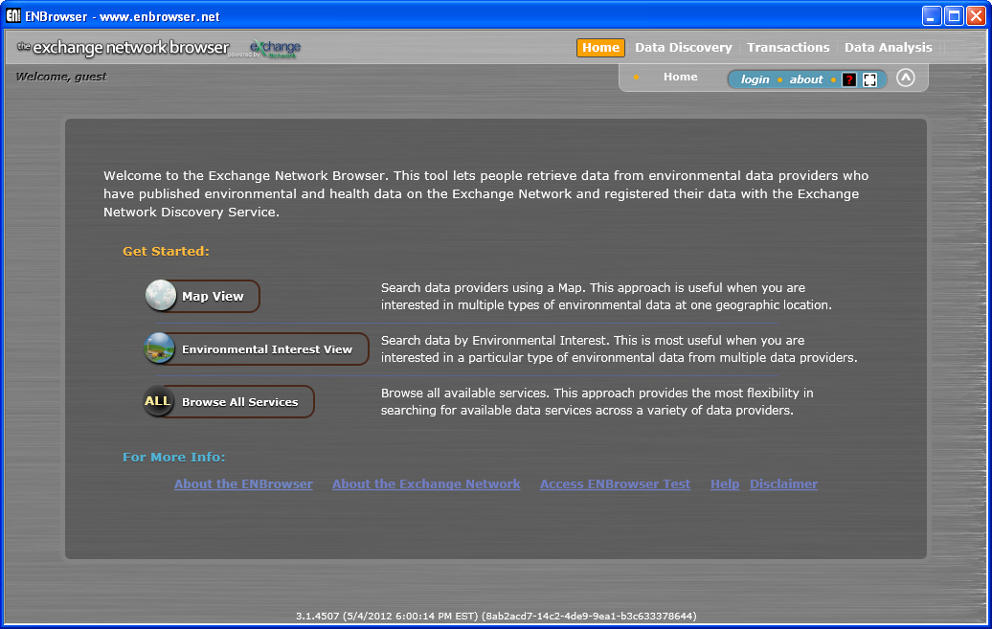
Exchange Network Browser

Slide 7
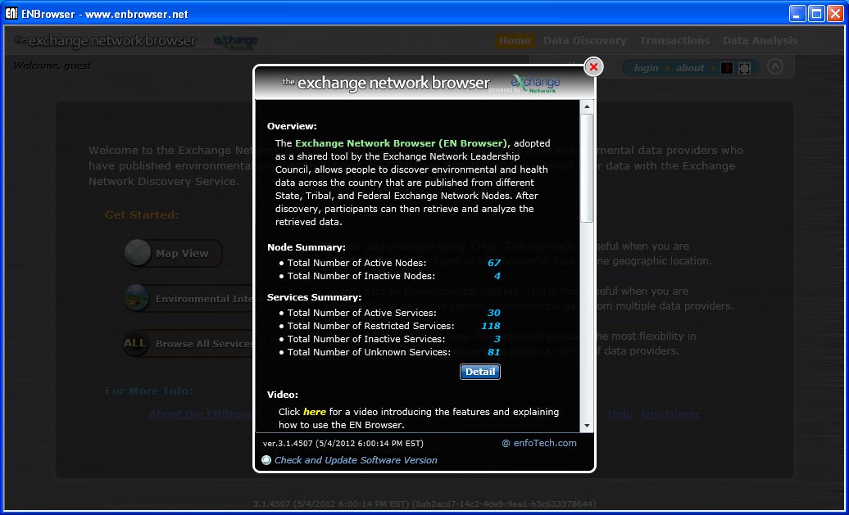
About - Node and Service Health Check

Slide 8
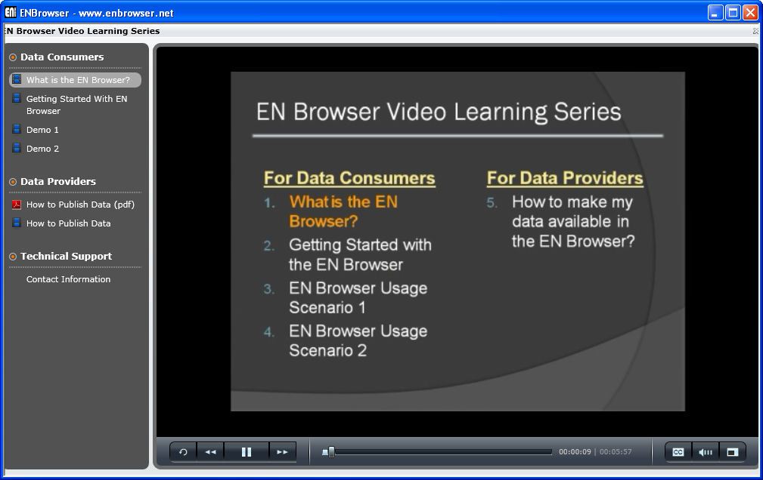
Help - Video Learning Series

Slide 9
Getting Started

Slide 10
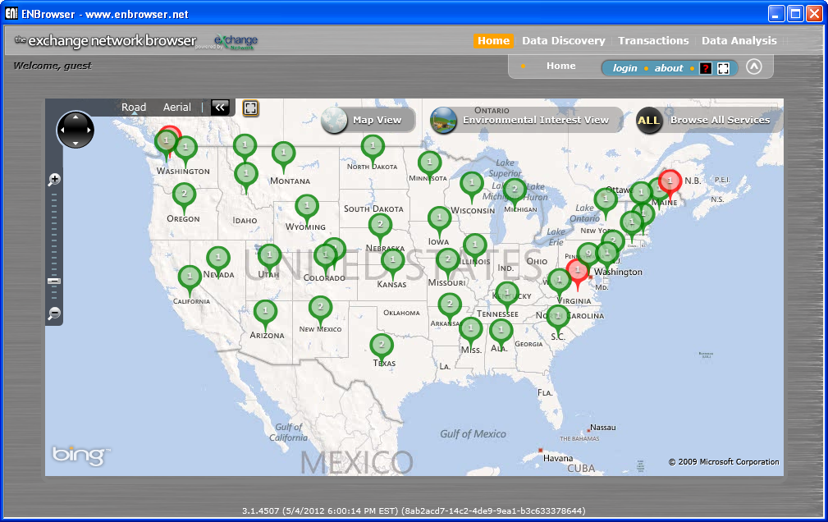
Discover Services by Map

Slide 11
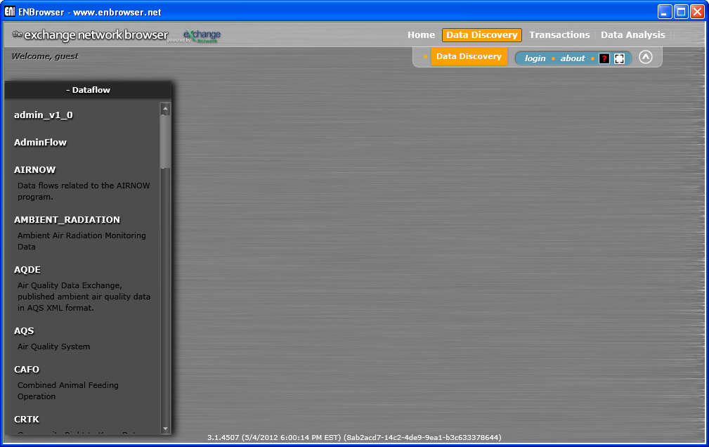
Discover Services by Data Flow

Slide 12
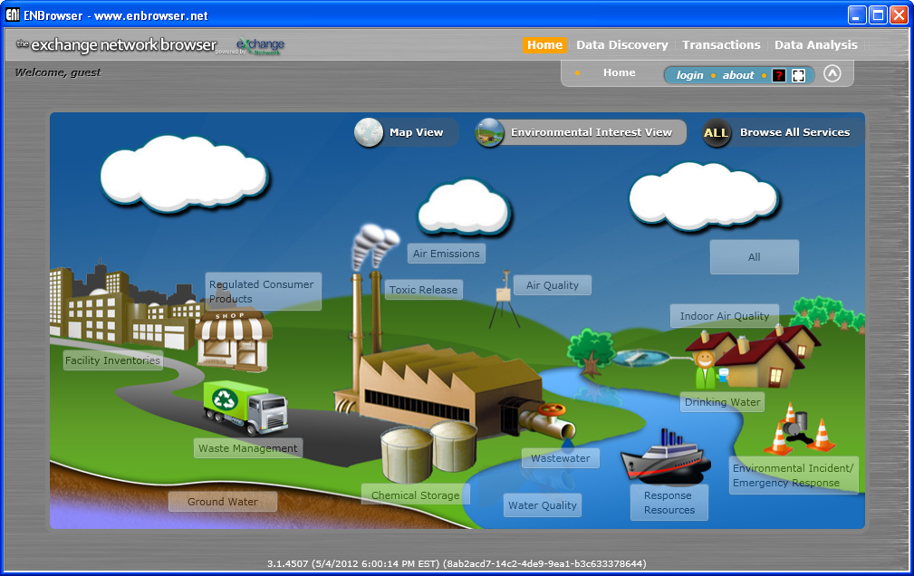
Discover Services by Environmental Interest

Slide 13
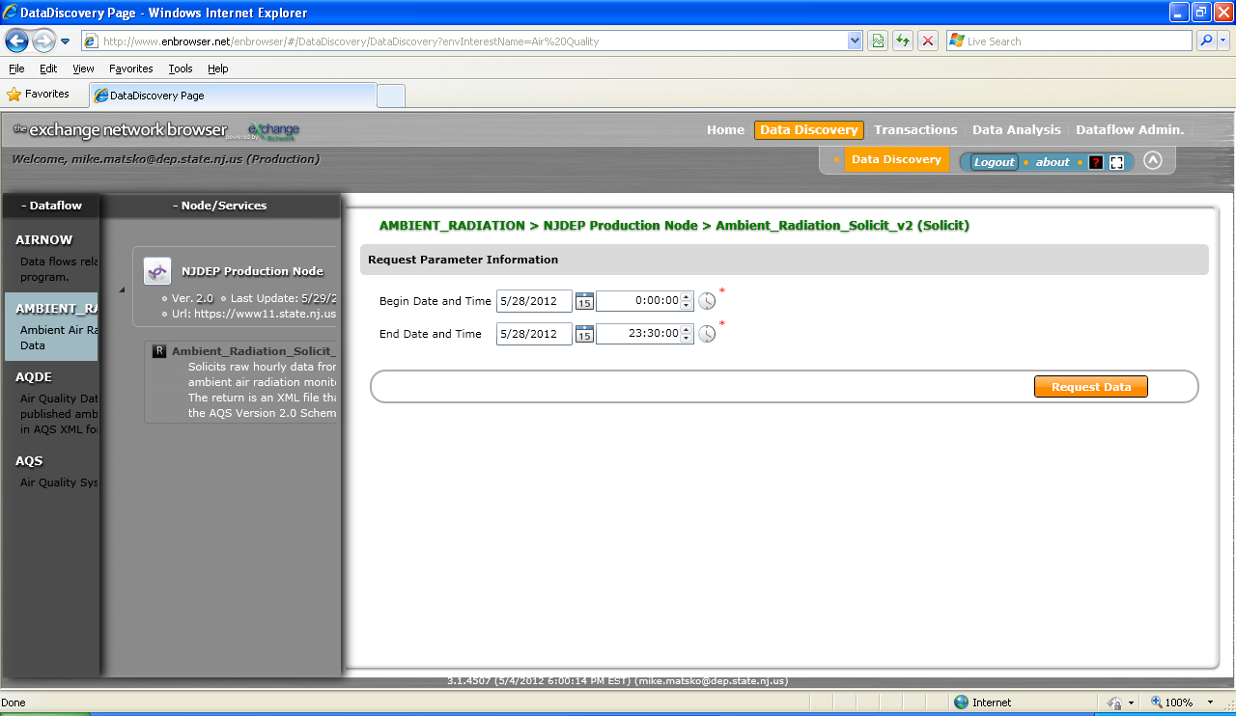
ENDS and DEDL Represented

Slide 14
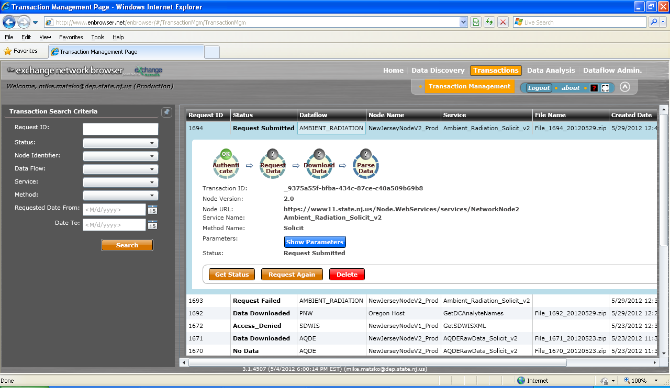
Transaction Management

Slide 15
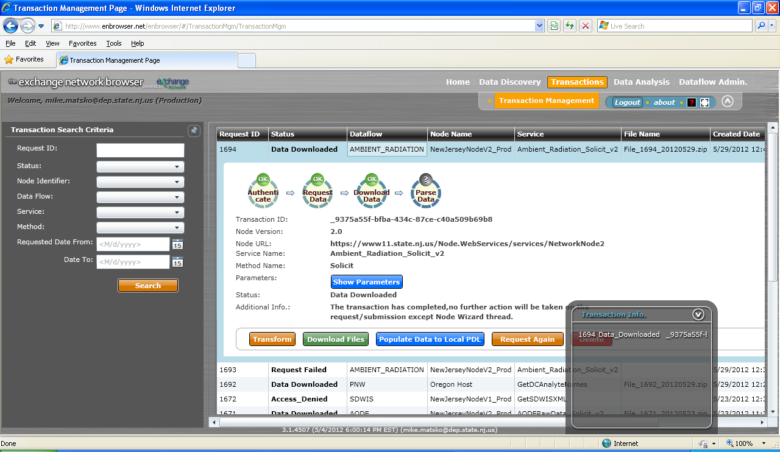
Advanced Solicit Handling

Slide 16
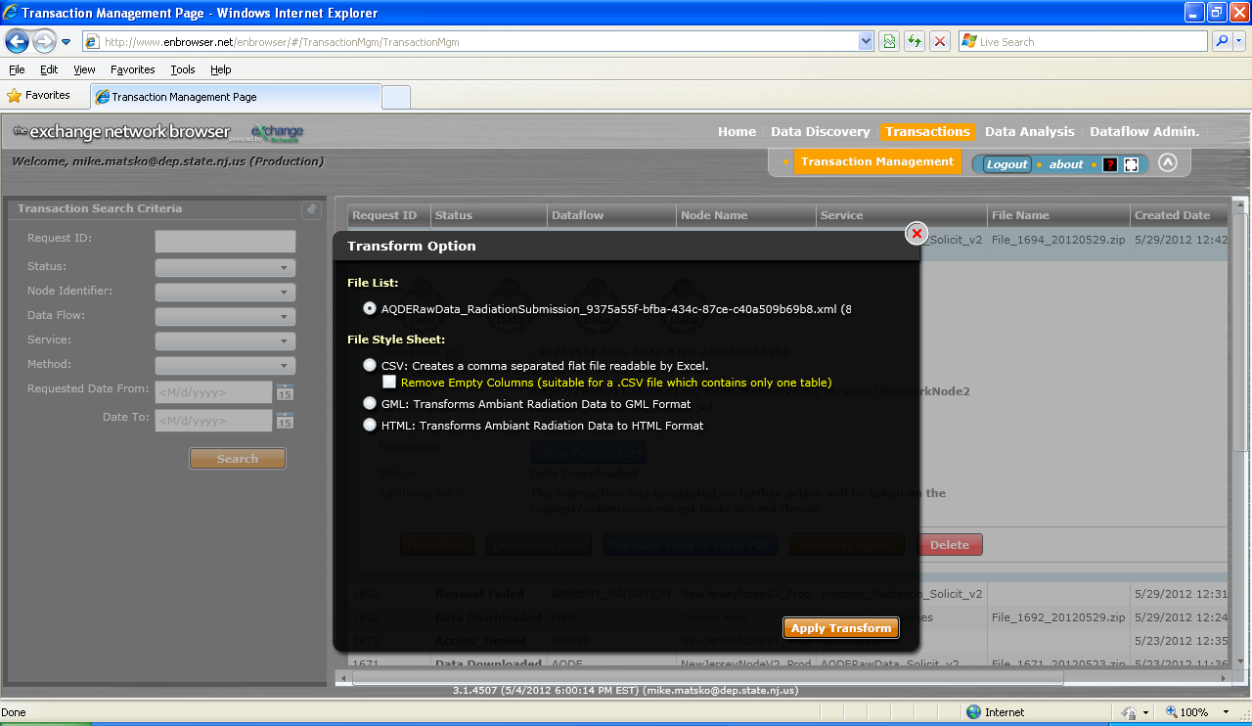
XML Transformation

Slide 17
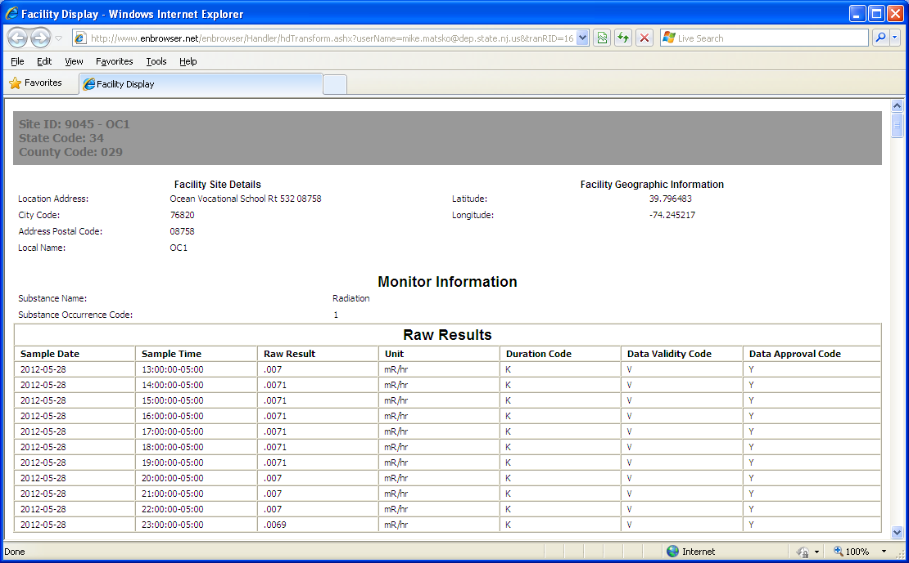
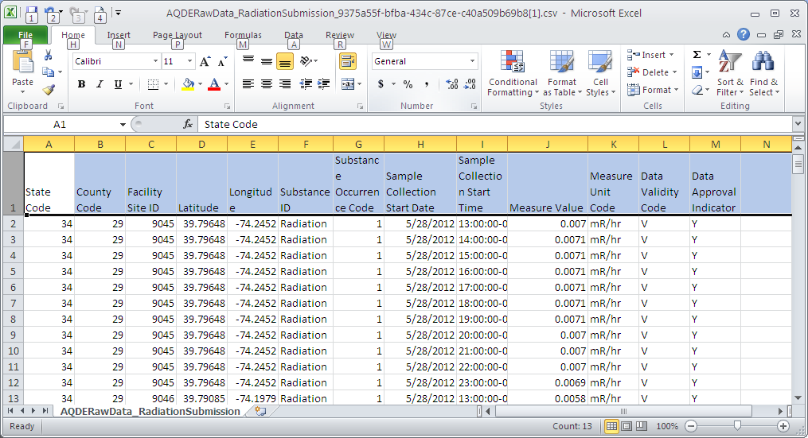
Exchange Network Browser

Slide 18
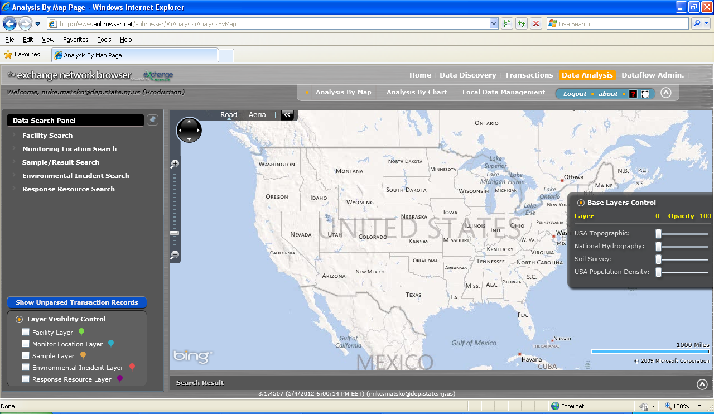
Exchange Network Browser

Slide 19
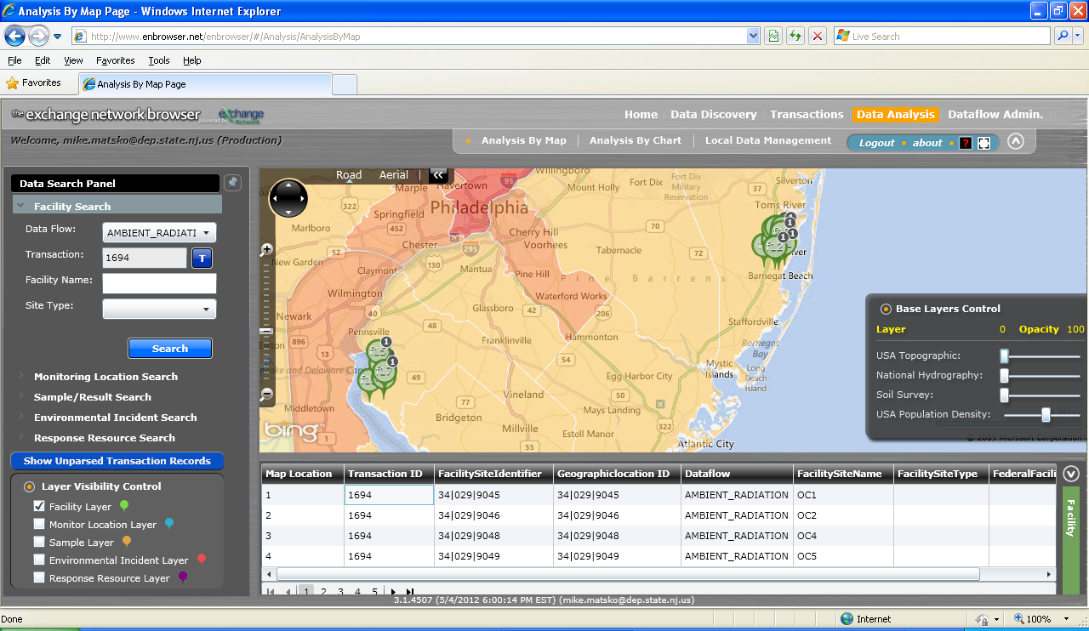
Exchange Network Browser

Slide 20
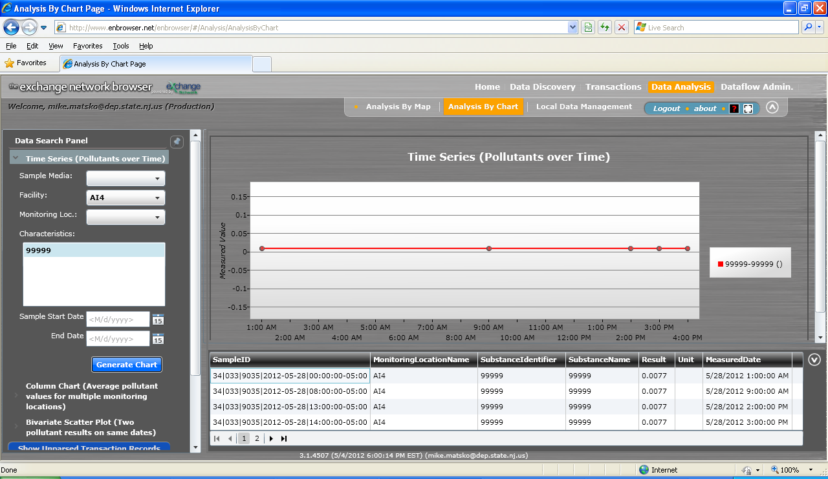
Exchange Network Browser

Slide 21
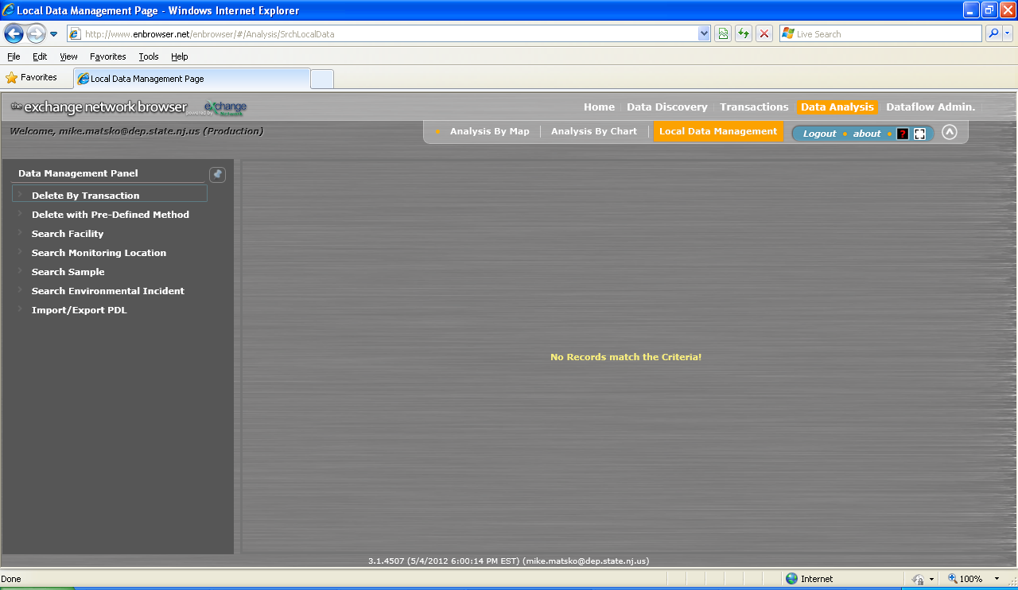
Exchange Network Browser

Slide 22
Governance
Integrated Project Team
  ECOS
  EPA
  NJ
  MI
  NE
  enfoTech
Annual Maintenance Contract
  Bug Fixing
  Enhancement Prioritization
  End User Support

Slide 23
Acknowledgements (2007 – 2012)
Aleem Mohamed (NJDEP)
Angela Witcher (NJDEP)
Chris Clark (EPA)
Chris Simmers (NHDES)
Connie Dwyer (EPA)
Doug Timms
Glen Carr (ORDEQ)
Greg McNelly (ECOS)
Harry Chen (NJDEP)
Jeremy Dupuis (NHDES)
Kurt Rakouskas (EN)
Mike Beaulac (MIDEQ)
Mike Matsko
Mike McGee (NJDEP)
Paul Morton (NJDEP)
Peter Gu (EPA)
Robert Simpson (EPA)
Roy Chaudet (EPA)
Sara Raja (MIDEQ)
Sherry Driber (NJDEP)
Yunhao Zhang (CDX)
enfoTech

Slide 24


