Slide 1
Introduction to the Exchange Network
May 30th, 2012

Slide 2
Overview
Business value of the Network
What is a node?
Who participates in the Exchange Network
Types of data exchanges
Examples of success
May 30th, 2012

Slide 3
Business Value of the Network
Improves data validity, timeliness, security and accessibility
Provides shared services and improves communication among EN partners and their systems
Empowers program staff and managers by making data more accessible and easy to integrate and analyze
Supports open government and transparency efforts
May 30th, 2012

Slide 4
What is an EN node?
Nodes
Requests and responses use eXtensible Markup Language (XML)
Software allows nodes to communicate to each other without human intervention
Use standardized tools and technology neutral components
The Central Data Exchange (CDX) is EPA’s node on the Exchange Network
A partner’s point of presence though which it exchanges data
Sends and responds to requests via the Internet
A computer (technically known as a web server)
May 30th, 2012

Slide 5
Who Participates in the EN?
Exchange Network Partners:
Other Federal Agencies
National Congress of American Indians
Environmental Council of the States
EPA
50 states/ 93 Tribes/ 2 Territories
Program Offices
Regions
OEI

Slide 7
Examples of Success
MassAir Online
Near real time access to data (1 hour delay)
Automated QA
Services that can be reused by other partners
May 30th, 2012
Notes:
Look up photos from thesis.

Slide 8
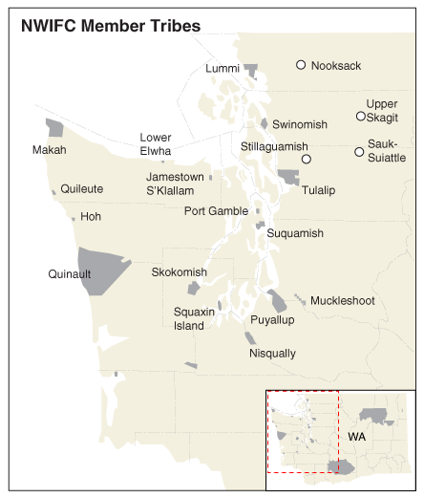
Tribal Success
Northwest Indian Fisheries Commission
Regional water quality network
Reporting water quality data from 20+ tribes
Regional “supernode” model that can be reused by other tribal consortia
May 30th, 2012

Slide 9
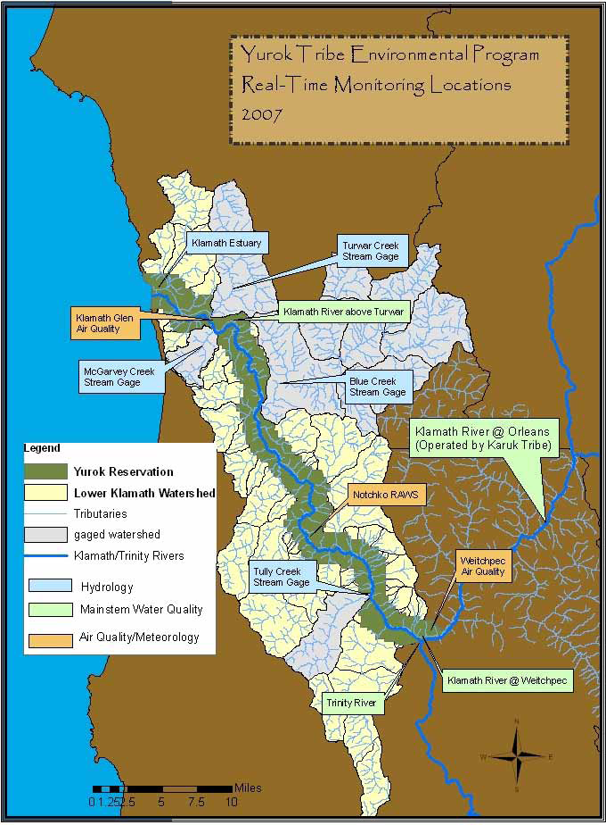
Tribal Success
Yurok Tribe
Develop an integrated Environmental Data Storage System and Exchange Network node
Develop a real- time water quality monitoring network
Promote transparency by making data publically accessible
May 30th, 2012

Slide 10
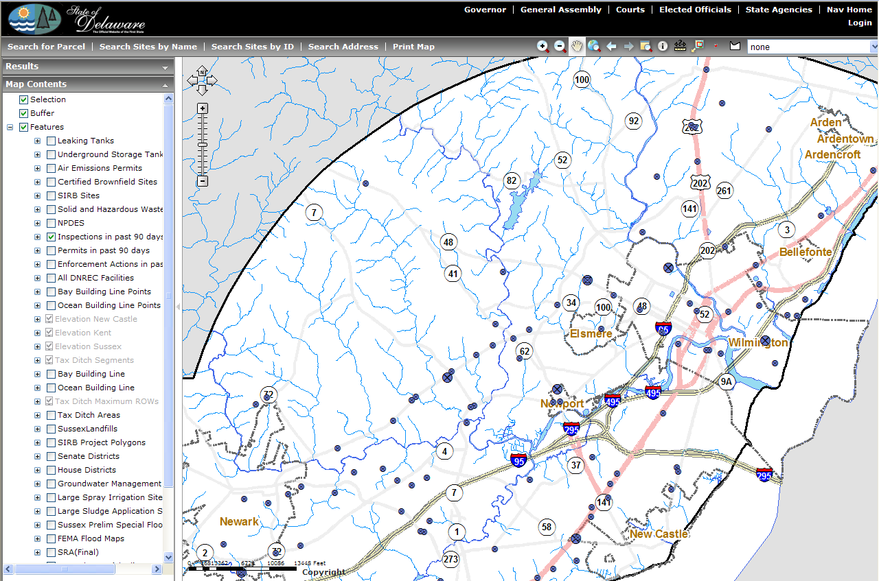
Examples of Success
Delaware UIC
Created Delaware Environmental Navigator (DEN) to house environmental data on class V wells
Users can perform queries and map data
Promotes transparency and supplies quality assurance
May 30th, 2012

Slide 11
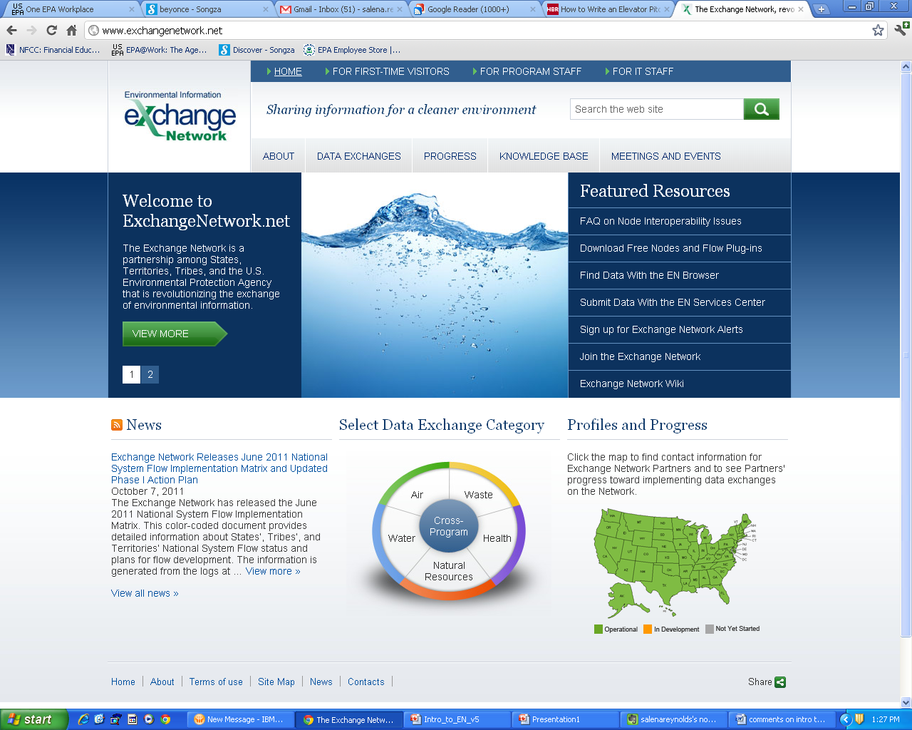
For more information on the EN
www.exchangenetwork.net
News
Policies
Documentation
Technical specifications
Success stories
Governance Information
Sign up for Exchange Network Alerts
www.epa.gov/exchangenetwork
EN Grant information
http://www.exchangenetworkwiki.com/wiki/index.php/Main_Page
Exchange Network Wiki
May 30th, 2012

Slide 12
Regional Coordinators
Ken Blumberg, Region 1
(617) 918-1084
Bob Simpson, Region 2
(212) 637-3335
Virginia Thompson, Region 3
(215) 814-5755
Rock Taber, Region 4
(404) 562-8011
Glynis (Gigi) Zywicki, Region 5
(312) 886-4571
Zenny Sadlon, Region 5
(312) 886-6682
Headquarters
Connie Dwyer, Director
Information Exchange and Services Division
(202) 566-1691
Jonathan Jacobson, Chief
Information Exchange Partnership Branch
(202) 566-1984
Exchange Network Coordinator
Kurt Rakouskas
(301) 531-5186
Salena Reynolds, Grants Program Manager
Information Exchange Partnership Branch
(202) 566-0466
Laurie Carter, Region 6
(214) 665-6566
Maryane Tremaine, Region 7
(913) 551-7430
Josie Lopez, Region 8
(303) 312-7079
Christine Vigil, Region 8
(303) 312-6992
Patricia Eklund, Region 9
(415) 972-3738
David Tetta, Region 10
(206) 553-1327
May 30th, 2012

