Slide 1
NPDES Electronic Reporting: Notices of Intent and Discharge Monitoring Reports Moderator: Andy Battin, U.S. EPA
Presented by:
John Dombrowski, U.S. EPA
Alison Kittle, U.S. EPA
U.S. Environmental Protection Agency

Slide 2
Presentation Outline
NPDES Electronic Reporting Rule
Future of NPDES Electronic Reporting
Current NPDES Electronic Reporting Tool
NetDMR
Proposed NPDES Electronic Reporting Tool
eNOI
Making the Future of NPDES Electronic Reporting a Reality

Slide 3
Presentation Outline
NPDES Electronic Reporting Rule
Future of NPDES Electronic Reporting
Current NPDES Electronic Reporting Tool
NetDMR
Proposed NPDES Electronic Reporting Tool
eNOI
Making the Future of NPDES Electronic Reporting a Reality

Slide 4
NPDES Electronic Reporting Rule
Overall Goals of the NPDES Electronic Reporting Rule
Using 21st Century technology to obtain more accurate, timely, and complete information about the NPDES program;
Reducing burden of existing paper-based reporting from regulated facilities; results in overall cost savings for those regulated;
Improve transparency by providing public access to accurate, timely, complete data; and
Allow EPA, state environmental agencies and Tribes to focus resources on the most important environmental problems

Slide 5
NPDES Electronic Reporting Rule
NPDES Regulated Facilities:
Majors, 6,700
.
Note: This graph covers all discharge sources except for pretreatment industrial users and dischargers operating under general permits for discharges from vessels and discharges from pesticide applicators.

Slide 6
NPDES Electronic Reporting Rule
Focus of the Rule
Information is provided by the source directly to EPA, state environmental agencies and Tribes
Submission of NPDES information and reports already required under other existing regulations electronically
DMRs
General Permits
Special Regulatory Program Reports
.

Slide 7
NPDES Electronic Reporting Rule
DMRs
General Permit Types of Information to be Submitted from the Regulated Community
Notice of Intent (NOI) to discharge form - seeking to start coverage under 40 CFR122.28(b)(2)(i) AND (ii)
Notice of Termination (NOT) form - seeking to terminate their coverage under 40 CFR124.5
No Exposure Certification (NEC) form - industrial stormwater permit under 40 CFR 122.26(g)(1) and (4)
Low Erosivity Waivers (LEW) form - construction stormwater permit under 40 CFR 122.26(b)(15)
.

Slide 8
NPDES Electronic Reporting Rule
Special Regulatory Program Reports to be Submitted
Biosolids Annual Program Reports
CAFO Annual Program Reports
MS4 Program Reports
Pretreatment Annual Program Reports
Industrial User Compliance Reports
CSO and SSO Overflow Event Reports
.

Slide 9
NPDES Electronic Reporting Rule
Data Requirements
Minimum set of NPDES data is from existing regulatory requirements
To be provided by permittees as well as state and Tribal environmental agencies
Required data will be listed in Appendix A to 40 CFR 127
Not applicable to all facilities
e.g., POTWs do not need to report CAFO data
The need to update and report this data depends on the source of the data
e.g., permit data upon issuance or reissuance only
.

Slide 10
NPDES Electronic Reporting Rule
Sources of NPDES Information Under the Rule
Inspections** and single event violations**
*Data supplied by permittees
**Data supplied by states & EPA
Program reports* and violations**
DMR information* and effluent violations**
Permit information (including permit applications*, eNOI*, effluent limits** and outfalls*)
.
Basic Facility*
Enforcement actions**
Data uses
Identify regulated universe, applicable requirements, and environmental significance
Determine and document compliance status
Document enforcement response

Slide 11
Presentation Outline
NPDES Electronic Reporting Rule
Future of NPDES Electronic Reporting
Current NPDES Electronic Reporting Tool
NetDMR
Proposed NPDES Electronic Reporting Tool
eNOI
Making the Future of NPDES Electronic Reporting a Reality

Slide 12
Future of NPDES Electronic Reporting
Timeline for Implementation
Permittees Begin to Submit DMR Data and Federal General Permit Data for Entire Applicable Universe
*
States Begin to Submit Implementation Data
*
States Complete Statute Modifications
Facilities Begin to Submit Data for Other State General Permit Data and Program Reports for the Entire Applicable Universe
Final Rule Issued
Sept. 2012 |  | Summer 2013 | Jan. 2014 |  |  | Sept. 2014 | Jan. 2015
* For the 308 Option, two separate flags indicate the start dates for submission of data under CWA Section 308 authority, representing a two-phased implementation.

Slide 13
Future of NPDES Electronic Reporting
EPA is developing tools based on the Rule for Regions, states and tribes to use:
National Installation of NetDMR (in production)
eNOI (in progress)
eProgram Reports (to be developed)
EPA is developing reporting of compliance data from inspectors in the field:
Region 4 inspectors to send their compliance monitoring data and RCRA inspection reports directly to ICIS from the field via CDX
Piloting tablet software for the PCB and NPDES Construction Storm Water compliance monitoring programs

Slide 14
Presentation Outline
NPDES Electronic Reporting Rule
Future of NPDES Electronic Reporting
Current NPDES Electronic Reporting Tool
NetDMR
Proposed NPDES Electronic Reporting Tool
eNOI
Making the Future of NPDES Electronic Reporting a Reality

Slide 15
Current NPDES Electronic Reporting Tool - NetDMR
National Installation of NetDMR
Available for states without an eDMR system to use
Hosted on EPA servers
In production since June 2009
656+ facilities in 11 states and 7 regions are using Federal Installation (AR, CO, CT, HI, IN, KY, LA, MD, SD, TN, UT, R1, R2, R3, R6, R8, R9, R10)
1 state awaiting CROMERR application review (GA)
1 state expressing interest (IL)

Slide 16
Current NPDES Electronic Reporting Tool - NetDMR
Facilities manage their DMRs
Enter data into a Web form or upload from a spreadsheet
Select users sign and submit DMRs to ICIS
Allows DMR copy of records to be corrected and resubmitted
Regions and States oversee their facilities
Electronically approve users who sign DMRs
Receive and file Subscriber Agreements
View all submitted DMRs and selected DMRs in progress
Monitor submissions and refresh data from ICIS
Cross-Media NPDES Electronic Reporting Regulation (CROMERR) compliant

Slide 17
Current NPDES Electronic Reporting Tool - NetDMR
NetDMR Home Page is @ www.epa.gov/netdmr
Login Page

Slide 18
Current NPDES Electronic Reporting Tool - NetDMR
DMR Data Entry Page

Slide 19
Current NPDES Electronic Reporting Tool - NetDMR
DMR Import Page

Slide 20
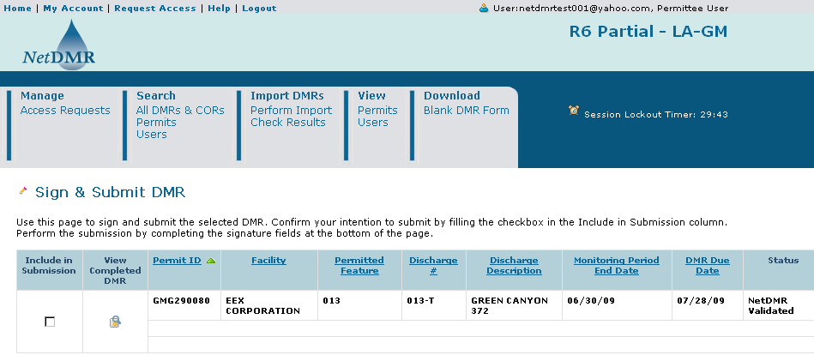
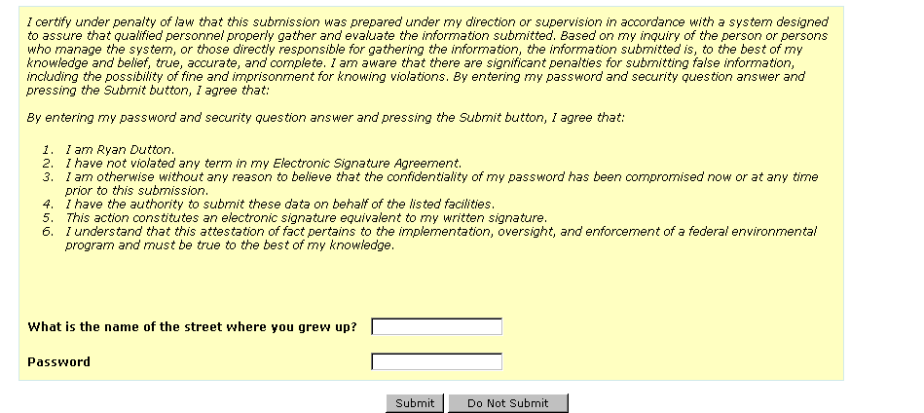
Current NPDES Electronic Reporting Tool - NetDMR
DMR Sign and Submit Page

Slide 21
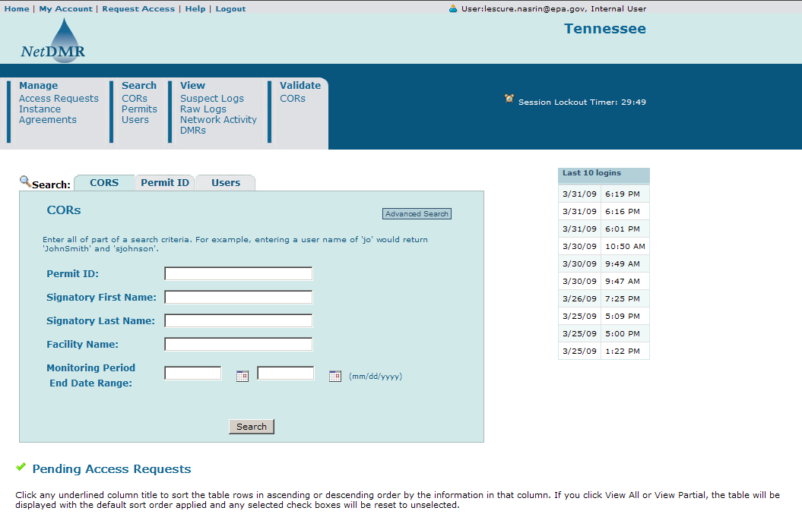
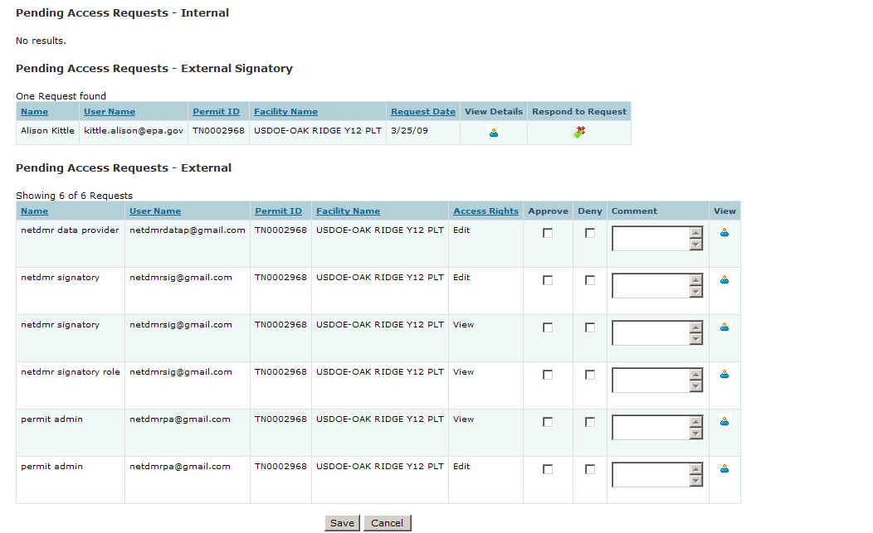
Current NPDES Electronic Reporting Tool - NetDMR
Regulatory Authority Home Page

Slide 22
Current NPDES Electronic Reporting Tool - NetDMR
Future Enhancements Needed
Simultaneous submissions to state and EPA
Daily, weekly and semi-monthly monitoring data
Customizable Subscriber Agreements
Enter DMRs for unscheduled limits

Slide 23
Presentation Outline
NPDES Electronic Reporting Rule
Future of NPDES Electronic Reporting
Current NPDES Electronic Reporting Tool
NetDMR
Proposed NPDES Electronic Reporting Tool
eNOI
Making the Future of NPDES Electronic Reporting a Reality

Slide 24
Proposed NPDES Electronic Reporting Tool - eNOI
Comprised of COTS software designed to allow the regulated community to fill out and submit NOIs online
Can be configured for groups of regulatory authority reviewers, approvers and automated approvals with email notifications at critical points
Built to handle electronic program reports as well
Populates ICIS with NPDES data
Creates a general permit covered facility permit per NOI
Creates limits for its ICIS permit where applicable
Sends NPDES data to states
Uses CDX to transfer data after permit has been created in ICIS
Cross-Media NPDES Electronic Reporting Regulation (CROMERR) compliant
Region 6 Offshore NOIs to be in place Fall 2012

Slide 25
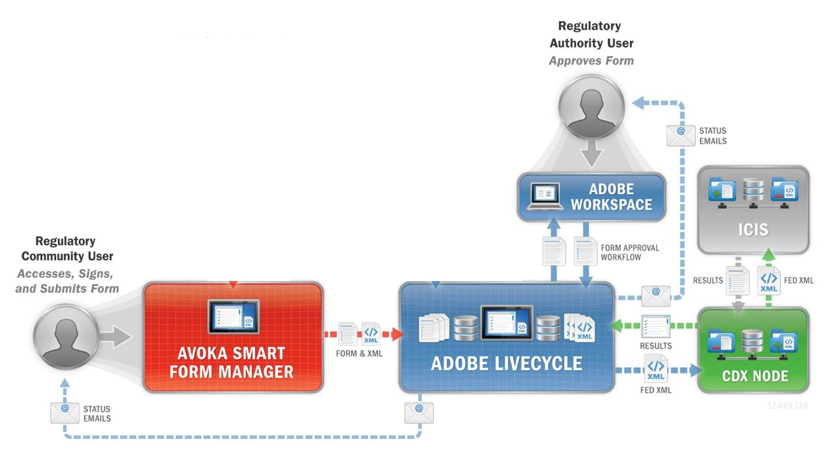
Proposed NPDES Electronic Reporting Tool - eNOI
Basic Architecture

Slide 26
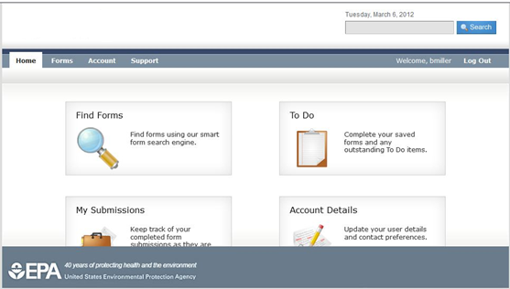
Proposed NPDES Electronic Reporting Tool - eNOI
Home Page for Regulated Community Form Submitters and Certifiers
(prototype example)

Slide 27
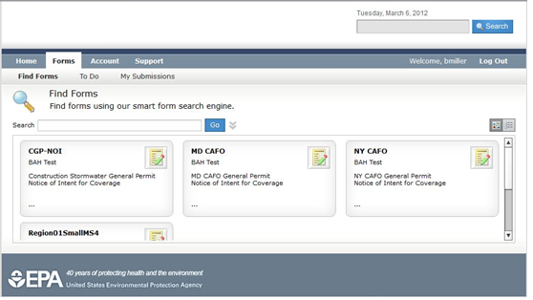
Proposed NPDES Electronic Reporting Tool - eNOI
Online Form Directory – card view
(prototype example)

Slide 28
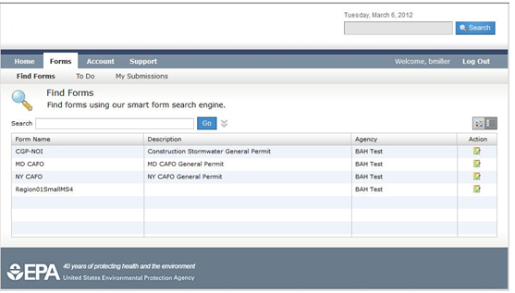
Proposed NPDES Electronic Reporting Tool - eNOI
Online Form Directory – list view
(prototype example)

Slide 29
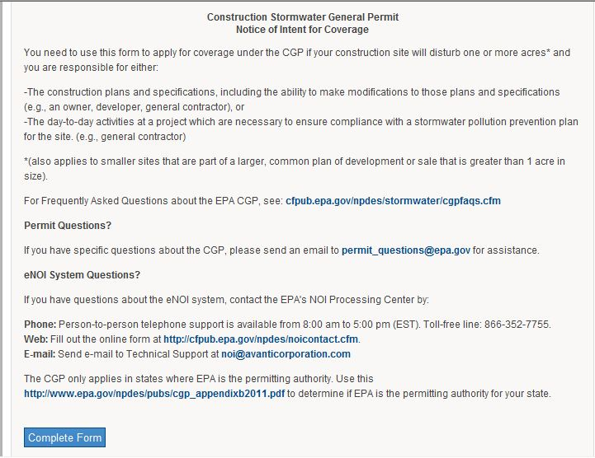
Proposed NPDES Electronic Reporting Tool - eNOI
Instructions for Completing an Online Form
(prototype example)

Slide 30
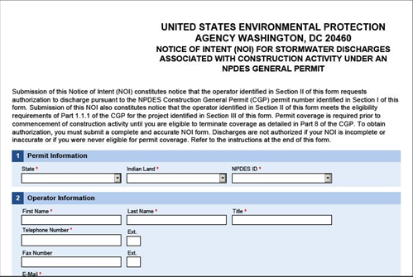
Proposed NPDES Electronic Reporting Tool - eNOI
Construction General Permit Online Form - partial example
(prototype example)

Slide 31
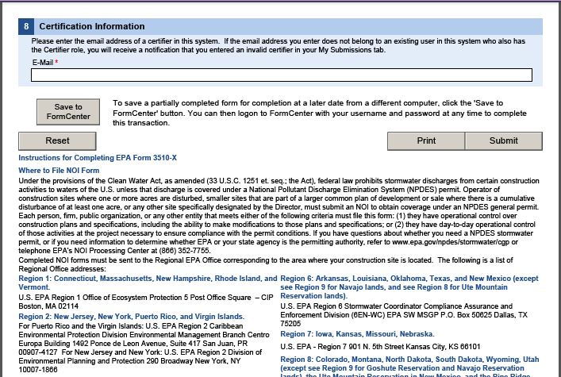
Proposed NPDES Electronic Reporting Tool - eNOI
Submission Block
(prototype example)

Slide 32
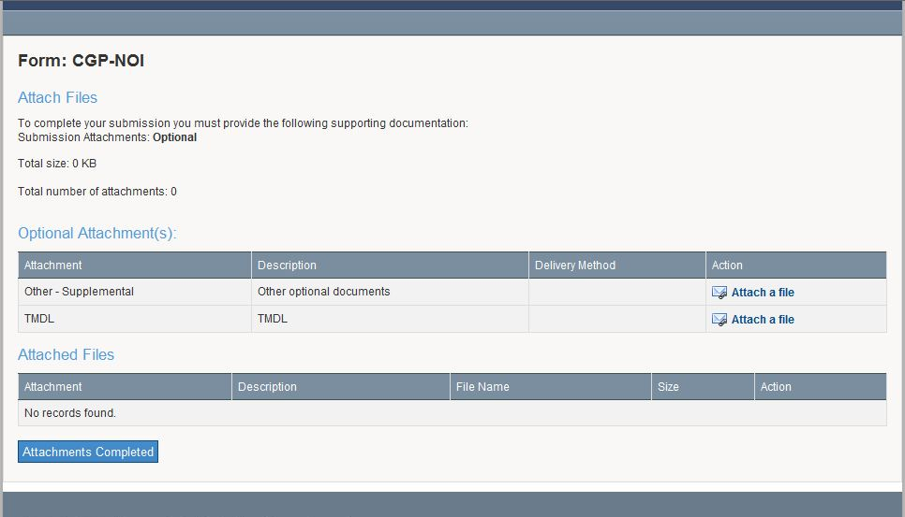
Proposed NPDES Electronic Reporting Tool - eNOI
File Attachment Block
(prototype example)

Slide 33
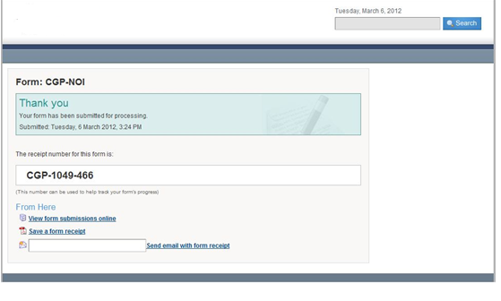
Proposed NPDES Electronic Reporting Tool - eNOI
Form Submission Receipt
(prototype example)

Slide 34
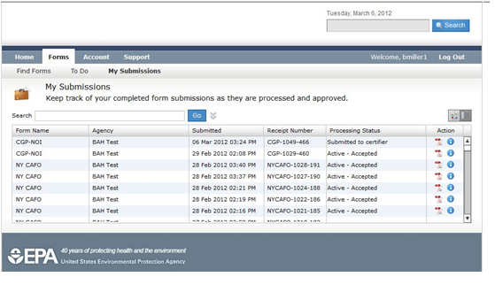
Proposed NPDES Electronic Reporting Tool - eNOI
Certifier Form Submission Status Listing
(prototype example)

Slide 35
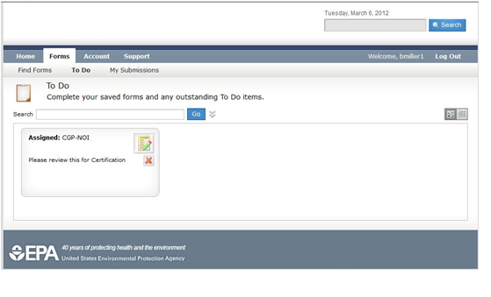
Proposed NPDES Electronic Reporting Tool - eNOI
Certifier Form Selection Directory – card view
(prototype example)

Slide 36
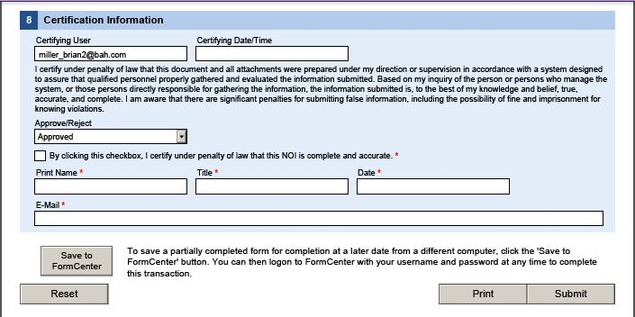
Proposed NPDES Electronic Reporting Tool - eNOI
Certifier Digital Signature Block
(prototype example)

Slide 37
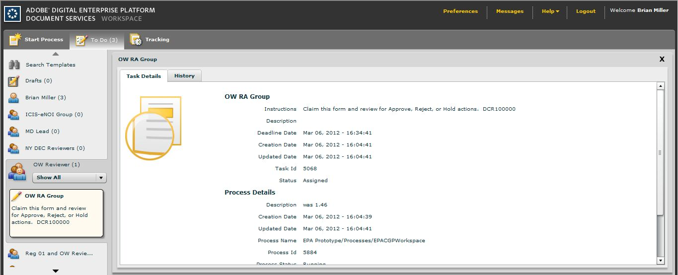
Proposed NPDES Electronic Reporting Tool - eNOI
Regulatory Authority Reviewer Group Assignments
(prototype example)

Slide 38
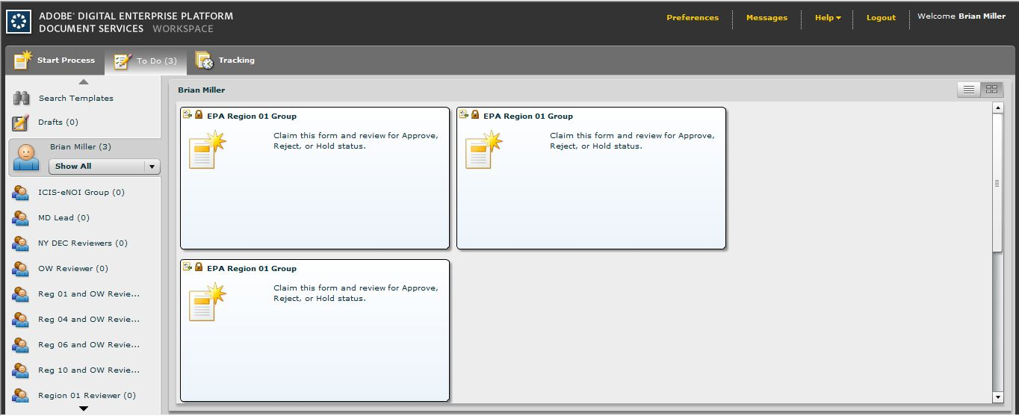
Proposed NPDES Electronic Reporting Tool - eNOI
Online Forms Awaiting Approval – card view
(prototype example)

Slide 39
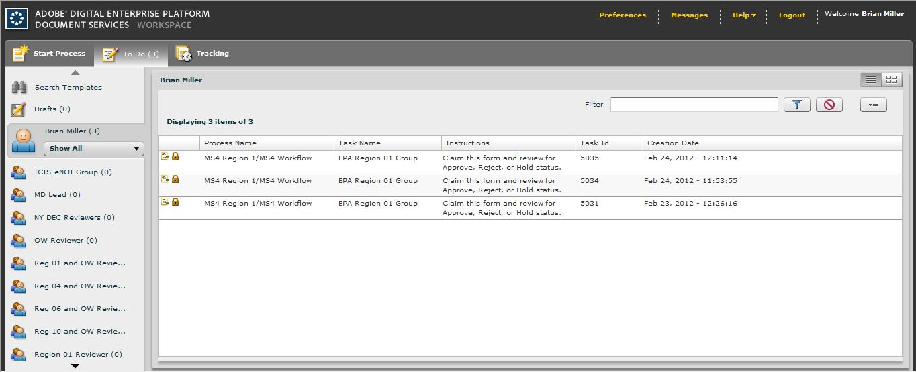
Proposed NPDES Electronic Reporting Tool - eNOI
Online Forms Awaiting Approval – list view
(prototype example)

Slide 40
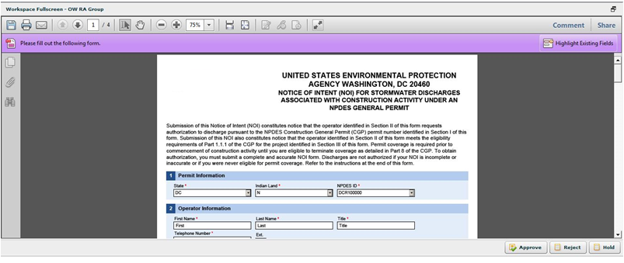
Proposed NPDES Electronic Reporting Tool - eNOI
Claim and Open Online Form to Review and Reject or Approve
(prototype example)

Slide 41
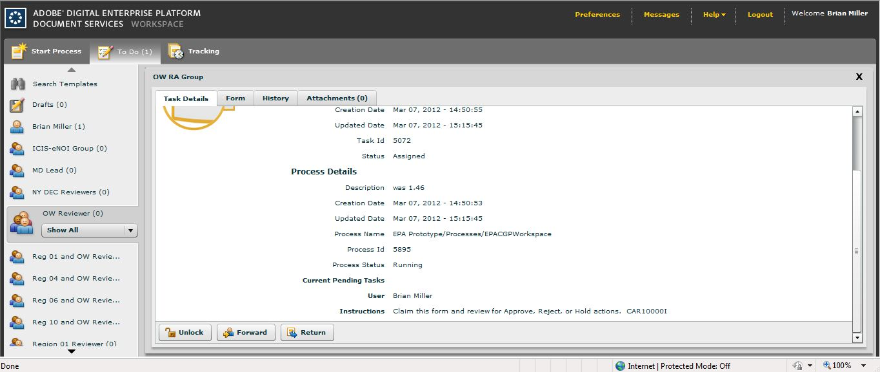
Proposed NPDES Electronic Reporting Tool - eNOI
Forward Form to Others for Review
(prototype example)

Slide 42
Presentation Outline
NPDES Electronic Reporting Rule
Future of NPDES Electronic Reporting
Current NPDES Electronic Reporting Tool
NetDMR
Proposed NPDES Electronic Reporting Tool
eNOI
Making the Future of NPDES Electronic Reporting a Reality

Slide 43
Making the Future of NPDES Electronic Reporting a Reality
OEI Exchange Network Grants:
Funding to states, territories and federally recognized Indian tribes to support the development of the Environmental Information Exchange Network related activities
The announcement of the availability of funds and soliciting of proposals and partial applications from applicants occurs through the Exchange Network Grant web page:
www.epa.gov/networkg

Slide 44
Making the Future of NPDES Electronic Reporting a Reality
Contacts
NPDES Electronic Reporting
John Dombrowski Dombrowski.John@epa.gov
NetDMR
Nasrin Lescure Lescure.Nasrin@epa.gov
eNOI
Alison Kittle Kittle.Alison@epa.gov

Slide 45
Questions
???

