Slide 1

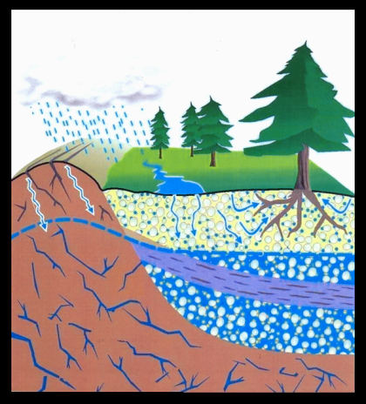

Arkansas Exchange Network for Groundwater-Quality Data and a Map-Based Web Page for Data Retrieval and Analysis
Roger Miller,
Arkansas Department of Environmental Quality
Barry Jackson,
USGS Arkansas Water Science Center

Slide 2
Outline
ADEQ Groundwater Protection Program information
Need for database upgrade/modernization
Project objectives and principal components
End uses and specific applications
Advantages

Slide 3
ADEQ Groundwater
Protection program
Principal responsibilities:
Manage Ambient Groundwater Quality monitoring program
Administer funding to other state GW Protection Programs, e.g. Wellhead Protection Program at the Arkansas Dept. of Health
Technical support -ADEQ staff, agencies and other organizations

Slide 4
ADEQ Groundwater
Protection program CONT’D.
History and Structure
Housed in Planning Branch of Water Division (non-regulatory)
Normal staff: two geologists; one supervisory/program manager
Funding: Percentage of EPA Clean Water Act Section 106 Grant

Slide 5
Ambient Groundwater Monitoring Program
Currently, 11 monitoring established areas , 1 in development
431 total sites since inception of program
Approximately 295 active sites at present
Monitoring schedule: each site sampled every 3rd year
Initial “prototype” ambient monitoring areas established during the late 1980s

Slide 6
Ambient Groundwater Monitoring Program - Continued
Types of monitoring sites:
  Domestic wells
  Public water supply wells
  Springs
  Irrigation wells
  Monitoring wells
  Research sites

Slide 7
Types of data collected
General chemistry: Major ions, trace metals, nutrients, Total Organic Carbon (TOC)
Volatile Organic Compounds (VOCs) and/or Semi-volatiles (SVOCs) where warranted
Field parameters – pH, specific conductance, temperature, dissolved oxygen (DO), and oxidation-reduction potential (ORP)
Site attributes – locational coordinates, well type (use), date drilled, well depth, casing depth, geologic unit name, water-producing zones, etc.

Slide 8
Existing Database disadvantages
Need for upgrade/modernization
Not available online
Data not aggregated into single database
Lab results are not available in single worksheet; manually compiled
Data management process is time-consuming and error prone
Older data not available electronically

Slide 9
Project origination and application process
Discussions with USGS and other agencies that maintain groundwater data
Conceptual design
Develop and finalize proposal
Establish time lines of separate goals
Develop budget for each goal and various phases
Agency review/approval process
Application, follow-up revisions and other submissions

Slide 10
Project Objectives
Goal 1 (ADEQ):
  Collect and standardize existing “legacy” data from disparate sources (ADEQ and other agencies and organizations)
  Upload legacy data to EPA STORET database
Goal 2 (ADEQ):
  Establish automatic flow of ambient groundwater data from ADEQ Laboratory Information Management System (LIMS) to STORET

Slide 11
Project Objectives - continued
Goal 3 (USGS) Develop and deploy a map-based web page to:
  Provide simultaneous online access to USGS NWIS and STORET data
  Allow depiction and selection of sites on interactive map
  Download selected data in various formats
  Provide built-in visualization of data via hydrochemical plots for analysis and comparison of analytical results

Slide 12
Uses of ambient
Groundwater Data
Assess background conditions
Support groundwater research
Support ADEQ permitting decisions
Guide Public Water Supply well siting and development
Support groundwater management decisions (protection, conservation, standards-setting)
Evaluate spatial and temporal trends

Slide 13
Project features
Digitization of “legacy” data from various sources
Consistent flow of current ambient ADEQ groundwater data to STORET
Interactive map to select data types and locations
Simultaneous access to USGS and ADEQ databases
Various export formats (WQX-XML, MS-Excel, CSV/tab delimited)
Visualization techniques for analysis and comparison

Slide 14
Advantages of improved process
For ADEQ:
Groundwater data no longer distributed in separate tables
Built in error traps
Frequent uploads to STORET
Time savings
For users:
Comprehensive database
Web accessible
Map display/selection
Integral graphical depictions for analysis and comparison

Slide 15
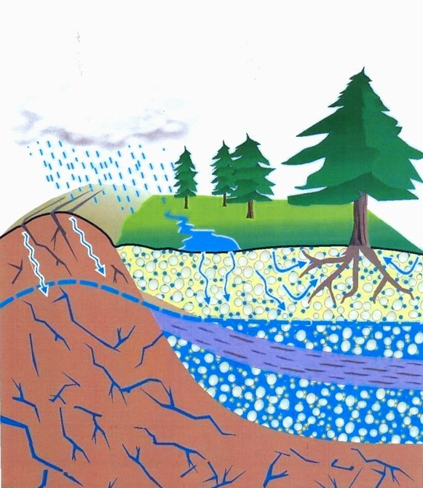

Slide 16
Overview
What currently exists for data retrieval
  In NWIS
  And in STORET
What this project was tasked with doing
Functionality

Slide 17
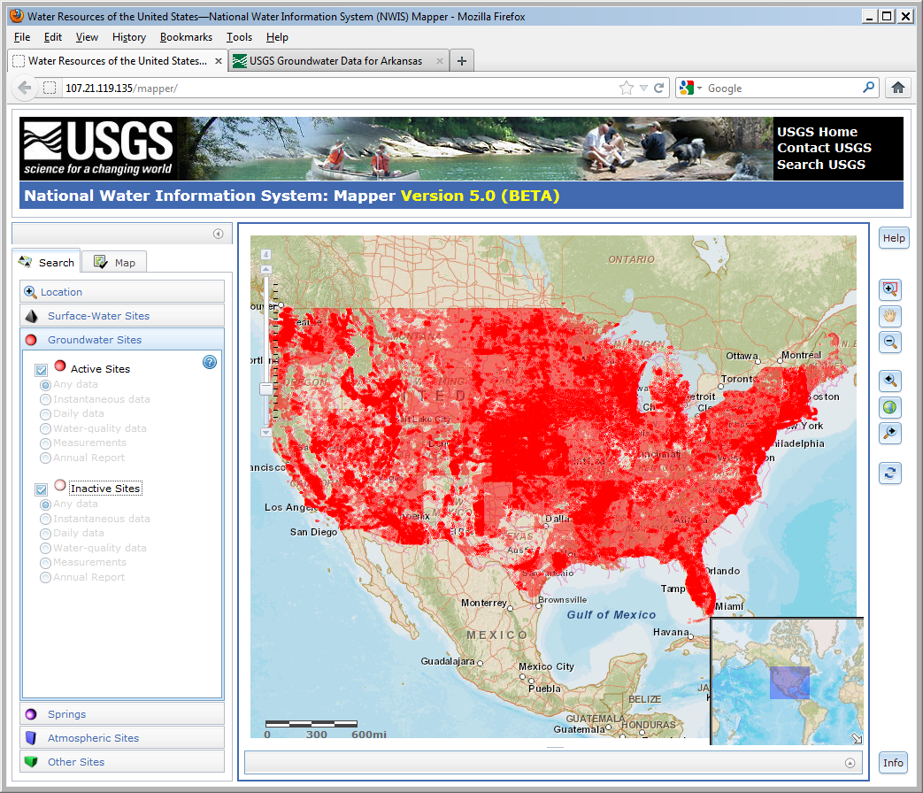
Groundwater Measurements (NWISWEB)
The NWISWEB groundwater database consists of more than 850,000 records of wells, springs, test holes, tunnels, drains, and excavations in the United States.

Slide 18
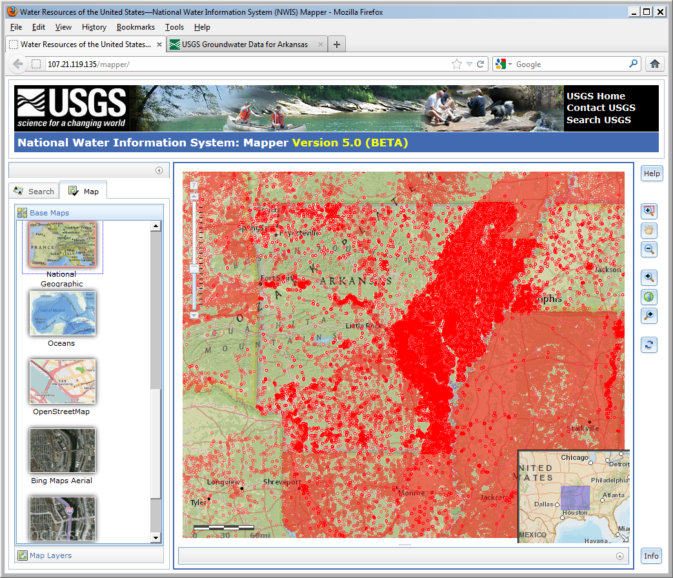
Groundwater Measurements
The Groundwater database consists of more than 10,000 records of wells, springs, test holes, tunnels, drains, and excavations in ARKANSAS.

Slide 19
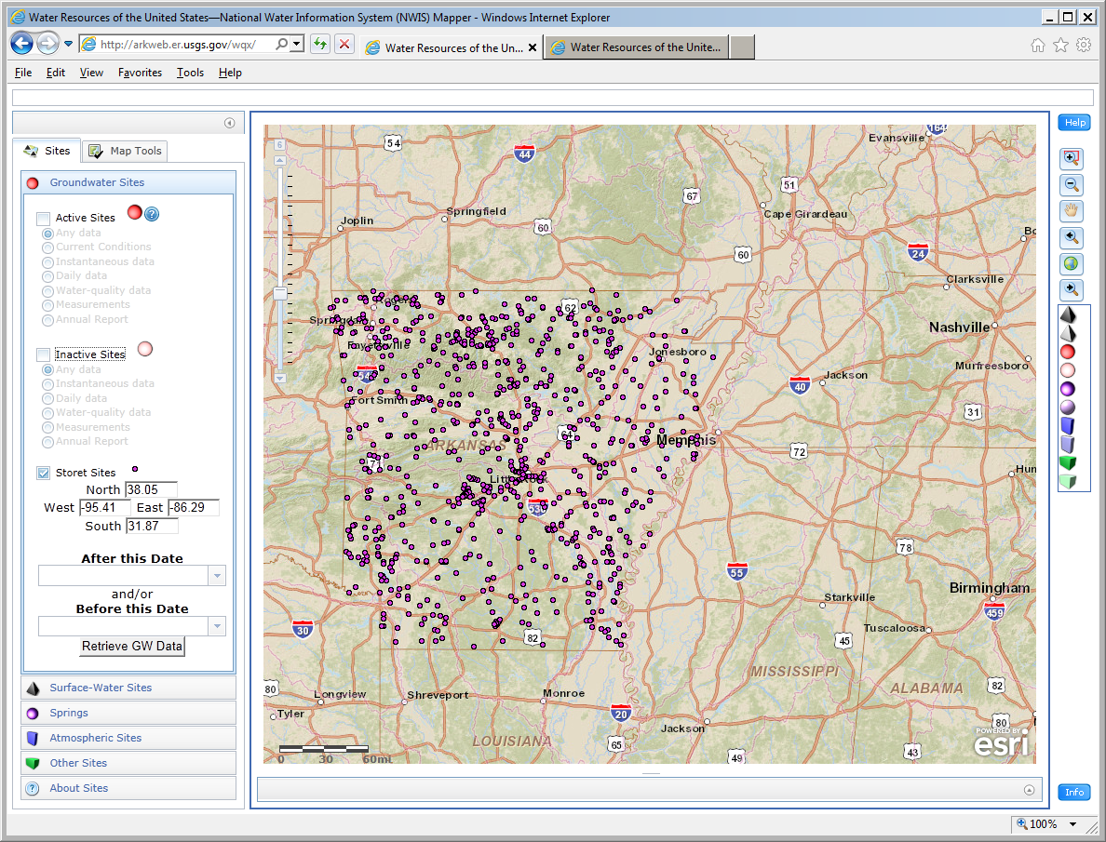
Storet Layers
Imported as KML
STORET Surface Water Layers for testing
STORET Data Sources
Arkansas Dept. of Environmental Quality
National Park Service
Arkansas Department Health
Arkansas Geological Survey

Slide 20
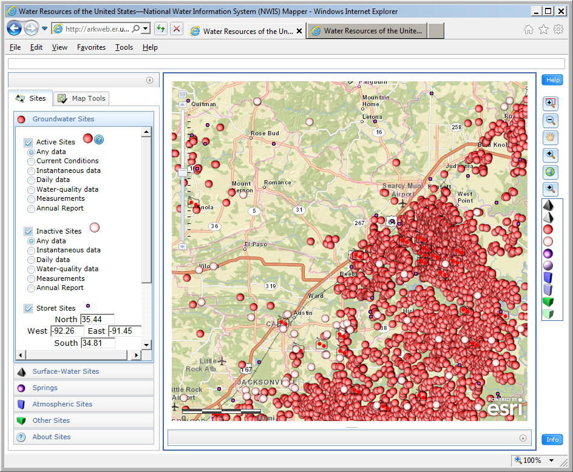
Mapping Interface
Usual GIS functions on right hand column

Slide 21
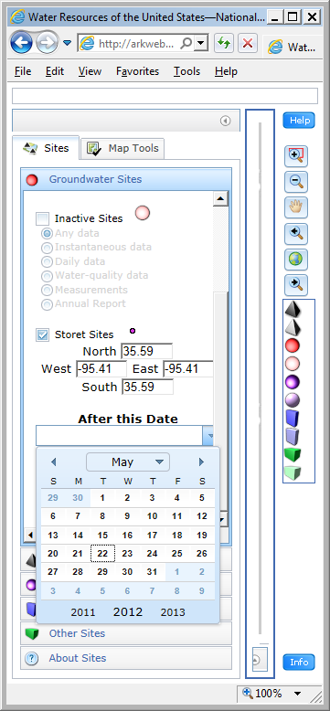
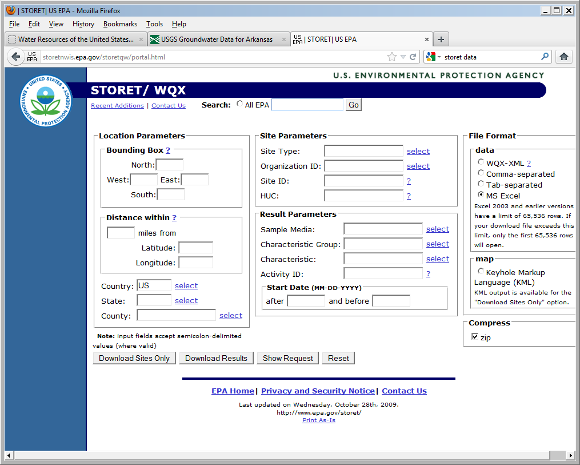
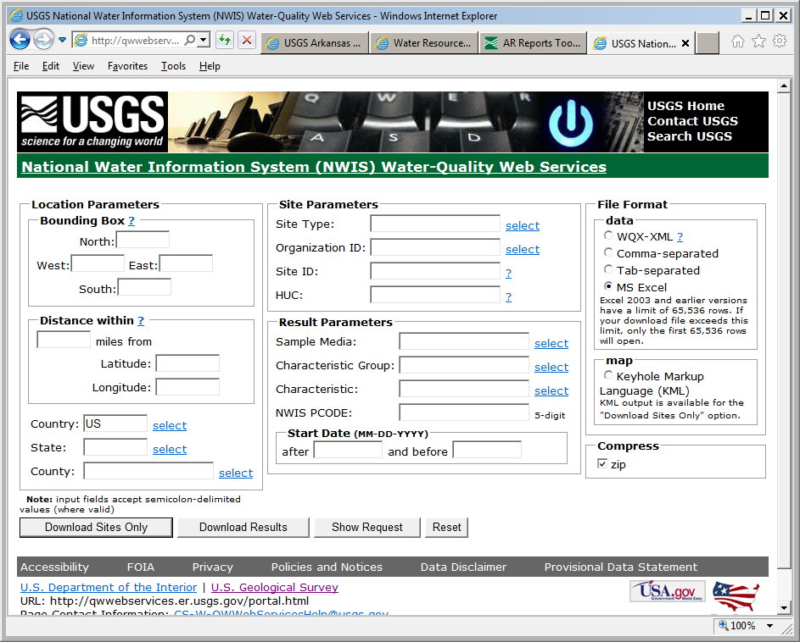
STORET / NWIS

Slide 22
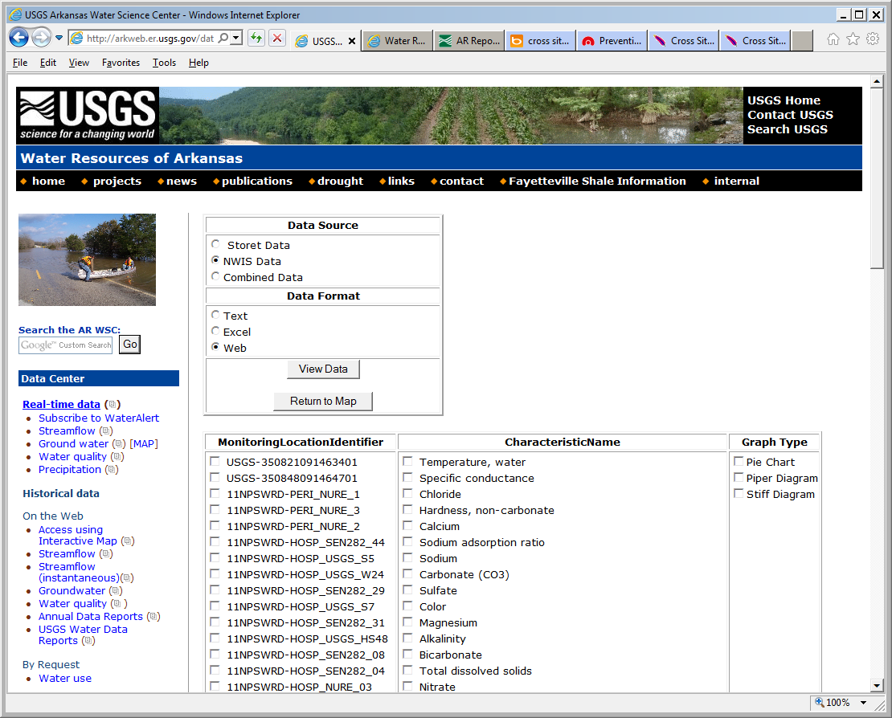

Slide 23
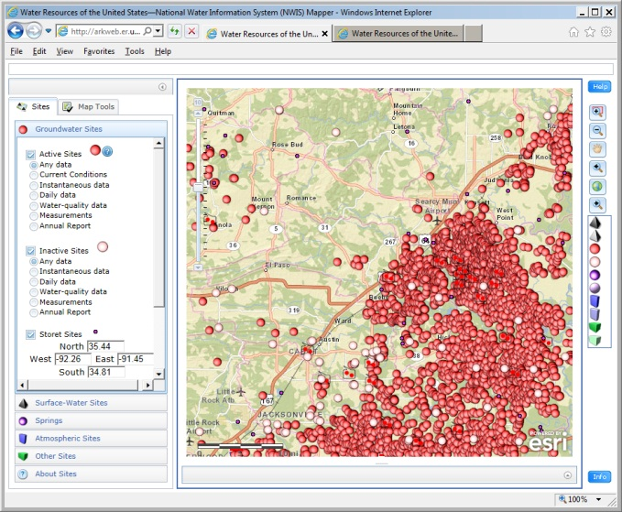
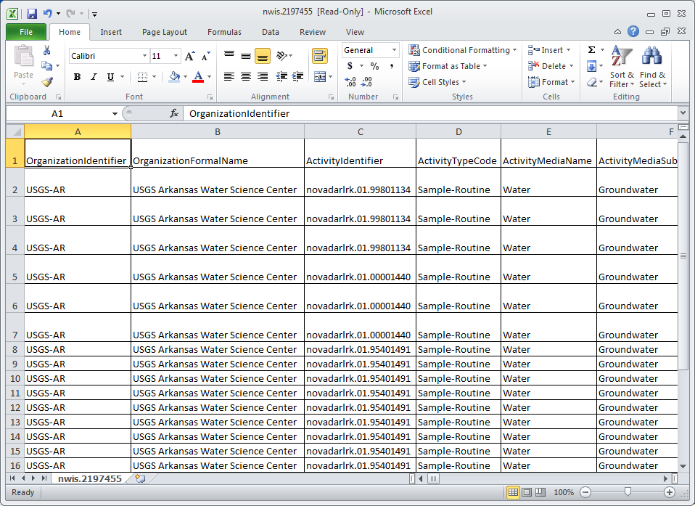
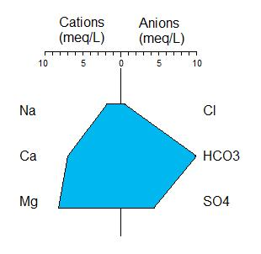
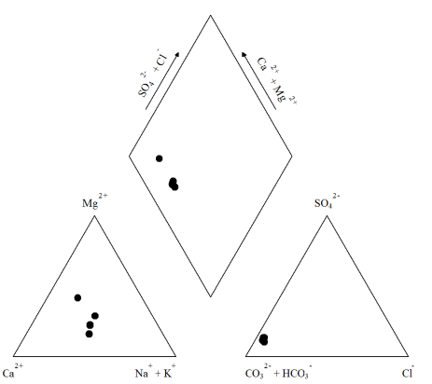
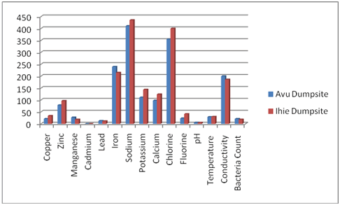

Slide 24
QUESTions / comments
Roger Miller, P.G.
Arkansas Department of Environmental Quality
Barry Jackson,
USGS Arkansas Water Science Center

