Slide 1
Electronic Reporting: ICIS Data Publishing
Presented by:
Alison Kittle, U.S. EPA
Elisa Willard, Colorado Department of Public Health & Environment
Roy Chaudet, U.S. EPA
U.S. Environmental Protection Agency

Slide 2
Presentation Outline
ICIS Data Publishing Overview
Data Access IPT
ICIS Data Publishing Activities
Exchange Network Data Publishing Tools
Exchange Network Services Center
Exchange Network Browser

Slide 3
Presentation Outline
ICIS Data Publishing Overview
Data Access IPT
ICIS Data Publishing Activities
Exchange Network Data Publishing Tools
Exchange Network Services Center
Exchange Network Browser

Slide 4
ICIS Data Publishing Overview
Arose from need for publishing all data fields in ICIS
Any node can request and receive ICIS data in XML format
Uses Query web services developed by CDX for Node 2.0
XML Schema development includes creation of basic NPDES shared schema components

Slide 5
ICIS Data Publishing Overview

Slide 6
Presentation Outline
ICIS Data Publishing Overview
Data Access IPT
ICIS Data Publishing Activities
Exchange Network Data Publishing Tools
Exchange Network Services Center
Exchange Network Browser

Slide 7
ICIS Data Access IPT
Comprised of 16 states, 4 EPA Regions, OECA, OEI and CDX Contractor Staff
Chaired by Elisa Willard of Colorado DPHE and Alison Kittle of U.S. EPA
Kicked off on August 25, 2011
Call held every 4 weeks on a Thursday
Oversees development of web services and XML schema
Members perform pilot testing of web services

Slide 8
ICIS Data Access IPT Conference Call Schedule
June 28 – Report Data Family
July 26 – Enforcement Action & Compliance Schedule Data Families
August 23 – Violation Data Families
September 20 – CDX Tool Demo
October 18 – User Validation Testing
November – Schema Package Review

Slide 9
Presentation Outline
ICIS Data Publishing Overview
Data Access IPT
ICIS Data Publishing Activities
Exchange Network Data Publishing Tools
Exchange Network Services Center
Exchange Network Browser

Slide 10
ICIS Data Publishing Activities
Publishing of ICIS Reference Codes and ICIS Data Families
Seven reference tables published February 20, 2012
Parameters – “GetICISParameters”
Units – “GetICISUnits”
Unit conversions – “GetICISUnitConversions”
Unit groups – “GetICISUnitGroups”
Parameter unit cross references – “GetICISUnitGroupCrossReferences”
Affiliation types – “GetICISAffiliationModuleCrossReferences”
Pollutants – “GetICISPollutants”
Other reference table codes will be addressed in the future

Slide 11
ICIS Data Publishing Activities
Example of an ICIS Unit Reference Code Results XML:
<ICISUnitCodes xmlns="http://www.exchangenetwork.net/schema/icisda/0" xmlns:xsi="http://www.w3.org/2001/XMLSchema-instance" xsi:schemaLocation="http://www.exchangenetwork.net/schema/icisda/0">
<Unit>
<UnitCode>12</UnitCode>
<UnitDescription>Gallons per Day</UnitDescription>
<UnitShortDescription>GPD</UnitShortDescription>
<NumerousToCountFlag>T</NumerousToCountFlag>
<StatusFlag>A</StatusFlag>
<UpdatedDate>2011-09-15</UpdatedDate>
</Unit>
</ICISUnitCodes>

Slide 12
ICIS Data Publishing Activities
ICIS Data families proposed to be available January, 2013:
Facility Interest
NPDES Permit, Components, Tracking Event, Narrative Condition & Permit Schedule
Permitted Feature, Limit Set, Limit
Discharge Monitoring Reports
Compliance Monitoring, Program Reports
Enforcement Action, Compliance Schedule
Single Event, Schedule and DMR Violations
Subsets of data to be published at a date to be determined yet

Slide 13
ICIS Data Publishing Activities
Example of an ICIS Permit Tracking Event XML:
<ICISUnitCodes xmlns="http://www.exchangenetwork.net/schema/icisda/0" xmlns:xsi="http://www.w3.org/2001/XMLSchema-instance" xsi:schemaLocation="http://www.exchangenetwork.net/schema/icisda/0">
<PermitTrackingEvent>
<PermitIdentifier>AA1234567</PermitIdentifier>
<PermitTrackingEventCode>PEX</PermitTrackingEventCode>
<PermitTrackingEventDate>2005-12-31</PermitTrackingEventDate>
<PermitTrackingEventCommentsText>String</PermitTrackingEventCommentsText>
</PermitTrackingEvent>
</ICISUnitCodes>

Slide 14
Presentation Outline
ICIS Data Publishing Overview
Data Access IPT
ICIS Data Publishing Activities
Exchange Network Data Publishing Tools
Exchange Network Services Center
Exchange Network Browser

Slide 15
Exchange Network Data Publishing Tools
CDX Services Center
Developed by CDX
Three methods for the exchange of environmental information between state, tribal and Federal staff:
Submit: Submit documents or information to another system on the Exchange Network
Get Info: Retrieve information from another system on the Exchange Network immediately via query services, or downloaded via solicit services
Download: Download a document from another system on the Exchange Network with a transaction or document ID
URL = https://enservicestest.epacdxnode.net

Slide 16
Exchange Network Data Publishing Tools
Demonstration by Roy Chaudet, U.S. EPA
Exchange Network Services Center

Slide 17
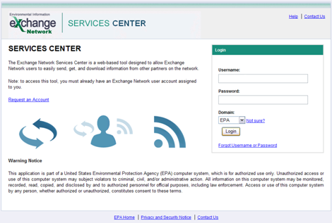
Exchange Network Data Publishing Tools
Exchange Network Services Center – Logon Page

Slide 18
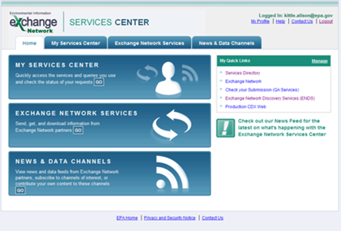
Exchange Network Data Publishing Tools
Exchange Network Services Center – Home Page

Slide 19
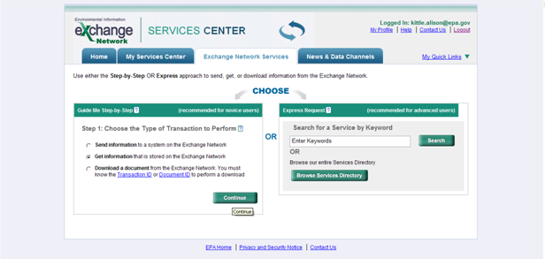
Exchange Network Data Publishing Tools
Exchange Network Services Center – Exchange Network Services Page

Slide 20
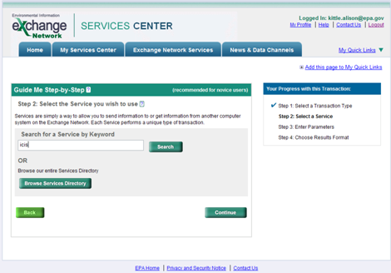
Exchange Network Data Publishing Tools
Exchange Network Services Center – Browse Services Search Page

Slide 21
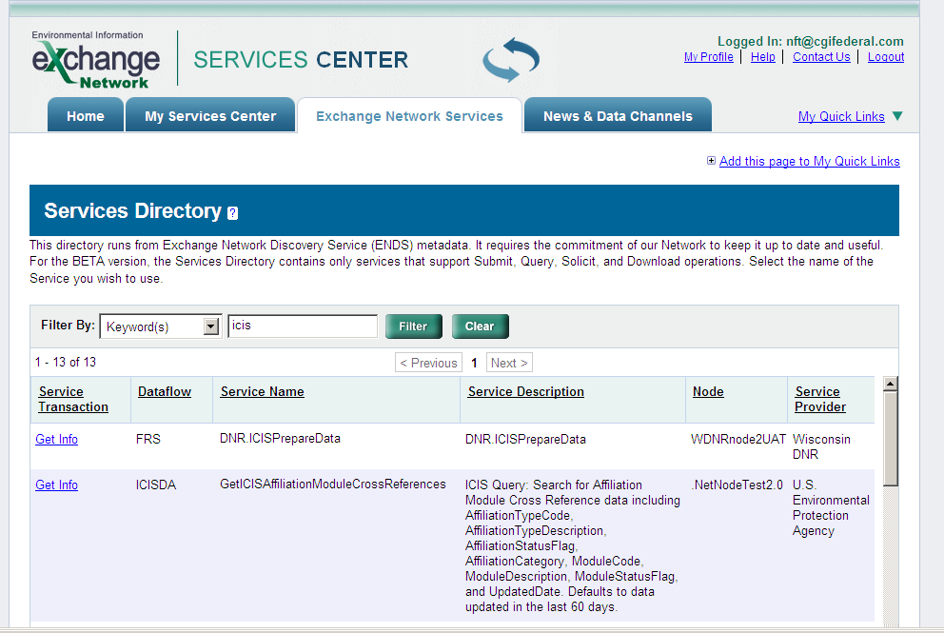
Exchange Network Data Publishing Tools
Exchange Network Services Center – Services Directory Selection Page

Slide 22
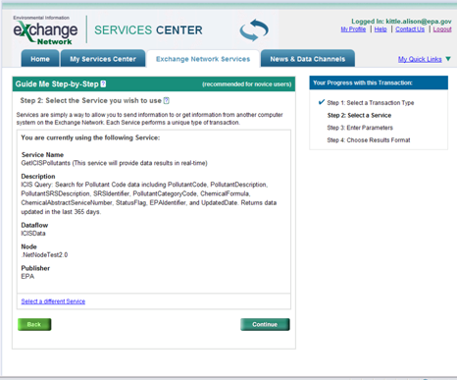
Exchange Network Data Publishing Tools
Exchange Network Services Center – Service Selection Page

Slide 23
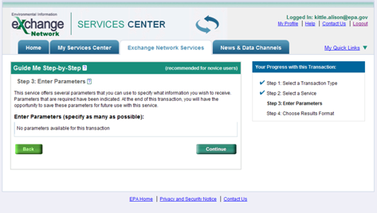
Exchange Network Data Publishing Tools
Exchange Network Services Center – Parameter Entry Page

Slide 24
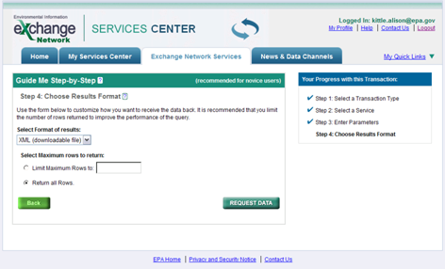
Exchange Network Data Publishing Tools
Exchange Network Services Center – Results Format Selection Page

Slide 25
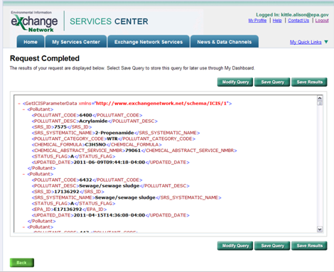
Exchange Network Data Publishing Tools
Exchange Network Services Center – XML Results Page

Slide 26
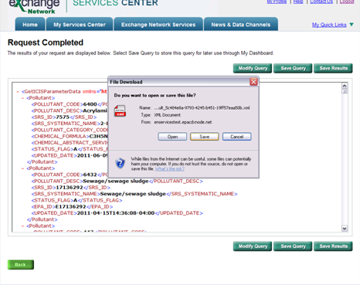
Exchange Network Data Publishing Tools
Exchange Network Services Center – Save Results Page

Slide 27
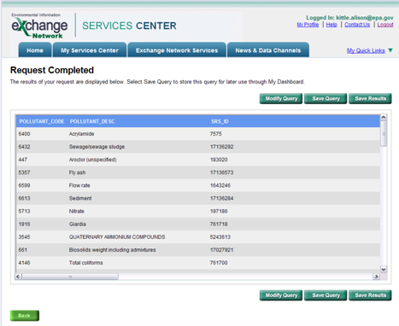
Exchange Network Data Publishing Tools
Exchange Network Services Center – HTML Results Page

Slide 28
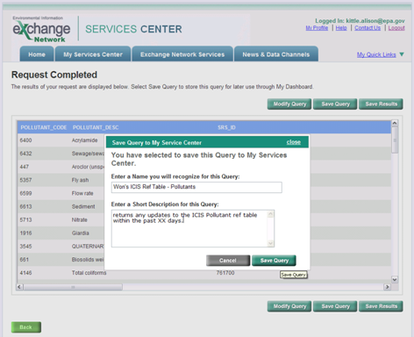
Exchange Network Data Publishing Tools
Exchange Network Services Center – Save Query Page

Slide 29
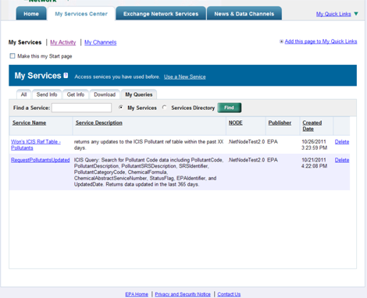
Exchange Network Data Publishing Tools
Exchange Network Services Center – My Services Page

Slide 30
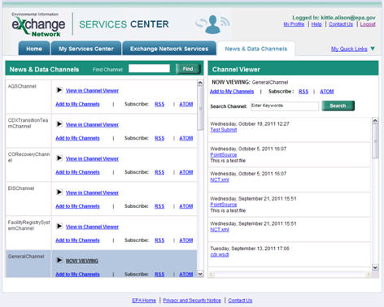
Exchange Network Data Publishing Tools
Exchange Network Services Center – News and Data Channels Page

Slide 31
Exchange Network Data Publishing Tools
Exchange Network Browser
Developed for New Jersey DEP, Michigan DEQ, New Hampshire DES, and Oregon DEQ under an Exchange Network Grant
Allows registered users to view and retrieve data published from different state, tribal and Federal Exchange Network Nodes
URL = http://www.enbrowser.net

Slide 32
Exchange Network Data Publishing Tools
Demonstration by Elisa Willard, Colorado DPHE
Exchange Network Browser

Slide 33
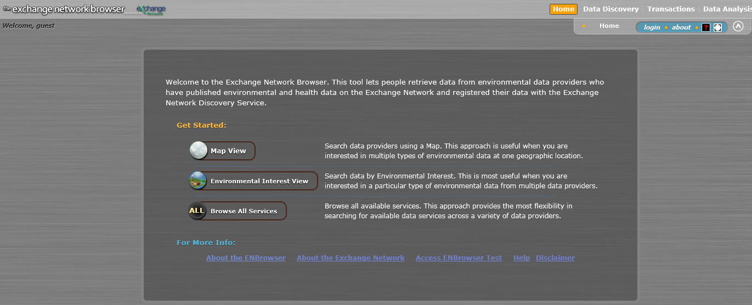
Exchange Network Data Publishing Tools
Exchange Network Browser – Home Page

Slide 34
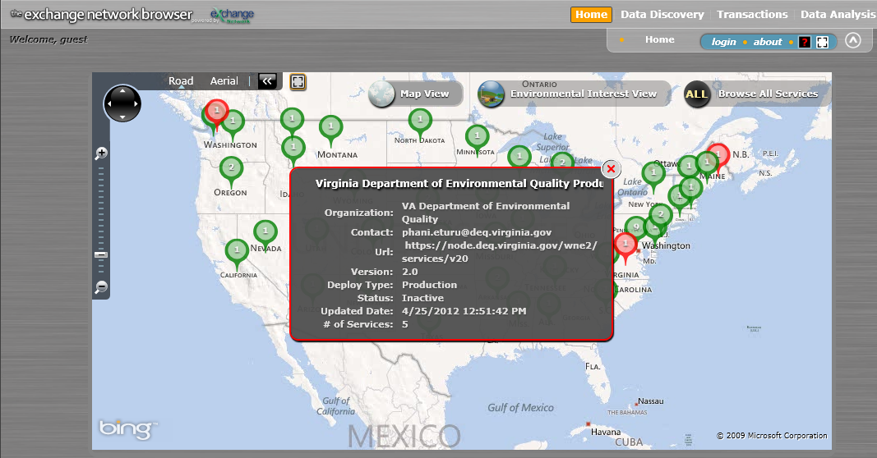
Exchange Network Data Publishing Tools
Exchange Network Browser – Map View

Slide 35
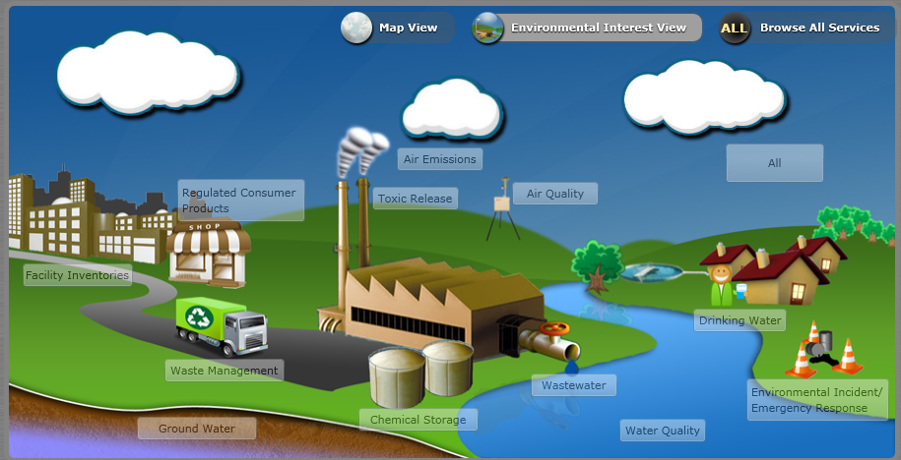
Exchange Network Data Publishing Tools
Exchange Network Browser – Environmental Interest View

Slide 36
Exchange Network Data Publishing Tools
Exchange Network Browser – All Services View

Slide 37
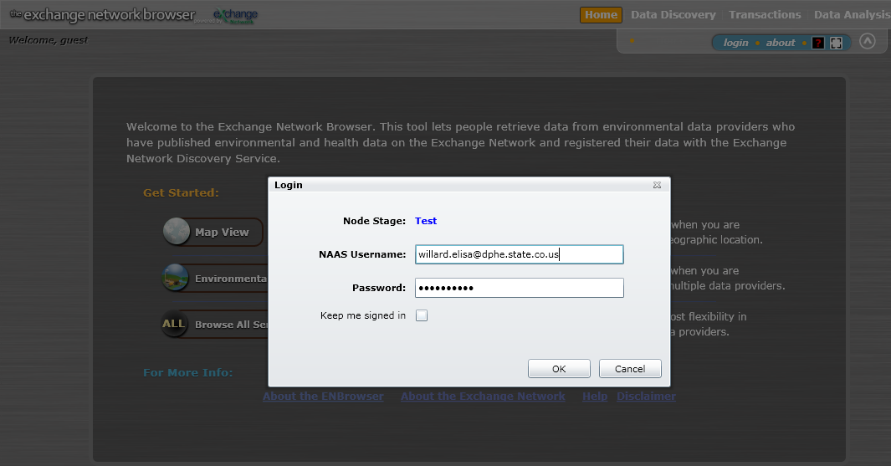
Exchange Network Data Publishing Tools
Exchange Network Browser – Login Page

Slide 38
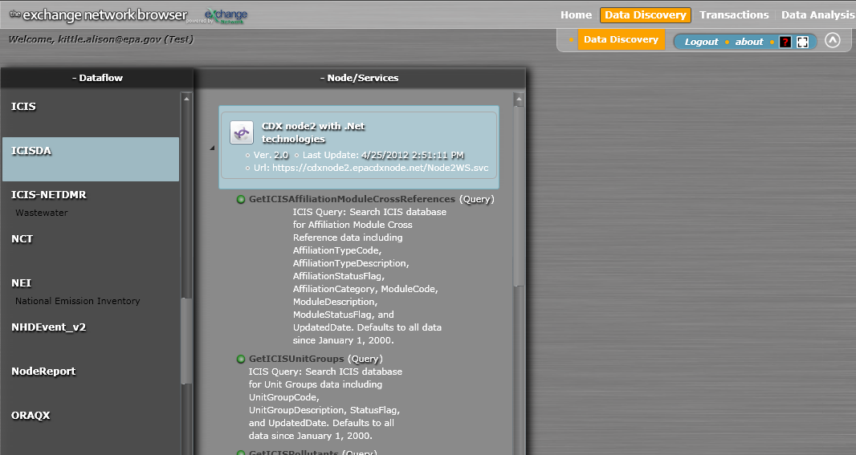
Exchange Network Data Publishing Tools
Exchange Network Browser – ICIS Data Access Flow Page

Slide 39
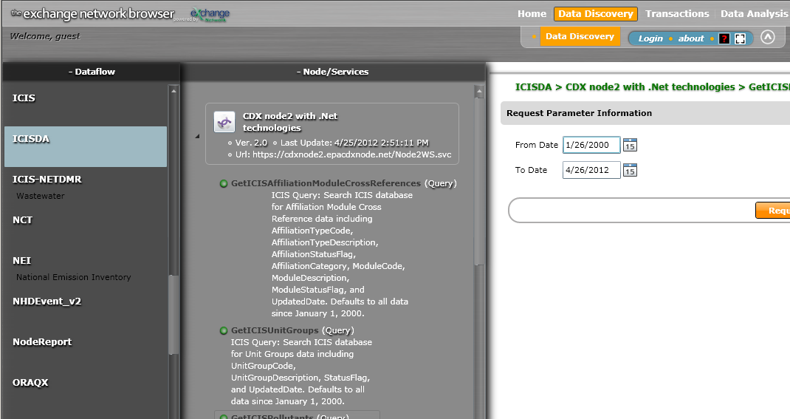
Exchange Network Data Publishing Tools
Exchange Network Browser – ICIS Data Access Pollutant Request Page

Slide 40
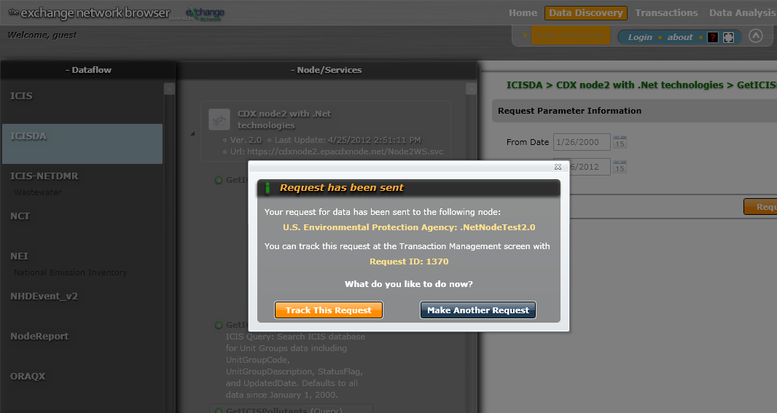
Exchange Network Data Publishing Tools
Exchange Network Browser – ICIS Data Access Request Notification Page

Slide 41
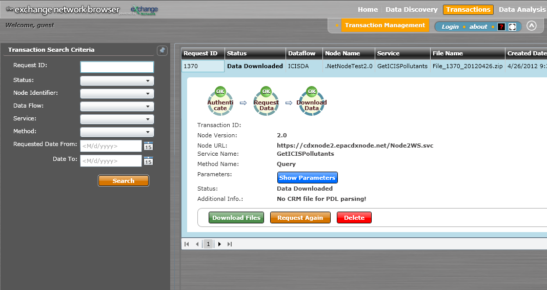
Exchange Network Data Publishing Tools
Exchange Network Browser – ICIS Data Access Request Results Page

Slide 42
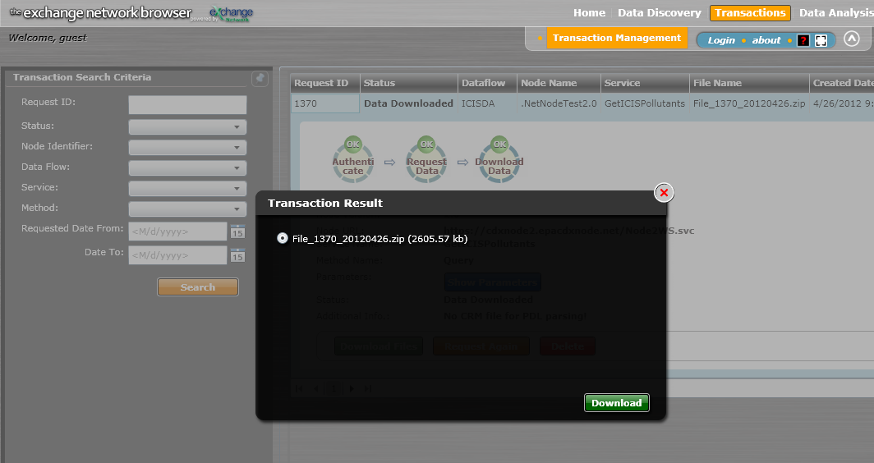
Exchange Network Data Publishing Tools
Exchange Network Browser – ICIS Data Access Download Page

Slide 43
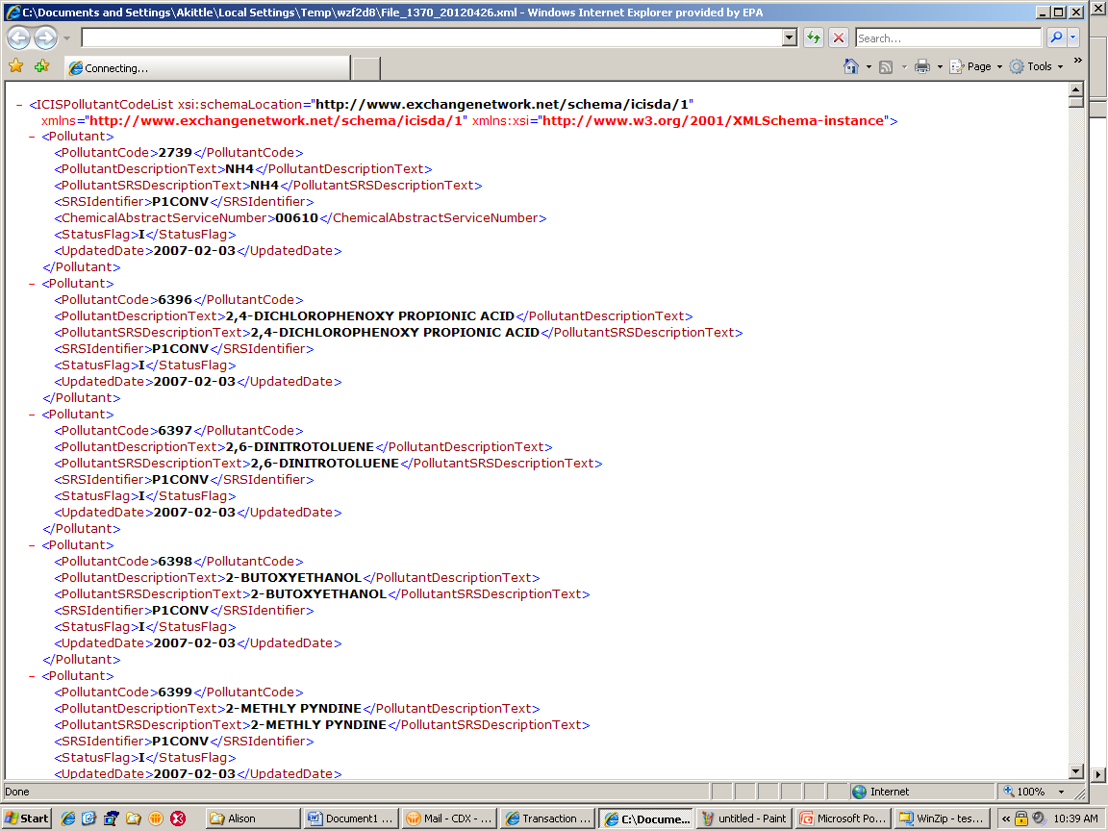
Exchange Network Data Publishing Tools
Exchange Network Browser – ICIS Data Access XML Results File

Slide 44
ICIS Data Publishing Contacts
Contacts
ICIS Data Access IPT
Elisa Willard Elisa.Willard@dphe.state.co.us
Alison Kittle Kittle.Alison@epa.gov
Exchange Network Services Center
Roy Chaudet Chaudet.Roy@epa.gov
Exchange Network Browser
Mike Matsko Mike.Matsko@dep.state.nj.us

Slide 45
Questions
???

