Slide 1
Task Scheduling with the EN-Node
State of Delaware Department of Natural Resources and Environmental Control

Slide 2
Background
State of Delaware already had this functionality for Node 1.1
EN-Node met all of our needs for Node 2.0 with the exception of scheduling submissions
Contracted with EnfoTech to create the Task Scheduling Module

Slide 3
Workflow
Schedule
Checks for new xml files
Configurable Intervals
Submit
Creates zip file
Submits files to dataflow endpoints
Status
Checks status of submissions
Sends emails based on status outcome
Custom application to query data
Application generates xml file
EN-Node

Slide 4
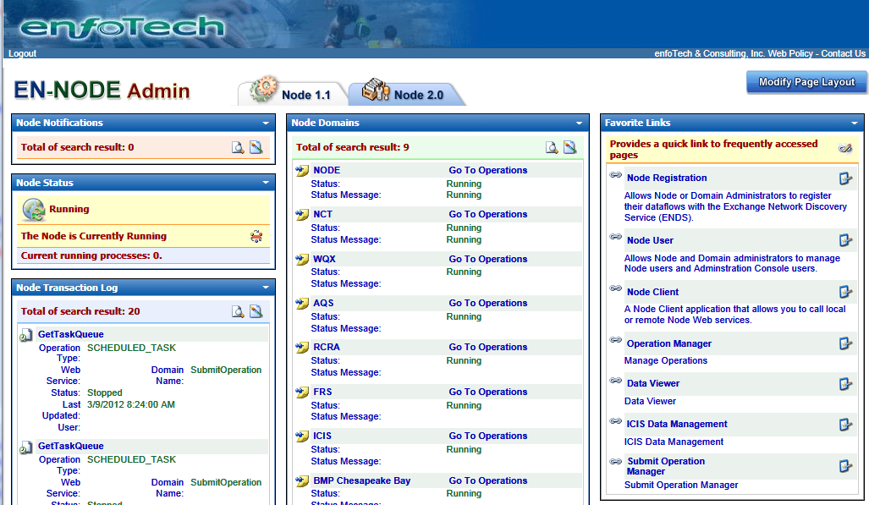
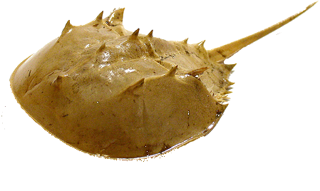
Task Scheduler Module

Slide 5
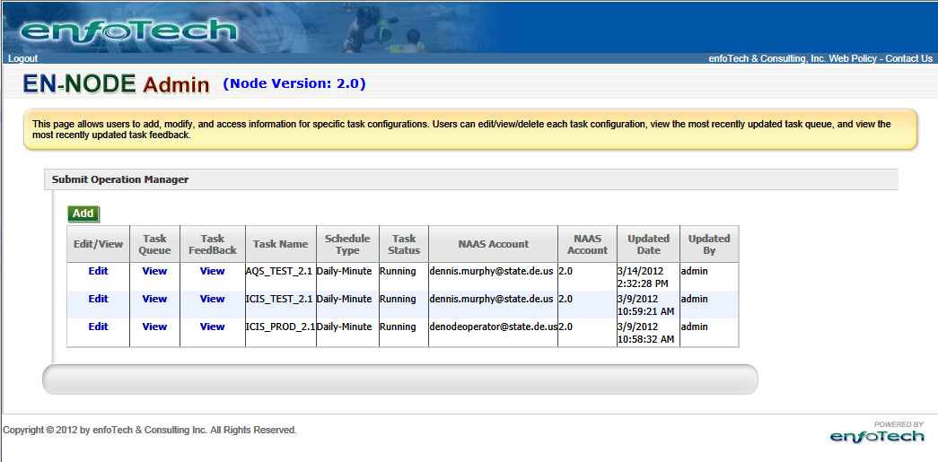
Submit Operation Manager
Create new tasks
New Endpoints
View Task Queue
Files waiting to be submitted
Submission Status
Original Files
View Task Feedback
Submission Status
Process Reports
Original Files
Edit task details
Endpoint
Schedule
Emails

Slide 6
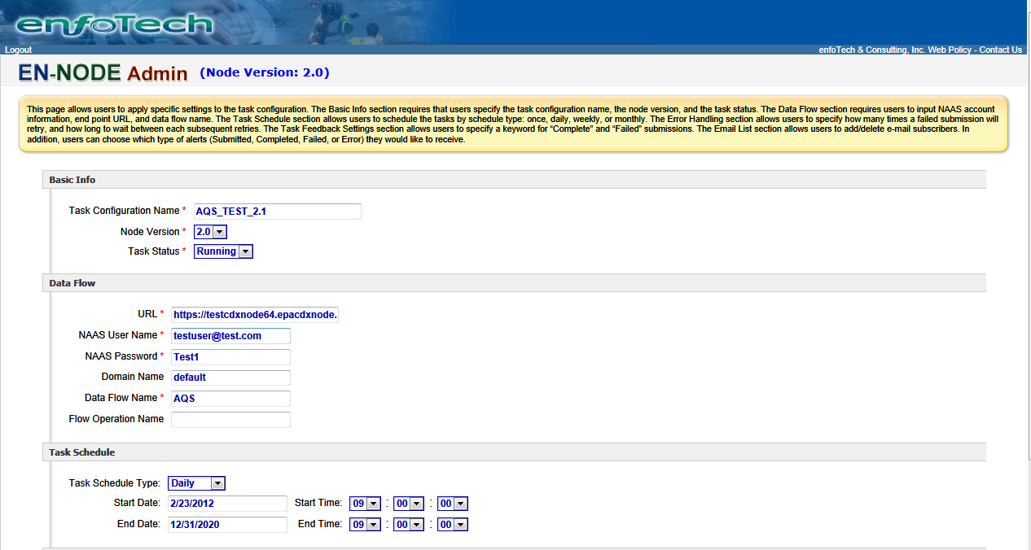
Task Details (1 of 2)
Basic Info
Task name
Node Version
Task Status
Data Flow
Endpoint
NAAS Account
Data Flow Name
Task Schedule
Schedule Type (Daily, Weekly, Monthly, etc.)
Start and Optional End Date/Times

Slide 7
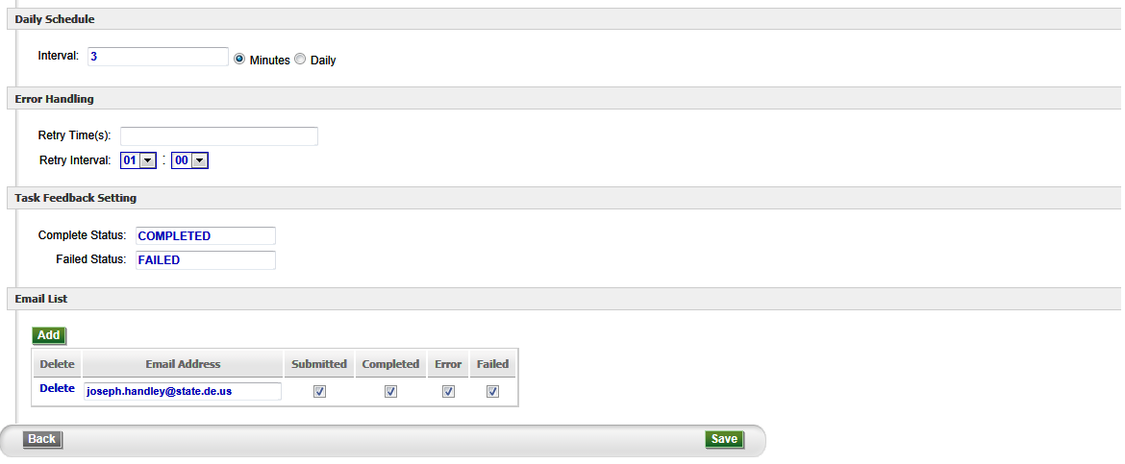
Task Details (2 of 2)
Schedule Type Details
Changes Based on Schedule Type
Daily: Set interval
Weekly: Day(s) of week, week intervals
Monthly: Certain day of the month,
Error Handling
Allow submission retries
Set Number of times to retry
Set retry intervals
Task Feedback
Set Status Messages to Task events
Email List
Multiple email addresses allowed
Can assign each email address to four different status events

Slide 8
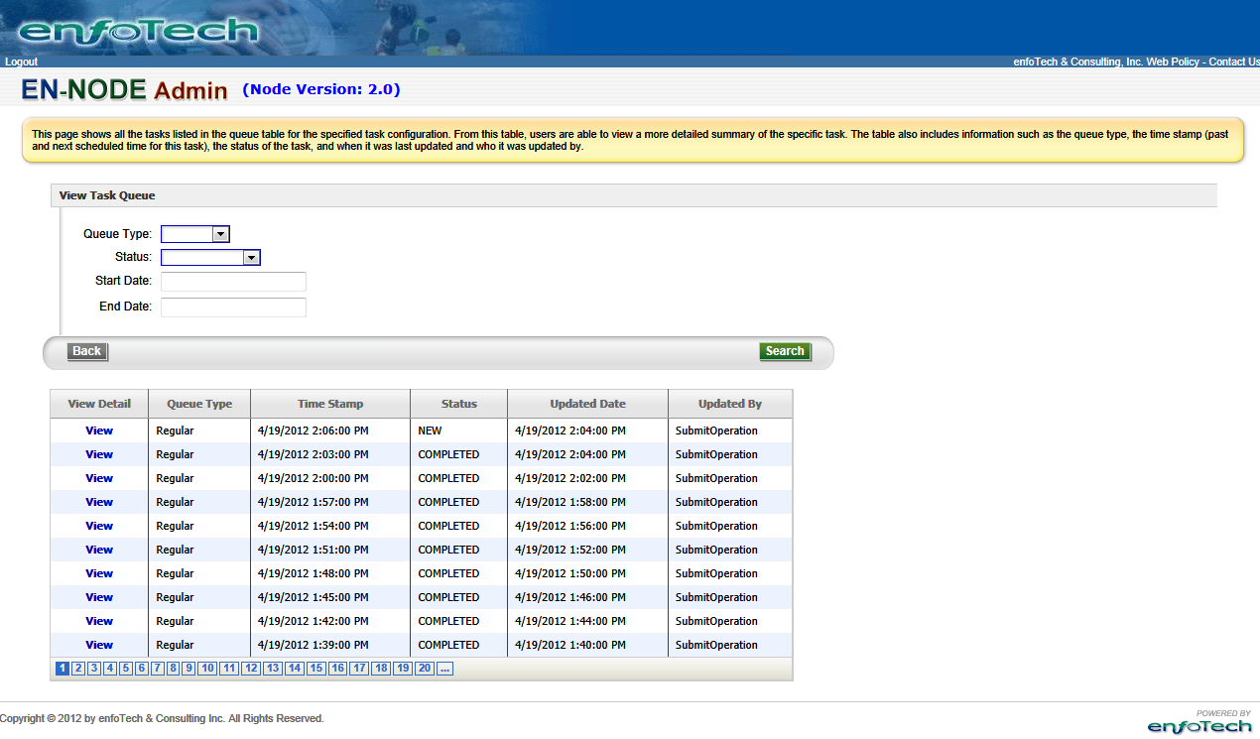
Task Queue
View Task Queue
Search for specific tasks based on criteria
Task Queue
Shows list of tasks
Last updated date
Status

Slide 9
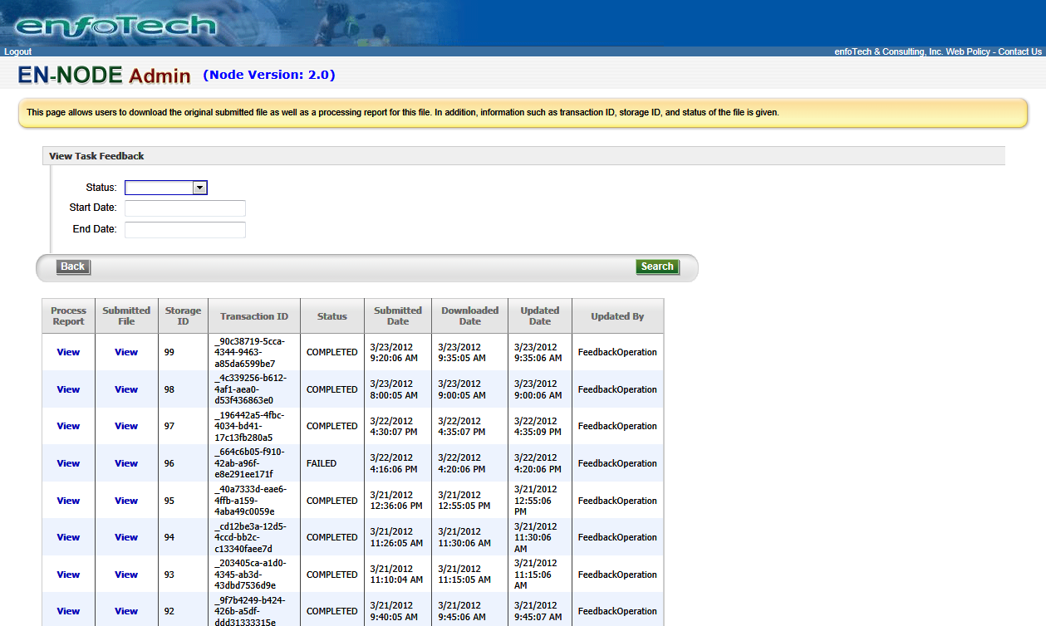
Task Feedback
View Task Feedback
Search for specific tasks based on criteria
Task Feedback
Shows list of tasks
Task Status
Process Reports
Original File
Transaction ID

Slide 10
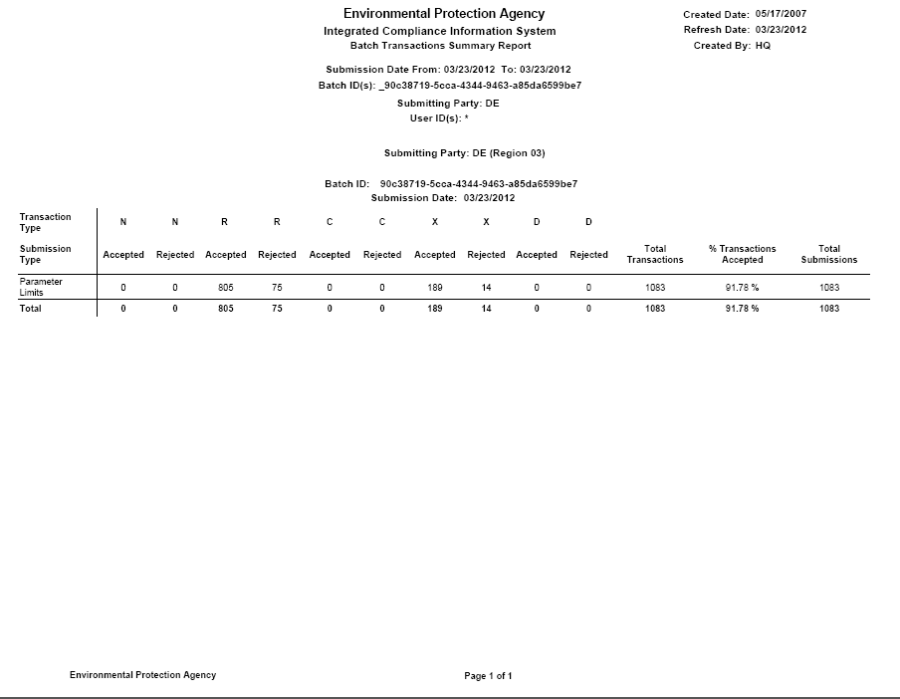
Process Report

