Slide 1
2012 Exchange Network Conference
Breakout #12 – The World of Geo
Lee Kyle 202-564-4622 Kyle.Lee@epa.gov
David Smith 202-566-0797 Smith.DavidG@epa.gov
Harvey Simon 202-566-0917 Simon.Harvey@epa.gov
David Parrish 214-665-8352 Parrish.David@epa.gov

Slide 2
Agenda
We’ve tried to anticipate your questions:
What does it mean to Geo-enable the Exchange Network? When should I use the network to publish Geo data?
Which data should I publish in Geo formats, and how can I begin? How does EPA catalog its datasets, and how can I access them?
When and how can I access the EPA GeoPlatform? What is the Federal GeoPlatform? How could I get capabilities like these in my state?
What FRS Geo services are available to me?
Recap

Slide 3
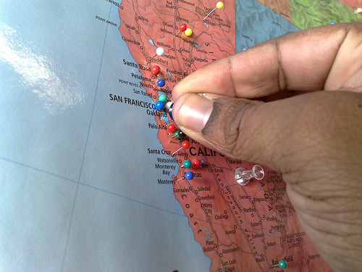
What does it mean to geo-enable the Exchange Network?
Make the data mappable
Geocoding addresses
Capturing coordinates & metadata – GPS, Aerial photo interpolation and other means
Polygonal and other data
Share the geodata
Use of geospatial standards for interoperability embedded in exchange
Notes:
Use of OGC GML profiles for transmitting geospatial data

Slide 4
When should I use the network to share Geo data?
Things To Consider
Large data volumes
Secure Data
  PII and other potentially sensitive data
Mapping presentation - Cartography
Operational data
Misc
  Scheduled Transfers, Machine-To-Machine Connections vs. On-Demand, snapshots (by change date)
Other?
Notes:
Public-facing Data
Use of COTS and OS map servers, e.g., ArcGIS Server and others
Cartography
COTS and OS Map Servers can render symbology
COTS/OS GIS Tools
Web Map Mashups

Slide 5
Agenda
What does it mean to Geo-enable the Exchange Network? When should I use the network to publish Geo data?
Which data should I publish in Geo formats, and how can I begin?
How does EPA catalog its datasets, and how can I access them?
When and how can I access the EPA GeoPlatform? What is the Federal GeoPlatform? How could I get capabilities like these in my state?
What FRS Geo services are available to me?
Recap

Slide 6

Environmental Dataset Gateway
“Connecting Our Data Resources” and GeoPlatform Publishing
2012 Exchange Network
National Meeting
David Parrish, US EPA
May 31, 2012

Slide 7
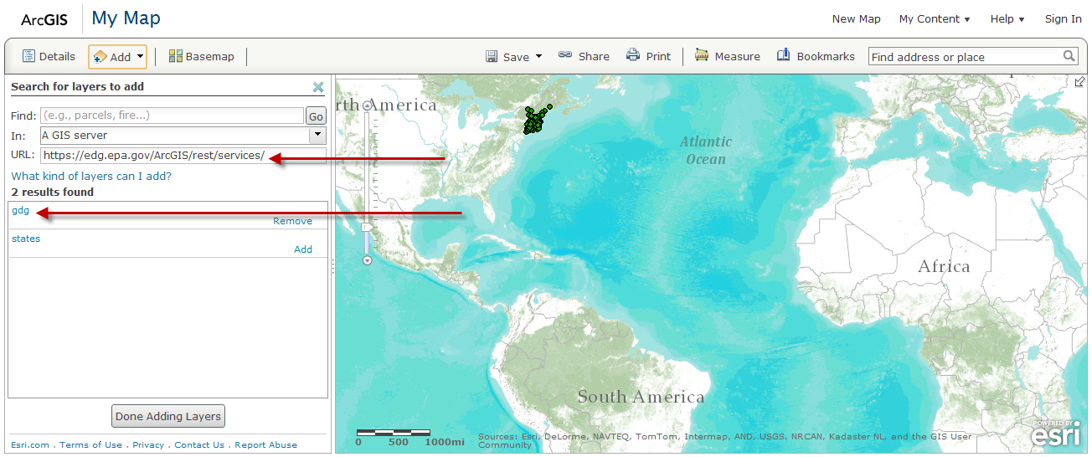
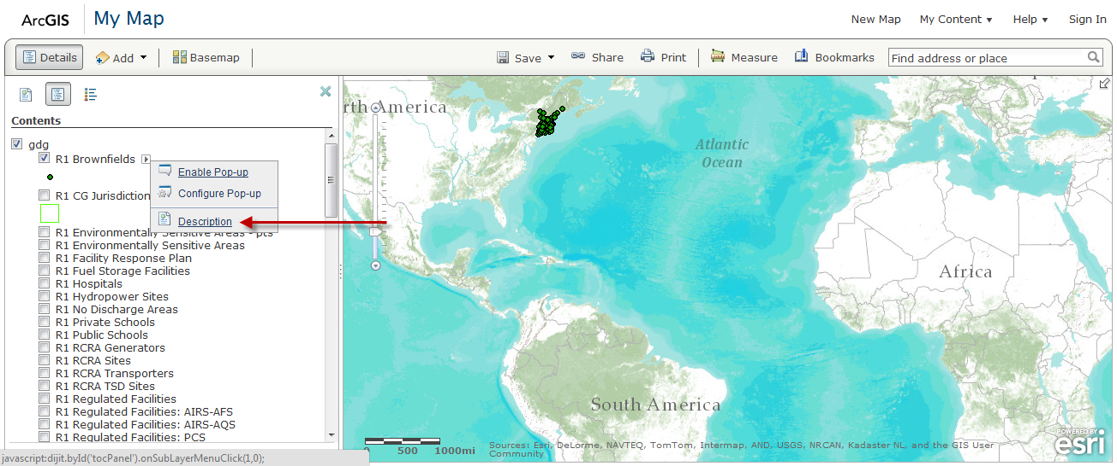
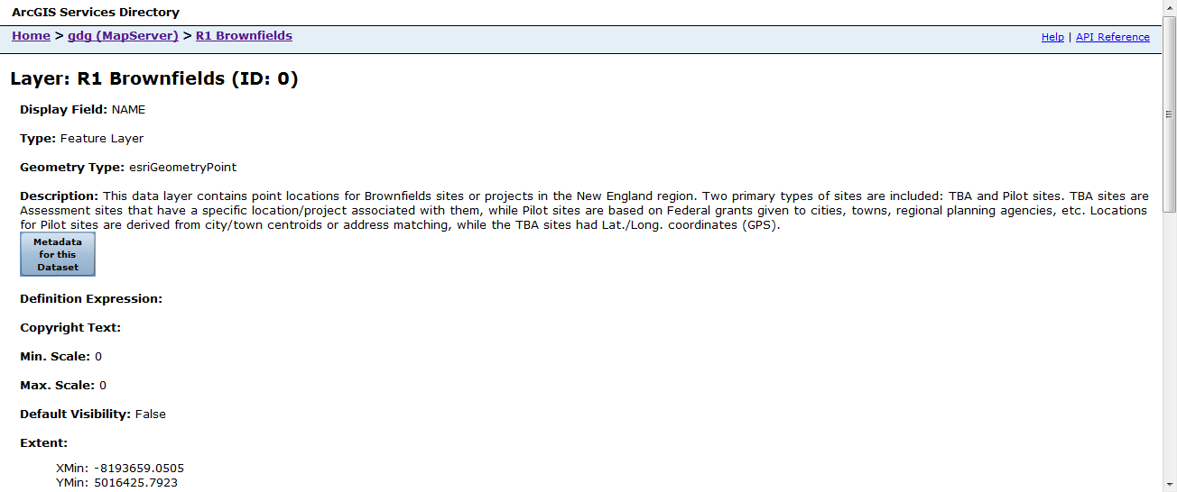
Why should I Publish?
1. Discover
2. Access
3. Understand the Data

Slide 8
But, Discovery Only Works if Everyone Publishes their Data

Slide 9
Publishing Roles & Responsibilities
Data Owner &
their Management
The Publishing Steward, our new metadata experts!!!
EDG Administration Team

Slide 10
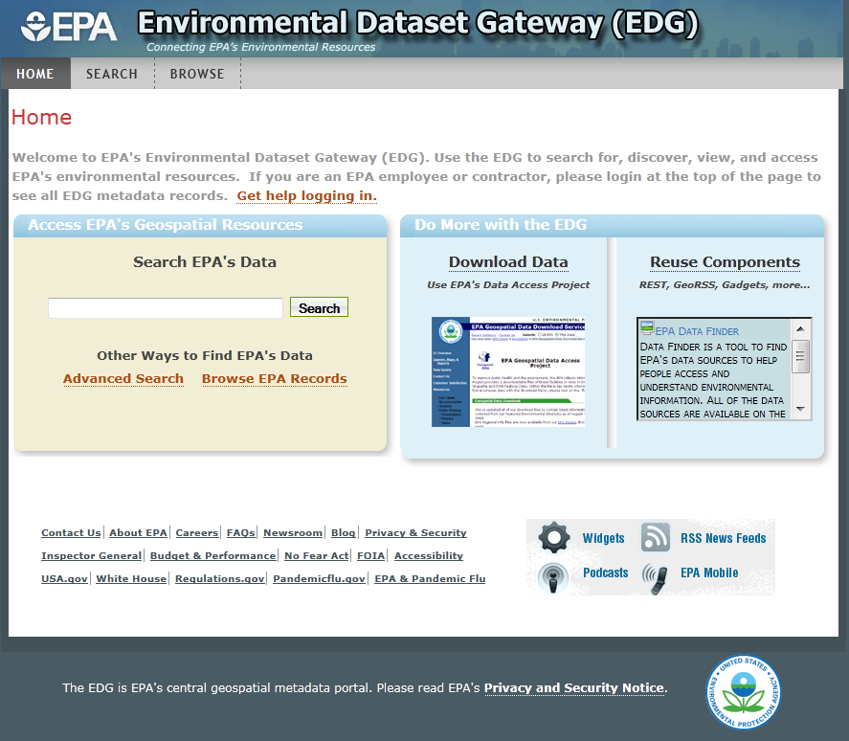
What is the Environmental Dataset Gateway?
ESRI Open Source geoportal software enhanced to meet several Needs
EPA’s central metadata repository for geospatial since 2006
  Expanded in 2011 to include non-geospatial metadata
Over 2,500 dataset records
Role-based secure access to resources (public-private)
edg.epa.gov

Slide 11
EDG is EPA’s Preferred Conduit to Data.gov
EDG accepts both FGDC geospatial standard metadata and Data.gov standard metadata
EDG Inputs- uploads or harvests
EDG Outputs
    EDG Dynamic Web Accessible Folder (WAF)
    EDG Catalog Service
    Dashboard & Inventory
    Embeddable Widget & REST Outputs

Slide 12
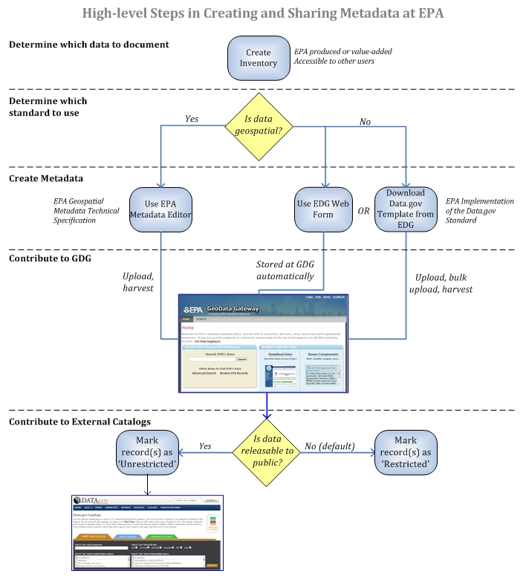


Process

Slide 13
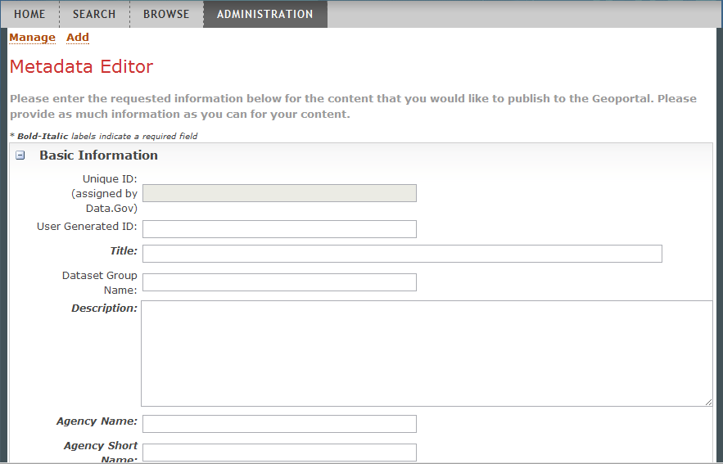
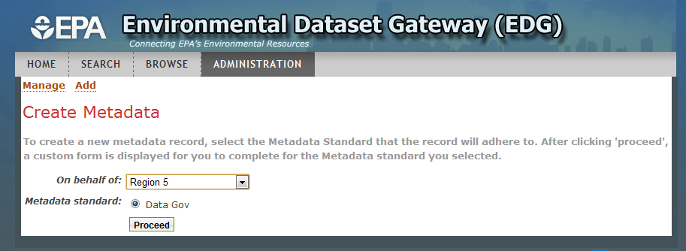
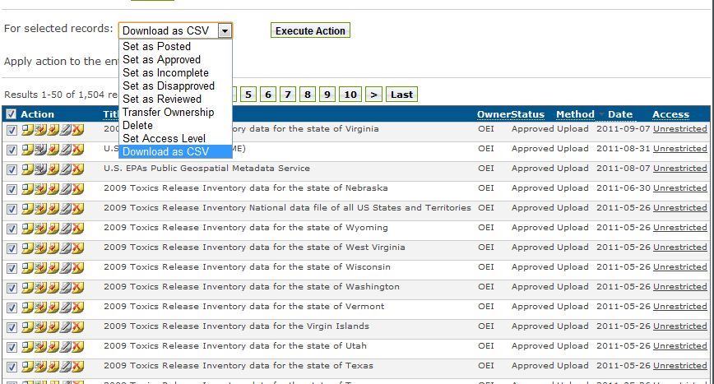
Creating and Managing Metadata Records at EDG

Slide 14
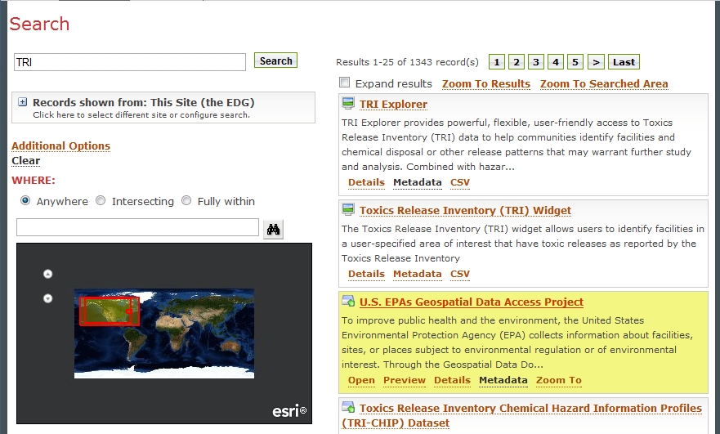
EDG ‘s Integrated Search
Geo and Non-Geo Records

Slide 15
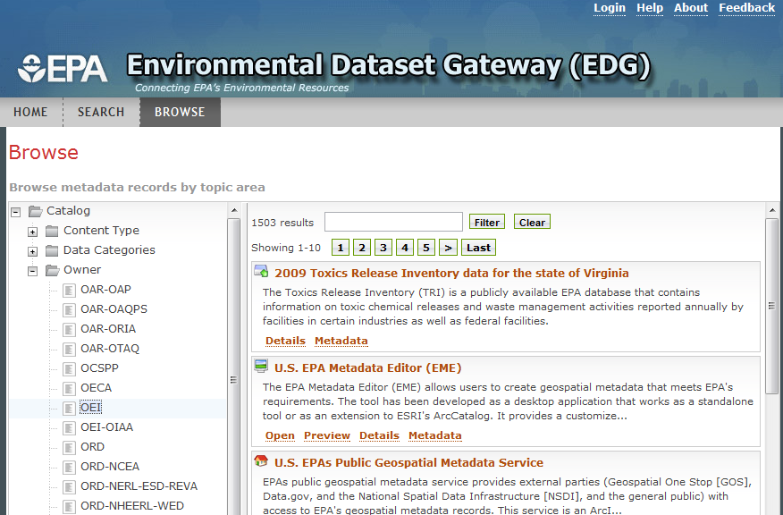
EDG’s Enhanced Browsing
Browse by
Contributor

Slide 16
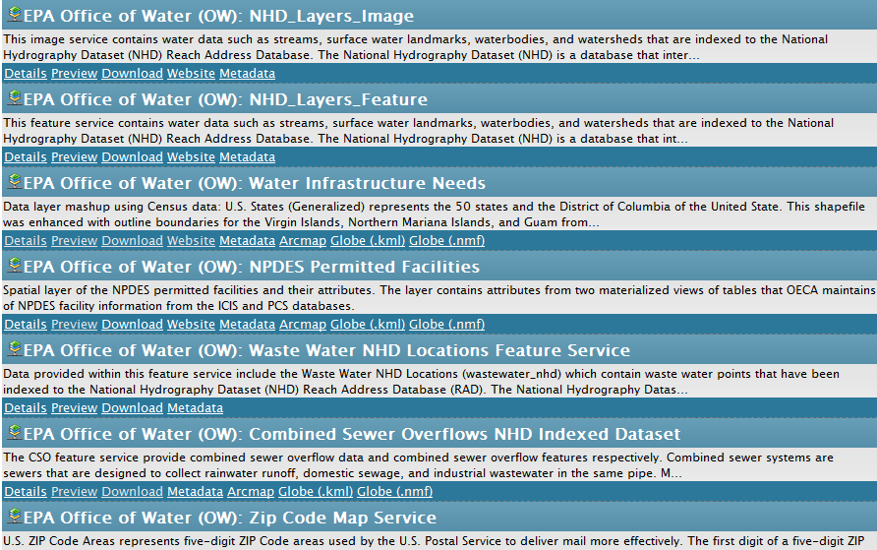
EDG ‘s Web Components REST Outputs & a Widget
HTML Output

Slide 17
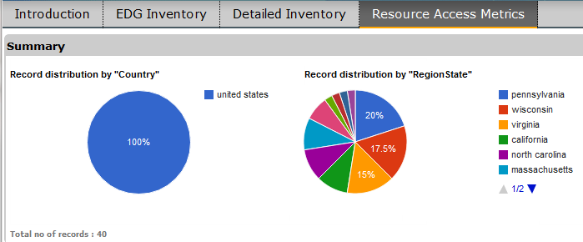
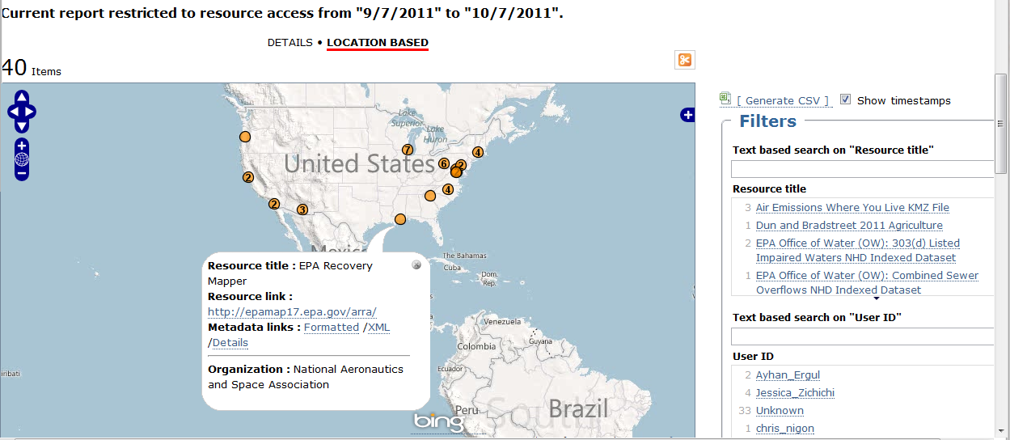
EDG Performance Metrics
Usage Metrics Dashboard
  Tracks user downloads
  Captures location (IP address)
  View usage by Data resource
  Users can filter, drill down and exports (CSV)

Slide 18
Governance Model/Process for
GeoPlatform Publishing
Implement a flexible, decentralized approach that centers around a network of EPA data stewards and managers who accept the responsibility for governance of their organization's geospatial data and agree to follow the guidelines.

Slide 19
GeoPlatform Publishing Procedures
Review Available EPA Data and Services
Understand Publishing Options & Processes
Develop Content & Initiate Hosting Requests
Deploy/Publish Content
Publish Metadata and Create Linkages
Review/Approve/Finalize Published Data

Slide 20
Review Available Data and Services
Integrated Geo Database (IGD)
Facilities Registry System (FRS) & EnviroFacts
Office and Regional Web Services
(ESRI) Business Analyst Server
(Internet) Federal & State Web Services
(ESRI) ArcGIS Online Services
& Exchange Network, System of Registries, …

Slide 21
Understand the Publishing Options and Processes
EPA GeoPlatform Online Environment (users)
NCC Server Environment
NCC GeoPlatform Hosting Environment
  Sandbox / Staging / Production
Environmental Dataset Gateway (EDG)
  Metadata Catalog
  Data Download Site (ftp)
  Clip & Ship Application

Slide 22
NCC GeoPlatform Hosting Environment Operations
No Major/large/complex GIS applications.
All data are local file geodatabases.
No sensitive/confidential data.
No complex network communications.
All Data & Apps require Metadata.
App must play nice.
    Security Certificate.

Slide 23
EPA Geo Data Publishing Managers
Together oversee geo-data governance.
Promote fair and equitable use.
Ensure that requirements are met.
Delegating roles (establish stewards).
Reasonable resource use (requirements).
Managers are fully responsible.

Slide 24



Contacting the EPA EDG Team
David Parrish, U.S.EPA
  214/665-8352
  parrish.david@epa.gov
Jessica Zichichi, Innovate!, Inc.
  edg@epa.gov
https://edg.epa.gov

Slide 25
Agenda
What does it mean to Geo-enable the Exchange Network? When should I use the network to publish Geo data?
Which data should I publish in Geo formats, and how can I begin? How does EPA catalog its datasets, and how can I access them?
When and how can I access the EPA GeoPlatform?
What is the Federal GeoPlatform?
How could I get capabilities like these in my state?
What FRS Geo services are available to me?
Recap

Slide 26
What’s a GeoPlatform?
Web-based utility for collaboration around maps – telling stories with maps and data
Support individual work, small or large groups up to public access
Natural evolution from simple catalogs, to search and immediate use of data
Hosting environment for preferred or trusted enterprise data sets
Allow fusing of internal and external data and services

Slide 27
Federal GeoPlatform
Is hosted on a scalable infrastructure that supports flexible demand for services hosted on GSA’s computer cloud.
Responsible agencies can use this cloud-based infrastructure to publish authoritative data sets as services.
Early version is available at GeoPlatform.gov, which provides a software-as-a-service (SAAS) interface for creation, management and sharing of maps.
Site visitors have a variety of ways to find highlighted content, search for data and maps, and create their own individualized maps and views within a web browser.
Goal is to have this GeoPlatform evolve into a larger, interconnected set of public GeoPlatforms and other public services that make it easy for users to combine federal, state, local, non-profit, academic, and commercial sources of published data.

Slide 28
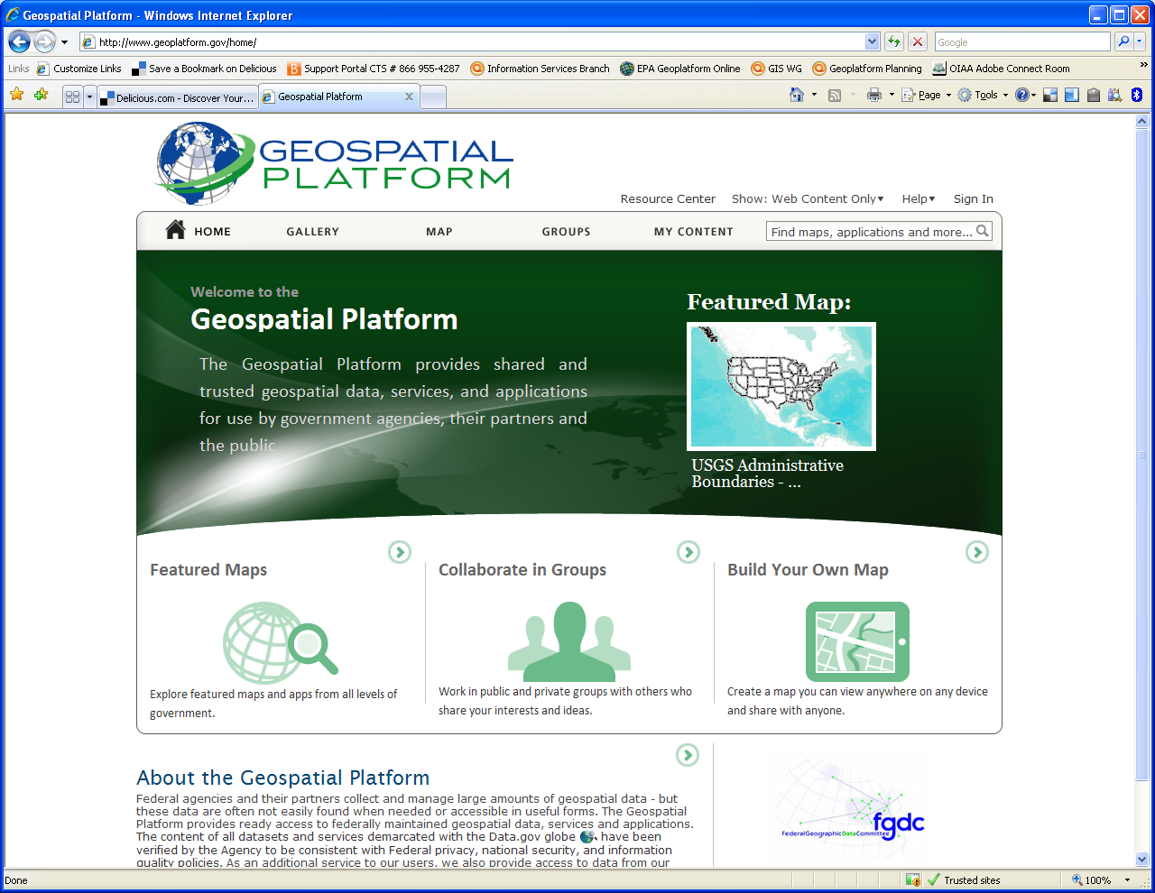
Federal GeoPlatform

Slide 29
EPA GeoPlatform
Provide a common infrastructure for sharing Geospatial Information
Leverage existing license agreements and commercial off the shelf software
Foster innovation and reuse of services and code
Work with our partners (Federal Geoplatform, state and locals)
Rapid prototyping:
  Develop operational capabilities for select pilot applications
  Continually enhance the solution over short iterations
Every organization at EPA needs to be a part of the project in order to achieve success
  Have a governance model and support structure that encourages participation

Slide 30
EPA GeoPlatform Status
Approximately 250 registered users using ESRI Global Accounts
Anticipating LDAP integration and agency wide access in the second half of 2012
Round 1 Business Line Pilots (Oil and Gas Enforcement Targeting, Community grants, and EJ Screen near completion), Additional pilots in planning stages including TRI, ER COP and Drinking Water Mapping
User needs interviews with many offices completed already, continuing process
Access to GeoPlatform content now provided through Intranet site. Deputy Administrator announced “availability” and required use of platform for new development: http://intranet.epa.gov/gis/

Slide 31
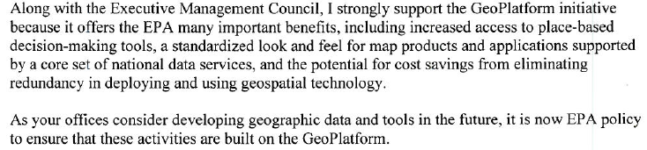
EPA GeoPlatform Status
Developing governance process including SOP’s for publishing content to the Environmental Dataset Gateway and GeoPlatform.
Deputy Administrator announcement memo distributed on May 15th
How can I obtain Platform capabilities in my state/tribal unit/territory?

Slide 32
Agenda
What does it mean to Geo-enable the Exchange Network? When should I use the network to publish Geo data?
Which data should I publish in Geo formats, and how can I begin? How does EPA catalog its datasets, and how can I access them?
When and how can I access the EPA GeoPlatform? What is the Federal GeoPlatform? How could I get capabilities like these in my state?
What FRS Geo services are available to me?
Recap

Slide 33
FRS and FacID in Geo
FRS
Facility Registry Service as place-based integration hub
FRS performs integration, validation and QA across over 30 federal databases and over 50 state, territory and tribal databases
Once place and identity are established, analyses and modeling can take place
FacID
Place-based information exchange
FacID as virtual datastore for place-based integration
Notes:
1-2 minutes

Slide 34
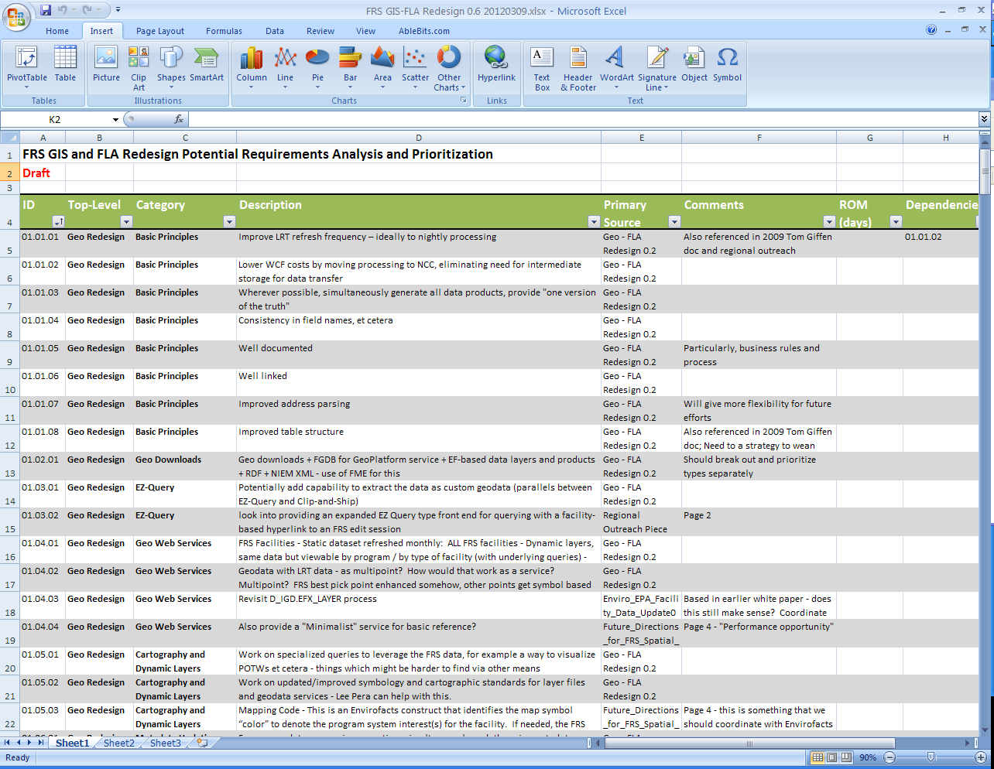
FRS Updates
Major Initiatives for Spring-Summer 2012
Geo Redesign
Facility Linkage
Application
(to be discussed in FRS
/ FacID breakout)
Notes:
We’ll talk about FLA redesign in the FRS/FacID breakout

Slide 35
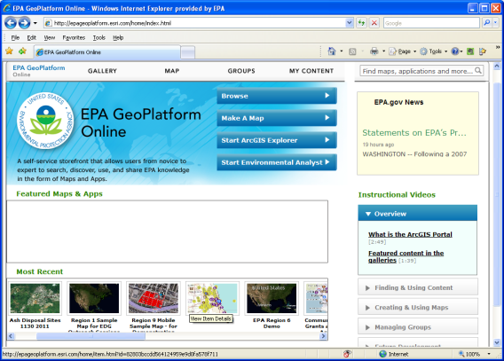

FRS Geospatial Redesign
Last Fall
Automated Refresh Processing
Improved Best Pick Processing
Coding fixes and transparency
This Spring
Weekly geospatial refresh
Improved Data Synchronicity and Timeliness
GeoPlatform Map Services, Downloadable Data
Improved architecture for QA and workflow
Additional Capabilities – clip & ship, metadata, indexing, web services…
Notes:
1 minute or so
We will be automating production of downloadable static data as well as refresh of map services

Slide 36
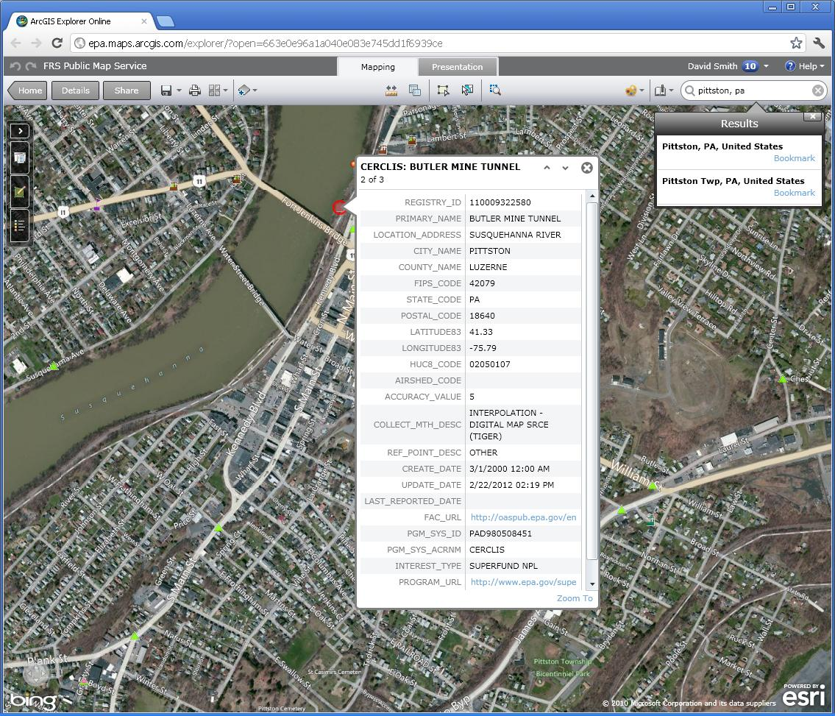
What FRS Geo services are available to me?
FRS Public-Facing Map Service (ArcGIS Server 10.0)
Service Endpoint: http://igeo.epa.gov/ArcGIS/rest/services/OEI/FRS/MapServer
36
Notes:
Minute - This topic is one that partners will be very interested in
Note that this is what the mobile pilot demo was using for accessing services
Service Endpoint: http://igeo.epa.gov/ArcGIS/rest/services/OEI/FRS/MapServer
Service Metadata: https://edg.epa.gov/metadata/rest/document?id=%7B0A2C3F02-3D68-4556-8A87-B288C318E0EE%7D&xsl=metadata_to_html_full
GeoPlatform Sample Link http://epa.maps.arcgis.com/home/item.html?id=663e0e96a1a040e083e745dd1f6939ce

Slide 37
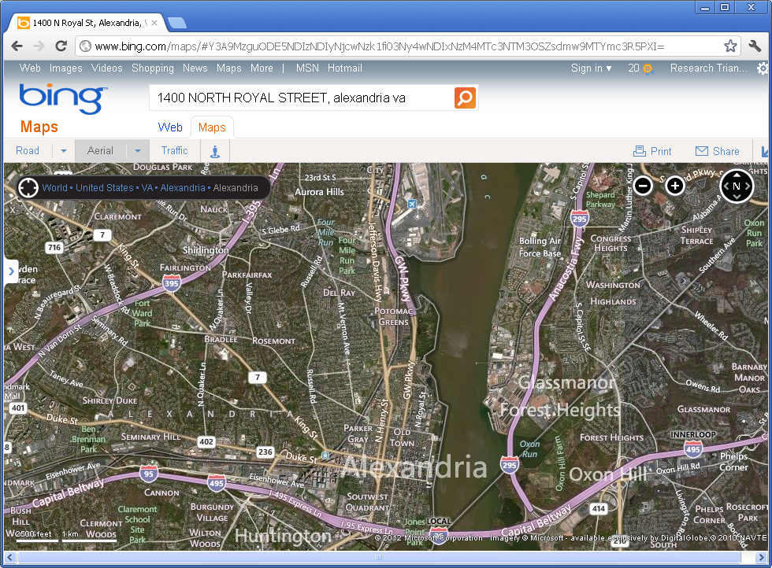
FRS REST Services
Search for TRI facilities within a 3 mile radius of lat 38.8 / lon -77.01.
http://ofmpub.epa.gov/enviro/frs_rest_services.get_facilities?latitude83=38.8&longitude83=-77.01&search_radius=3&pgm_sys_acrnm=TRIS
Facility Lookup Service
<?xml version="1.0" encoding="UTF-8" ?>
- <Results>
- <FRSFacility>
<RegistryId>110000340916</RegistryId>
<FacilityName>GENON POTOMAC RIVER GENERATING STATION</FacilityName>
<LocationAddress>1400 NORTH ROYAL STREET</LocationAddress>
<SupplementalLocation>POTOMAC RIVER GENERATING STATION</SupplementalLocation>
<CityName>ALEXANDRIA</CityName>
<CountyName>ALEXANDRIA CITY</CountyName>
<StateAbbr>VA</StateAbbr>
<ZipCode>22314-1111</ZipCode>
<FIPSCode>51510</FIPSCode>
<Latitude83>38.820391</Latitude83>
<Longitude83>-77.041088</Longitude83>
</FRSFacility>
- <FRSFacility>
<RegistryId>110002321434</RegistryId>
<FacilityName>U.S. AIR FORCE BOLLING AFB DC</FacilityName>
<LocationAddress>370 BROOKLEY AVENUE</LocationAddress>
<SupplementalLocation />
<CityName>WASHINGTON</CityName>
<CountyName>DISTRICT OF COLUMBIA</CountyName>
<StateAbbr>DC</StateAbbr>
<ZipCode>20032-7718</ZipCode>
<FIPSCode>11001</FIPSCode>
<Latitude83>38.833713</Latitude83>
<Longitude83>-77.003698</Longitude83>
</FRSFacility>
- <FRSFacility>
<RegistryId>110001891506</RegistryId>
<FacilityName>VIRGINIA CONCRETE ALEXANDRIA PLANT</FacilityName>
<LocationAddress>340 HOOFFS RUN DRIVE</LocationAddress>
<SupplementalLocation />
<CityName>ALEXANDRIA</CityName>
<CountyName>ALEXANDRIA</CountyName>
<StateAbbr>VA</StateAbbr>
<ZipCode>22314-4646</ZipCode>
<FIPSCode>51510</FIPSCode>
<Latitude83>38.799218</Latitude83>
<Longitude83>-77.062888</Longitude83>
</FRSFacility>
- <FRSFacility>
<RegistryId>110016695744</RegistryId>
<FacilityName>WOODROW WILSON BRIDGE READY MIX CONCRETE DIV</FacilityName>
<LocationAddress>6711 OXON HILL ROAD</LocationAddress>
<SupplementalLocation>PRINCE GEORGE'S COUNTY</SupplementalLocation>
<CityName>OXON HILL</CityName>
<CountyName>PRINCE GEORGES</CountyName>
<StateAbbr>MD</StateAbbr>
<ZipCode>20745-1122</ZipCode>
<FIPSCode>24033</FIPSCode>
<Latitude83>38.799311</Latitude83>
<Longitude83>-77.002576</Longitude83>
</FRSFacility>
</Results>
Where is industrial wastewater being sent?
Can we retrieve an ID for that facility?
Other offsite recycling and processing?
Notes:
1-2 minutes minutes Example Use Case

Slide 38

FRS REST Services
FRS REST Lookup Service -
Provides ability to programmatically query FRS database and integrate results either at the backend or for mashups
Return results as XML, JSON (Javascript Object Notation) or JSONP (JSON with callback function)
Now Spatially Enabled

Slide 39
FRS REST Services
Radial Search Capability
Example: CERCLIS (Superfund) facilities within a 3 mile radius of latitude 38.8/longitude -77.01.
Bounding Box Search
Example: Get facilities for the area encompassed by (36.8 -76.4, 37.0 -76.5)
Access Spatial Indexes
Watershed Search - WBD (12-digit HUC) for a facility
Congressional District by lat/long
Documentation: http://www.epa.gov/enviro/html/fii/FRS_REST_Services.html
Notes:
Quick example (no more than 30 seconds)

Slide 40
Recap
We covered…
What it means to Geo-enable the Exchange Network, and when you should use the network to publish Geo data
Which data you should publish in Geo formats, and how you can begin. How EPA catalogs its datasets, and how you can access them?
When and how you can access the EPA GeoPlatform and the Federal GeoPlatform. How you could get capabilities like these in your state.
What FRS Geo services are available to you.
Do you have any additional questions?

Slide 41
Thank You!
Topic | URL
FRS Home Site | http://www.epa.gov/enviro/html/fii/
FRS Geodata Download | http://www.epa.gov/enviro/geo_data.html
FRS REST Services | http://www.epa.gov/enviro/html/fii/FRS_REST_Services.html
FRS ArcGIS Server Service | http://igeo.epa.gov/ArcGIS/rest/services/OEI/FRS/MapServer
EPA Geospatial Program | http://www.epa.gov/geospatial/index.html
EPA Geodata Gateway | https://edg.epa.gov/
EPA Geo Metadata | https://edg.epa.gov/EME/

Slide 42
Term/Acronym | Definition
CSW | The OGC Catalog Service defines common interfaces to discover, browse and query metadata about data, services and other potential resources. Web Catalog Service includes several profiles including Catalog Service - Web (CSW) Reference: "Web Catalog Service" - Wikipedia, The Free Encyclopedia. http://en.wikipedia.org/w/index.php?title=Web_Catalog_Service&oldid=288816713
ENDS | The Exchange Network Discovery Service (ENDS) 2.0 will offer the Exchange Network an opportunity to create an automated system of service description, cataloging and discovery. (http://www.exchangenetwork.net/node/ends.htm)
GML | The Geography Markup Language (GML) is the XML grammar defined by the Open Geospatial Consortium (OGC) to express geographical features. GML serves as a modeling language for geographic systems as well as an open interchange format for geographic transactions on the internet (http://www.opengeospatial.org/standards/gml). GML is a complex and feature-rich vocabulary; because of this complexity, many real world features can be encoded using very different GML constructs. To manage this complexity, communities have developed subsets of the GML vocabulary called "profiles". One of these profiles, GeoRSS GML has emerged as a de facto standard to provide a basic approach for encoding basic geographic information in RSS (feeds, blogs, etc.) and other web applications. GeoRSS GML has the capability to represent simple geographic structures (point, line, polygon and bounding envelope) and provides a standard notation for expressing coordinate reference systems beyond the EN standard of decimal degree latitude/longitude. In addition, GeoRSS is supported by a growing number of web services such as Google Maps, Yahoo Pipes, Microsoft Virtual Earth and many others. (http://www.ogcnetwork.net/gml-georss) Reference: "Recommended Practices for Integrating Geospatial Data into Exchange Network Schema" Exchange Network Geospatial Task Force http://www.exchangenetwork.net/exchanges/cross/geo.htm
NAAS | Network Authorization and Authentication Services (NAAS) are a set of centralized informaiton security services that Exchange Network partners can use to authenticate and authorize their users. NAAS provides an efficient way for Exchange Network participants to exchange data, without having to build and maintain their own security system. NAAS supports many levels of security, from PIN/passwords to Public Key Infrastructure. Security tokens and assertions issued by NAAS are trusted and accepted by all Network Nodes. All operations defined in NAAS must be conducted over a secure SSL channel using 128 bit encyrption. (http://www.exchangenetworkwiki.com/wiki/index.php/NAAS
NHD | The National Hydrography Dataset (NHD) is the surface water component of The National Map. The NHD is a comprehensive set of digital spatial data representing the surface water of the United States using common features such as lakes, ponds, streams, rivers, canals and oceans. These data are designed to be used in general mapping and in the analysis of surface-water systems using geographic information systems (GIS) (http://nhd.usgs.gov) Reference: "National Hydrography Dataset" US Geological Survey http://nhd.usgs.gov
OGC | Founded in 1994, the Open Geospatial Consortium (OGC) is an international voluntary consensus standards organization. In the OGC, more than 370+ commercial, governmental, nonprofit and research organizations worldwide collaborate in an open consensus process encouraging development and implementation of standards for geospatial content and services, GIS data processing and datasharing. Reference: "Open Geospatial Consortium", Wikipedia, The Free Encyclopedia http://en.wikipedia.org/w/index.php?title=Open_Geospatial_Consortium&oldid=312761435
FRS Overview
Term/Acronym | Definition
OpenLayers | OpenLayers is an open source (provided under a modified BSD license) JavaScript library for displaying map data in web browsers. It provides an API for building rich web-based geographic applications similar to Google Maps and Bing Maps. The library includes components from the Rico Javascript library and the Prototype JavaScript Framework. Official site: http://www.openlayers.org OpenLayers was originally developed by Christopher Schmidt at MetaCarta as a visualization tool for their geotagging and search technology. It was initially funded by MetaCarta and has since been released as open source; support at this point is largely from the open source community. An extensive amount of integration capability has been build, to support other commercial mapping APIs such as Bing and Google for consuming map tiles, GeoRSS, as well as OGC mapping capability such as WMS and WFS/WFS-T. There are a number of great examples of OpenLayers in use. It's built entirely on JavaScript and can be hosted and integrated into virtually any platform. Reference: "OpenLayers", Wikipedia, The Free Encyclopedia, 18 Sep 2009, 03:41 UTC http://en.wikipedia.org/w/index.php?title=OpenLayers&oldid=314655891
RSS | RSS (most commonly translated as "Really Simple Syndication" but sometimes "Rich Site Summary" is a family of web feed formats used to publish frequently updated works - such as blog entries, news headlines, audio and video - in a standardized format. Reference: "RSS", Wikipedia, The Free Encyclopedia. http://en.wikipedia.org/w/index.php?title=RSS&oldid=314369789
SOS | The OpenGIS Sensor Observation Service interface Standard (SOS) provides an API for managing deployed sensors and retreiving sensor data and specifically "observation" data. Whether from in-situ sensors (e.g., water monitoring) or dynamic sensors (e.g., satellite imaging), measurements made from sensor systems contribute most of the geospatial data by volume used in geospatial systems today. This is one of the OGC Sensor Web Enablement (SWE) [1] suite of standards. (http://www.opengeospatial.org/standards/sos) Reference: "Sensor Observation Service", Open Geospatial Consortium, Inc. http://www.opengeospatial.org/standards/sos
WCS | The Open Geospatial Consortium Web Coverage Service Interface Standard (WCS) provides an interface allowing requests for geographical coverages across the web using platform-independent calls. The coverages are objects (or images) in a geographical area, whereas the WMS interface or online mapping portals like Google Maps return only an image, which end-users cannot edit or spatially analyze. Reference: "Web Coverage Service" Wikipedia, The Free Encyclopedia. http://en.wikipedia.org/w/index.php?title=Web_Coverage_Service&oldid=296767170
WFS | The Open Geospatial Consortium Web Feature Service Interface Standard (WFS) provides an interface allowing requests for geographical features across the web using platform-independent calls. One can think of geographical features as the "source code" behind a map, whereas the WMS interface or online mapping portals like Google Maps return only an image, which end-users cannot edit or spatially analyze. The XML-based GML furnishes the default payload-encoding for transporting the geographic features, but other formats like shapefiles can also serve for transport. Reference: "Web Feature Service", Wikipedia, The Free Encyclopedia. http://en.wikipedia.org/w/index.php?title=Web_Feature_Service&oldid=298139758
WMS | The OpenGIS Web Map Service Interface Standard (WMS) provides a simple HTTP interface for requesting geo-registered map images from one or more distributed geospatial databases. A WMS request defines the geographic layer(s) and area of interest to be processed. The response to the request is one or more geo-registered map images (returned as JPEG, PNG, etc) that can be displayed in a browser application. Reference: "Web Map Service", Wikipedia, The Free Encyclopedia. http://en.wikipedia.org/w/index.php?title=Web_Map_Service&oldid=305087736

