Slide 1
Exchange Network Open Call
November 17, 2011

Slide 2
Today’s Agenda
Background on Exchange Network data access policy and data publishing
New default Network security settings for Query and Solicit web services
Impact to existing data flows
Special security considerations for the Exchange Network Browser
Actions for Node Administrators
Securing sensitive data
Steps for OpenNode2 users and EN Node users
Reminder on Node interoperability issues

Slide 3
Data Publishing Basics
Today, most Network data flows are powered by the Submit web service and are not publishing-oriented
Data owner initiates the exchange of data
Some data flows use Query and Solicit web services to enable data publishing
Data are made available through a Node so that others with permission can access it on demand
Only Nodes can support Query and Solicit web services
Node Clients are not affected

Slide 4
EN Data Access Policy
Ease of data access and exchange is a fundamental principle of the Exchange Network. Whenever possible, data owners must:
Make data accessible to partners to the maximum degree appropriate
Set node privilege defaults so EN partners can query/solicit data
Register nodes and web services to make them discoverable and accessible to trusted partners, and
Ensure that all data access and exchange relationships are governed by agreements that meet partners’ legal and programmatic obligations
http://www.exchangenetwork.net/about/network-management/network-policy-framework/

Slide 5
New Default Security Settings
For Nodes that Authorize data flow access using the Network Authentication and Authorization Service (NAAS), Query and Solicit services are open by default to any valid NAAS account with an authenticated security token.
Any existing NAAS policies that restrict access will remain in effect and supersede these new default behaviors

Slide 6
Exchange Network Browser
Web-based tool that allows users to discover and access data published by Exchange Network Nodes and registered in ENDS
Pre-release version available today at http://www.enbrowser.net
Allows users to log-in with valid NAAS credentials to access secure data flows
Will also offers Guest access to unsecured data flows for public users without their own NAAS credentials

Slide 7
Special Considerations for EN Browser Guest Account
EN Browser uses hard-coded NAAS credentials to enable public access
User name: enbrowser@exchangenetwork.net
If you answer YES to all 3 questions below you should ensure that your flow is set up to deny access to the EN Browser guest account
Do you have Query or Solicit services on your Node?
Are those services registered in ENDS?
Is the data inappropriate for public access?
Guest access goes live on December 12, 2011

Slide 8
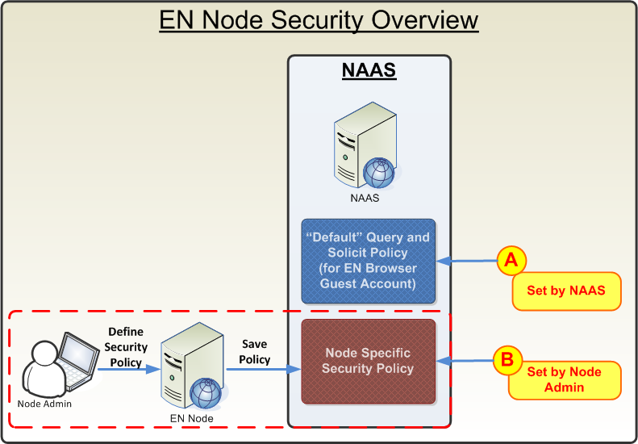
EN Node: Security Model
All queries and solicit services will be open to the enbrowser@exchangenetwork.net Guest Account by default.
Policies defined by the Node Admin will supersede the default NAAS query and solicit security policies.

Slide 9
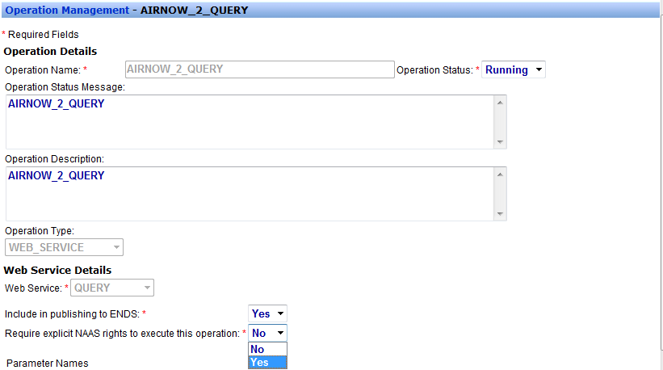
EN Node: Protecting Services
Step 1: Node Admin selects “Yes” for “Require explicit NAAS rights to execute this operation”
The service will be totally locked down

Slide 10
EN Node: Protecting Services
Step 2: Node Admin can grant or deny access to a specific service on the User Management screen
Check to grant privileges

Slide 11
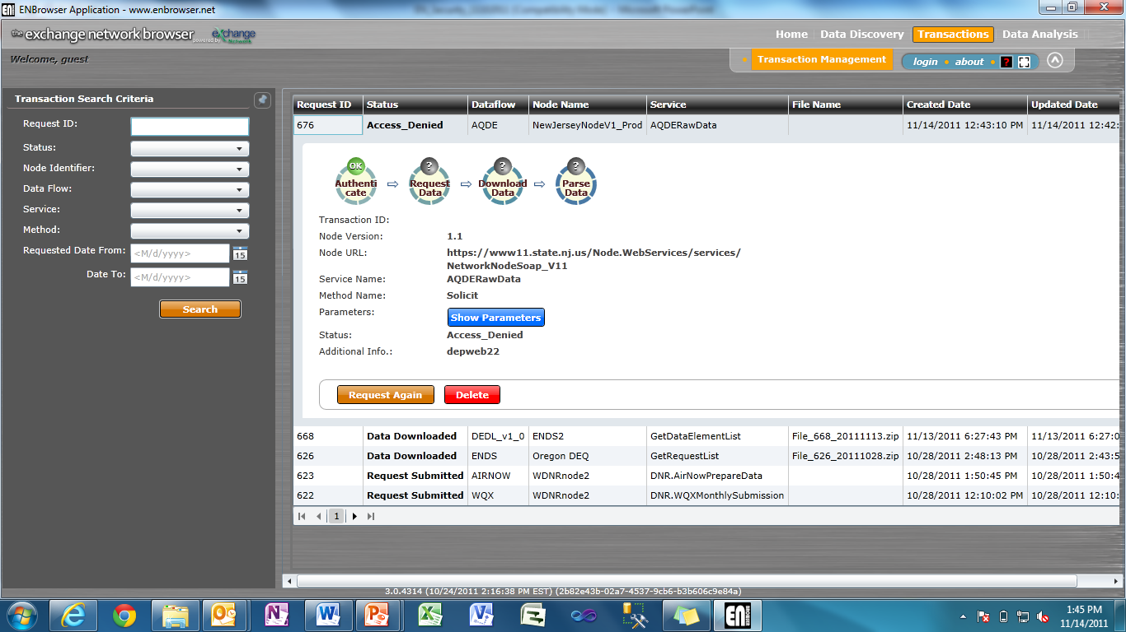
EN Node: Protecting Services
Once a service is secured, the enbrowser@exchangenetwork.net Guest Account will not be able to access the service unless explicitly granted rights to do so
enbrowser@exchangenetwork.net has no right to the Service

Slide 12
OpenNode2: Security Model
OpenNode2 uses NAAS for Authentication but not Authorization
NAAS Policies are not used by OpenNode2
Flow access permissions are stored in the OpenNode2 database
OpenNode2 flows are either protected or unprotected. Users are either allowed access to all flow services or denied access to all flow services

Slide 13
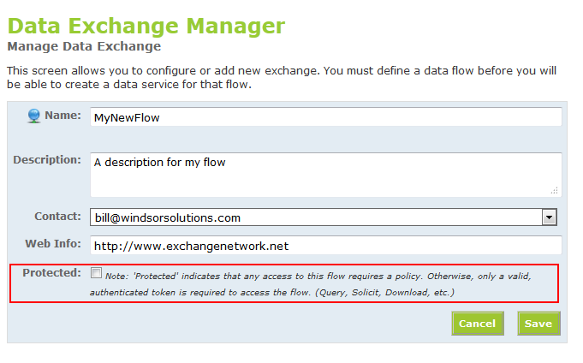
OpenNode2: Unprotected Flows
OpenNode2 flows are not protected by default. Any valid NAAS user may access the services of an unprotected flow, including anonymous EN Browser users (guests).

Slide 14
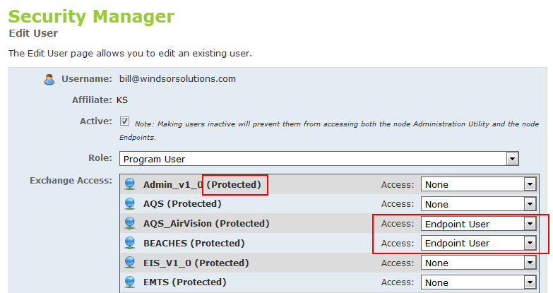
OpenNode2: Protecting Flows
.NET OpenNode2: In the Security Manager, assign access rights of “Endpoint User” to grant access to a given flow to a user.

Slide 15
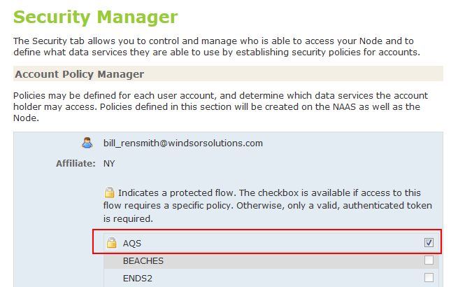
OpenNode2: Protecting Flows
Java OpenNode2: In the Security Manager, assign access rights by checking the “Flow Access” box next to the flow name.

Slide 16
Reminder: Node Interoperability
The specification for Exchange Network Nodes was updated in June to address problems that were preventing some Nodes from communicating
Information on affected products and the fixes is available at: http://www.exchangenetwork.net/node-interoperability-faqs
January 31, 2012 is the target date for reinstalling affected Node software

Slide 17
Questions?
Kurt Rakouskas 301.531.5186 kurt@exchangenetwork.net

