Slide 1
Mobile Inspections
Rebecca Wenner Kansas DHE
Guy Outred Windsor Solutions

Slide 2
Drivers
To improve efficiency: more inspections with fewer staff
To improve data quality
To speed up the availability of compliance data
Notes:
We were putting the same information into multiple forms and databases.

Slide 3
Key Capabilities
Manages data for the full inspection lifecycle
Supports scheduling of inspections
Supports inspection results and violations
Can attach photos/documents
Non compliance notices and tracks RTC
Extreme mobility
Download scheduled inspections so that inspection forms are prefilled
Synchronizes the inspection results with the central server
Easy expandability and maintenance
Create or modify inspection forms easily
Supports EPA’s compliance monitoring data formats

Slide 4
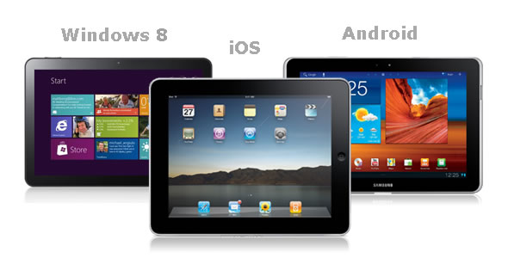
Requirements for Field Equipment
Lightweight and small enough to carry
Long battery life
Carrying case with a shoulder strap
Compatible with our systems
Reasonable cost

Slide 5
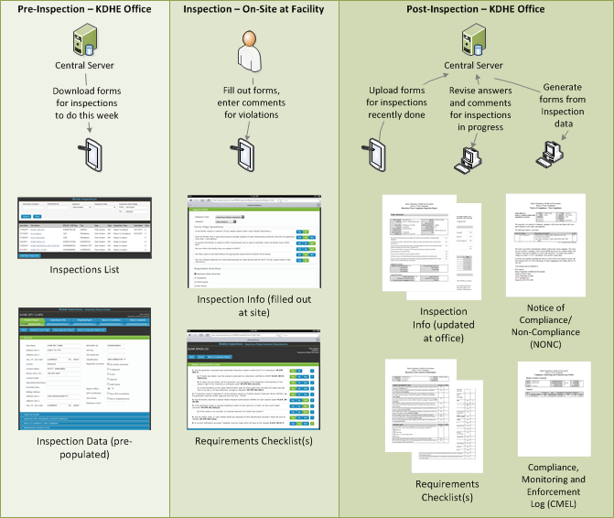
Solution Overview
Notes:
Note: this diagram will be made readable

Slide 6
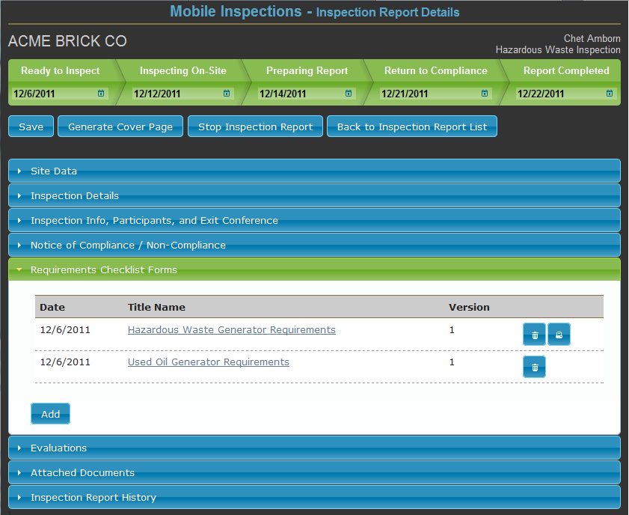
Application Demonstration
Notes:
The work involved in completing the inspection is done on an inspector’s desktop/laptop computer. Inspection progress is tracked from initial scheduling through return to compliance work and preparation of a final inspection report. Documents like the Inspection Report cover pages, requirements checklists, and the Notice of Compliance/ Non-Compliance are generated from data entered on the tablet computer. The documents are created in Microsoft Word format for easy editing if special notes or comments are needed
Other documents like photo logs and e-mail attachments received from a facility are attached to the inspection report so that all relevant documents are stored in the central server database

Slide 7
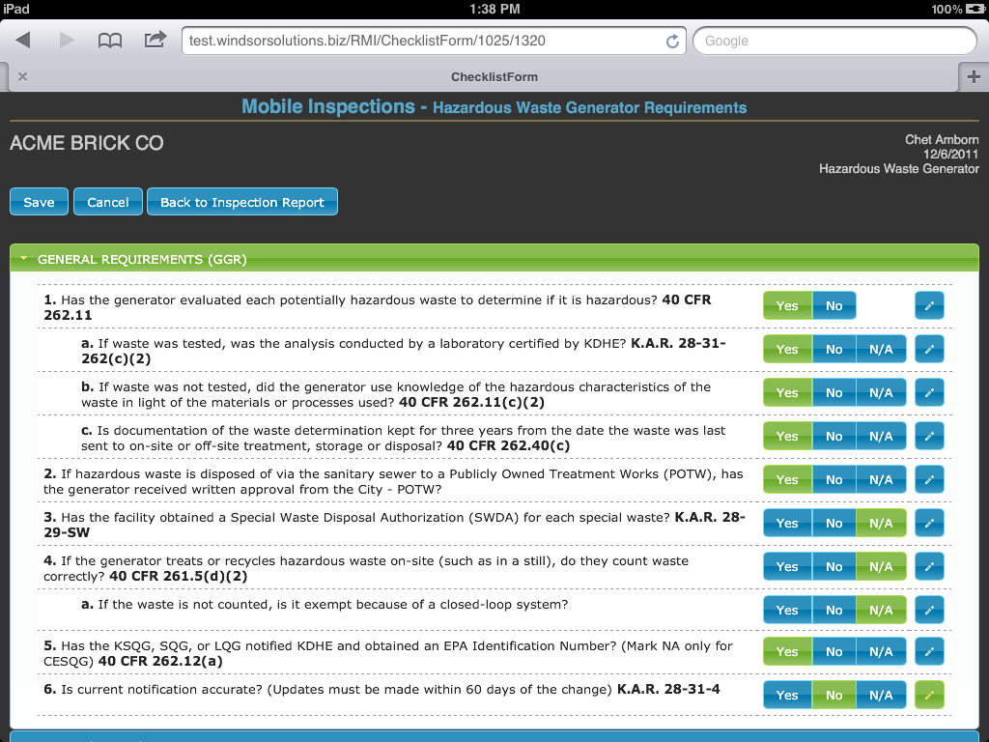
A checklist
Notes:
Inspection requirements checklists are filled out by tapping “Yes”, “No”, or “N/A” for each question. Comments about violations can be entered at the time a citation is recorded or later on the inspector’s office computer after the checklist is uploaded to the central server. Multiple checklists can be used depending on the permitted activities at the facility being inspected
Data on a facility is pre-populated on a “cover page” form. Comments about the facility, participants involved in the inspection, concerns, record requests, and exit briefing discussions can be entered on the tablet computer or back at the office.

Slide 8
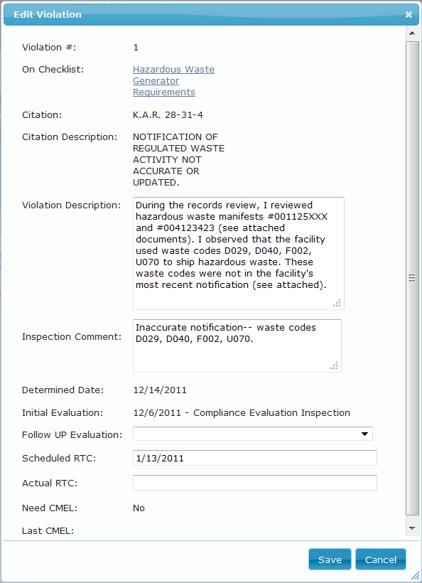
A violation

Slide 9
Technology
Two major solution components:
Server based data repository (e.g, Oracle or SQL Server)
Inspection application
HTML5 which provides key benefits:
Run within any recent browser, thus almost any device
No manual installation required
Ability to support and synchronize to a disconnected data store
Ability to support the latest user interface features and capabilities

Slide 10
Benefits
Reduce Effort
Reduce the time inspectors spend in preparing an inspection report
Eliminate the need to re-key the same data into multiple systems
Faster data
Reduce the time for return to compliance (RTC) for violations
Reduce the lag time when inspection data is accessible to the agency and EPA
Better data
Improve data collection consistency
Avoid illegible handwritten content
Encyclopedia of forms and regulations always on hand
Notes:
Many fields are pre-populated and information only needs to be entered once. We are able to review existing information rather than re-creating it each time. This improves our data quality and our efficiency.
Inspectors used to carry storage bins of many various spare forms in their vans. Now they all can reside on the tablet.
Reduces time and money by being able to transmit information electronically.
Small errors can be fixed in the central office.
Large errors can be fixed remotely in the districts.
Reviews are conducted before finalizing reports.

Slide 11
Lessons Learned
Tablets are revolutionizing field work
IT Security Policies may be a hurdle
Field office connectivity challenges
Inspector involvement aids adoption
HTML5 offers h/w independence
Notes:
Tablets are extraordinarily powerful – combining many items of equipment (e.g., GPS / PC / Camera / Navigation) into a light easy to use devices.
IT Policies:
Make sure IT understands the project and the future electronic direction of the agency
Think through agency security policies prior to distributing equipment and how that will affect maintenance and repair of systems.
Inspectors participated in the design and development process so they were prepared for and excited about the changes.

Slide 12
Questions?

