Slide 1
Delaware Source Water Protection Polygons
Douglas Rambo, P.G.
Delaware Department of Natural Resources and
Environmental Control
Source Water Protection Program

Slide 2
Delaware Source Water Protection Polygons
In 1999 EPA Region III approved Delaware’s Source Water Assessment Plan (SWAP) detailing the methodologies used to delineate wellhead protection area (WHPA) polygons for approximately 1,200 wells (500+ water systems).
Delaware has delineation criteria for drinking water sources in confined and unconfined aquifers.

Slide 3
Delaware Source Water Protection Polygons
Methodologies
  Confined aquifer well WHPA’s consist of a circular fixed radius with a minimum 150-foot radius.
  Unconfined aquifer wells pumping less than 50,000 gallons/day also get delineated with a fixed radius delineation of at least 150-foot radius.
  Unconfined aquifer wells that pump greater than 50,000 gallons/day require delineation using groundwater modeling software (i.e. EPA WhAEM or Schlumberger Water Services’ Visual MODFLOW).

Slide 4
Delaware Source Water Protection Polygons
  Special Cases
    New Castle County: more stringent than State with a minimum of 300-foot radius area around a public well.
    New Castle County also has public supply wells that were delineated and bound by ordinance prior to DNREC’s SWAP.
    City of Dover East Wellfield = 7 high volume unconfined aquifer wells each buffered by a 1-mile radius

Slide 5
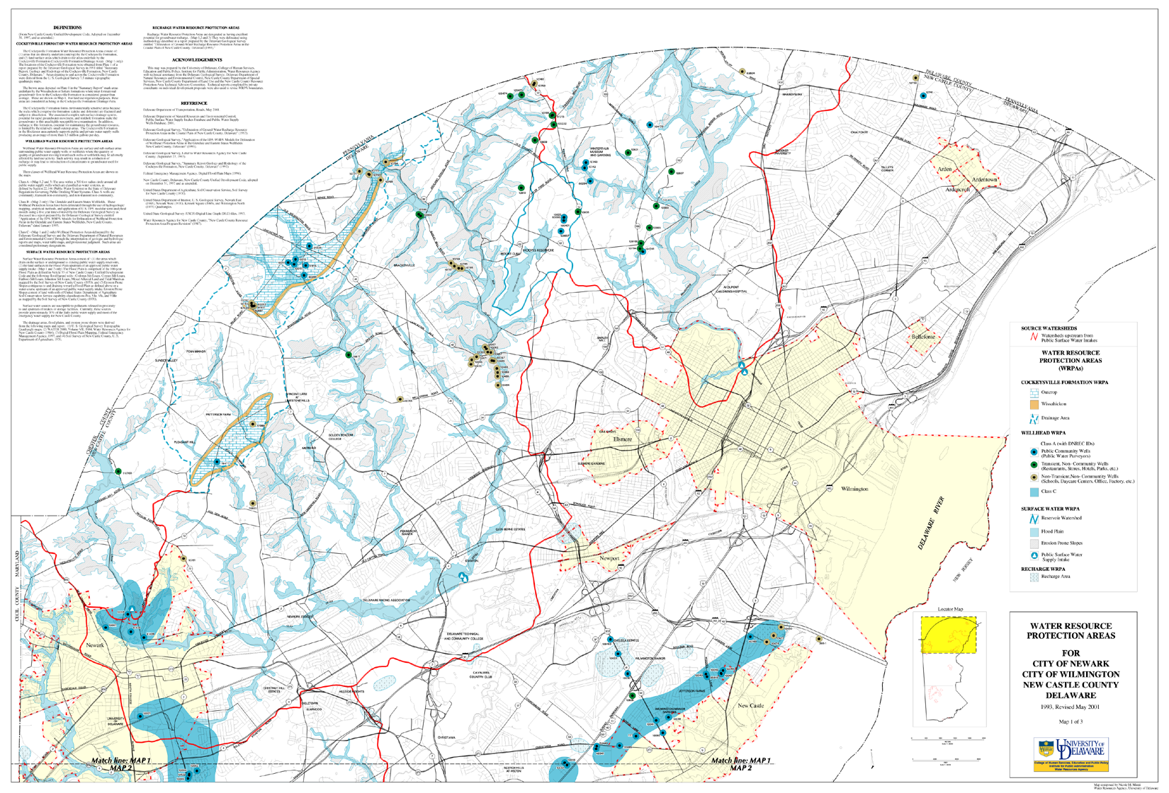

Slide 8
Delaware Source Water Protection Polygons
Ground Water Protection Council Pilot Project
  In 2003 DNREC participated in a pilot project with the GWPC to explore transfer of SWA data to EPA for incorporation into the WATERS database.
  The CADMUS Group analyzed the Delaware Source Water Program Database and created a XML Schema that allowed for the merging of our geospatial (ESRI Shapefile) data and data from our program’s MS Access database.
  This XML Schema became the basis for the work that Mike Townshend’s group in the DNREC OIT did to prepare the data for transfer to EPA Region 3.

Slide 9
Delaware Source Water Protection Polygons
The Source water Program provides an ESRI shapefile to the DNREC Office of Information Technology as well as source data from our program database.
Future improvements
  Delineation information is now being stored in ESRI Personal Geotadabases by water system with detailed source information tied to the polygon.
  A DNREC contractor has developed a routine to compile the delineation information from all of the individual Geodatabases into a single ESRI Shapefile. This may reduce the need to send both shapefile and database data through the node.

