Slide 1
Underground Injection Control (UIC): Steps to Flow Data via Exchange Network
Exchange Network National Meeting Philadelphia, PA – May 30, 2012
Trang Le, US EPA

Slide 2
Overview
Purpose: to explain how to succeed in flowing UIC data from States to EPA, targeted to States not currently flowing data
Topics:
UIC Program Background & Status
Benefits of Flowing UIC Data
Data Flow Milestones
Next Step Actions

Slide 3
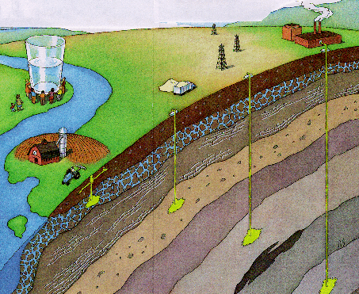
What is Underground Injection Control?
The practice of placing fluids (injectate) underground, in porous formations
of rock and/or soil, through wells or
other similar conveyance systems
Designed to:
protect underground sources of drinking water
provide a safe and cost effective means for industries, municipalities, and small businesses to dispose of their wastes
Linked with:
important industries: mining, oil & gas, petrochemical & industrial manufacturing;
many common-place practices: waste disposal in septic systems; storm water drainage, etc.
Notes:
What is underground injection????????????????
Program sets federal regulation for any hole in the ground “deeper than it is wide.”
UIC practices very far and wide, linked to some of the most critical industries………
3

Slide 4
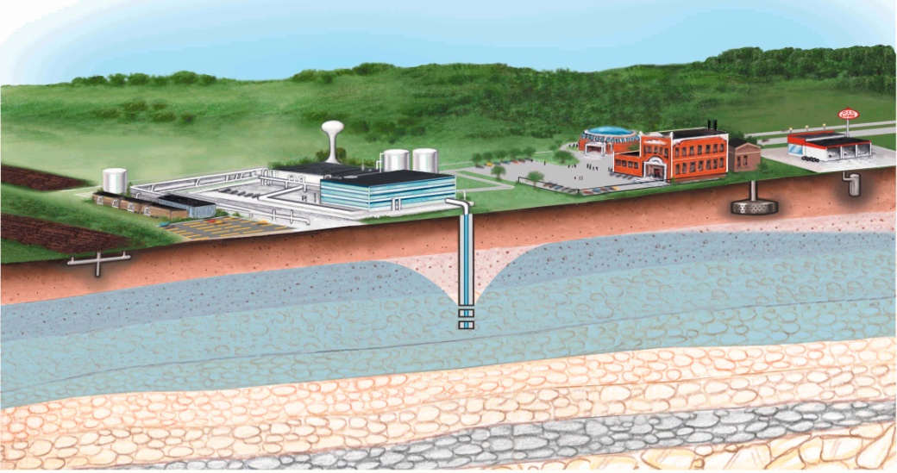
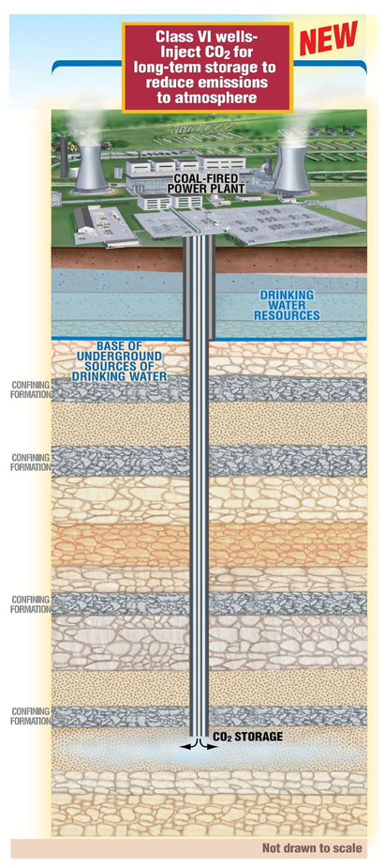
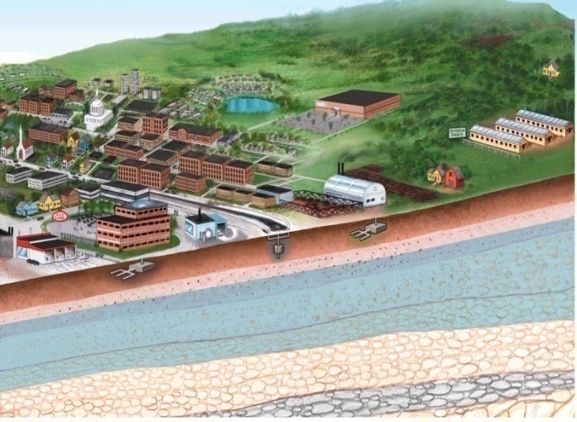
UIC Well Class
Class I
Class II
Class III
Class V
Class VI
Notes:
4

Slide 5
National UIC Data Flow
Data Source’s site
Schematron
69 Regional
and state
databases
ICIS Reports (ICDS)
(2)
XML Doc
State/DI XML Doc
OGWDW Management:
7520 summary info
UIC PAM Measures
UIC Inventory Reporting Sys
SWP/UIC Integration
Class I Special Needs
Class V Invent. Initiative
Congr/GAO/OMB Questions
notification
(1)
XML Conversion
Tool
CDX
(XML Doc
Repository)
Schematron
Staging Access
Database
Parse and Load XML Doc
notification
Standard reports
and ad-hoc queries
Backend Reports :
1. Backend invalid data
2. Changes from last data submission
Data ready for reports
UIC Operational Database
(Pre-Prod Database)
UIC Reporting Database
(Prod Database)
5
Notes:
Many of you may already be familiar with the National UIC Database System Framework. Over the last few years we have worked on identifying programs to begin the data flow process; establishing an easier way to complete the 5 step data flow process; establishing a thorough QA/QC process; and now we are focusing on transiting programs from existing reporting to electronic reporting.
5

Slide 6
Data Flow Status
Nationwide: 69 UIC programs (10 regions + 59 states/tribes)
Flowing Data : 31 programs (25 production + 6 test)
Mapping Data: 10 programs in various mapping phases
Remaining: 28 programs – 3 EN grantees FY12, 25 in target (15 environment agencies + 10 oil & gas agencies)

Slide 7
Benefits of UIC Data Flow
E-reporting:
Burden reduction for paper UIC reporting
1 of 10 EN priority data flows
Simple process:
Tools available to support for data flow
Flexible way to submit data
Data quality improvement & long-term cost saving:
Improve data quality
Increase automatic operation, reduce cost of staffs, do more with less
Easy access data

Slide 8
Data Flow Milestones
Logical Mapping Form
XML document/Staging UIC Database
Test Submission
Production Submission

Slide 9
Logical Mapping Form
Excel format, “UIC Logical Mapping Form”
A document of activities:
Identify data match in source data
Recognize if data is available in source data
Note if available data is in what forms: paper files, text, Excel, Access, etc.
A conceptual evaluation of data readiness for physical UIC transfer process

Slide 10
Logical Mapping Process
2.
Find equivalent data
1. Understand required data
3.
Document data found

Slide 11
a. Understand Required Data
Well centric structure
Data collection-- 4 categories:
Inventory
Compliance Monitoring
Violation/Enforcement
Class I and Deep Wells
Business Rules
2 levels: required 1 and required 2
Applying for table and data element

Slide 12
b. Find Equivalent Data
Where is the required data stored in the source? – electronic/paper file, table, column
How equivalent data element is? – one-to-one or one-to-many from the source
How many values are on each element? – one or multiple values exist in the source column
Is the data primitive or derived?

Slide 13
c. Document Data Found
Write equivalent data found or/and logic to get the required data in the Logical Mapping form
Indicate if data is not available, not in electronic form, not in similar data structure, etc.
Specify default values if used

Slide 14
XML document/UIC Staging Database
XML format, “Sample XML Instance File” or Access/Oracle format, “UIC Access Template”
Conformed UIC “XML Schema “ v.2 or UIC Staging Database template
A set of activities:
Extract data identified in the logical mapping form
Transform appropriate data format & data structure followed UIC Business Rules
Generate the transformed data to XML document, or
Load the transformed data to the Staging database template

Slide 15
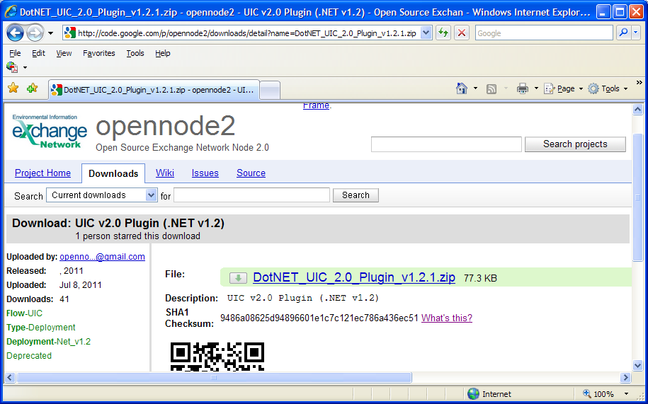
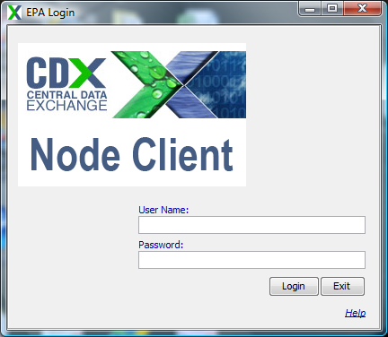
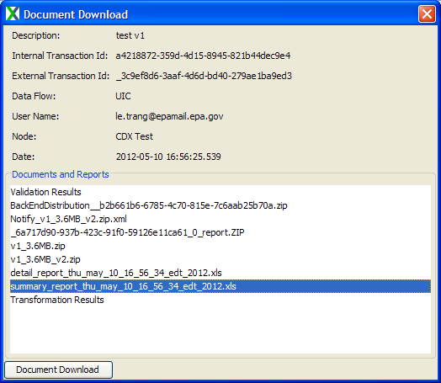
Available Mapping Tools
UIC v2.0 plugin (.NET v1.2)
Staging UIC Access Template
CDX Client
Submit data from either Access/Oracle database or XML doc
Validate Presubmission Data
Convert data to XML format

Slide 16
Test Submission
UIC NAAS Account
Submit data to CDX (“CDXTest”) via:
State Node – available only if data submitters having their own node
CDX Node Client (customized with UIC features) – available for all submitters, download at: http://test.epacdxnode.net/cdx_client/
Exchange Network Services Center – available for all submitters: https://enservices.epa.gov/login.aspx#
Review validation reports & correct data errors

Slide 17
Production Submission
Select “CDXProd” option when submitting to CDX
Review & discuss QA/QC comments from EPA
Adjust and resubmit the file if submitted data shows data quality issues (i.e., illogical to program implementation, unintended mapping errors, etc.)
Standard Operating Procedure (2012 UIC Data Submission SOP ): guidance for quarterly submission

Slide 18
Next Steps
Collaborate with State’s UIC program to flow UIC data & transition to e-reporting
Join ongoing UIC IPT 2 to understand data flow details and learn experiences sharing from other states
Evaluate technical program & resource requirements to flow data

Slide 19
Contact
UIC page on the EN Web site: http://www.exchangenetwork.net/data-exchange/underground-injection-controls
EPA Region:
UIC programs – Data Management Coordinators
EN Coordinators ,“EPA Regional Contact”: http://www.exchangenetwork.net/about/contacts/
EPA HQ:
Technical Questions
Carl Reeverts - (202) 564-4632
Trang Le - (202) 564-1572
Program Questions
Beth Hall – (202) 564-3883
Robert Smith - (202) 564-3880
Data Security Questions
Towana Dorsey - (202) 564-4099

Slide 20
Targeting UIC State Programs
Region | State or DI Agency | # of State/DI | UIC Data Management Coordinator (DMC) & EN Coordinators
 | (15 programs Class 1/3/4/5 – 90,773 wells) | Active Wells (2011)
1 | Connecticut Department of Environmental Protection | 710 | DMC: Gevon Solomon, 617.918.1513, solomon.gevon@epa.gov EN Coordinator: Ken Blumberg, 617.918.1084, blumberg.ken@epa.gov
1 | New Hampshire Department of Environmental Services | 7,623
1 | Maine Department of Environmental Protection | 1,927
1 | Rhode Island Dept of Environmental Management | 1,470
2 | New Jersey Department of Environmental Protection | 968 | DMC: Frank Brock, 212.637.3762, brock.frank@epa.gov EN Coordinator: Robert Simpson, 212.637.3335, simpson.robert@epa.gov
2 | PR Environmental Quality Board | 3,341
3 | Maryland Dept of Environment | 13,701 | DMC: Maria Conicelli, 215.814.5465, conicelli.maria@epa.gov EN Coordinator: Virginia Thompson, 215.814.5755, thompson.virginia@epa.gov
3 | West Virginia Department of Environmental Protection (all types, incl Class2) | 4,815
4 | GA of Natural Resources | 10,459 | DMC: Nancy Marsh, 404.562.9450, marsh.nancy@epa.gov EN Coordinators: Rock Taber, 404. 562. 8011, tabor.rock@epa.gov
5 | Wisconsin Department of Natural Resources | 1,662 | DMC: Bill Bates, 312. 886.6110, Bates.william@epa.gov EN Coordinator: Glynis Zywicki, 312. 886.4571, zywicki.glynis@epa.gov
6 | Arkansas Department of Environmental Quality | 294 | DMC: Ray Leissner, 214 665 7183, leissner.ray@epa.gov EN Coordinator: Laurie Carter, 214.665.6566, carter.laurie@epa.gov
6 | Louisiana Dept of Nat’l Resources (all types, incl Class 2) | 4,100
7 | Nebraska Department of Environmental Quality | 4,593 | DMC: Kurt Hildebrandt, 913.551.7413, hildebrandt.kurt@epa.gov EN Coordinator: Maryane Tremaine, 913.551.7430, tremaine.maryane@epa.gov
9 | Guam Environmental Protection Agency | 460 | DMC: Elizabeth Janes, 415.972.3557, janes.elizabeth@epa.gov EN Coordinator: Patricia Eklund, 415.972.3738, eklund.patricia@epa.gov
10 | WA Dept of Ecology and Water Quality Program | 34,650 | DMC: Kirk Robinson, 206. 553.2104, Robinson.kirk@epa.gov EN Coordinator: David Tetta, 206.553.1327, tetta.david@epa.gov

