Slide 1
REST and the Exchange Network
5/30/2012

Slide 2
REST
REST stands for Representational State Transfer

Slide 3
REST
REST stands for Representational State Transfer
It should have been called: DUDE
  Dynamic URL Data Extraction
  Dude enters a URL with some parameters then data is extracted dynamically.
  or
  http://www.waterqualitydata.us/Station/search?characteristicName=Atrazine
  (web site) (service Name) (Parameter)
  In other words, the way the web works

Slide 4
REST Strengths
Good support for basic web publishing
Can support public queries with small payloads
User-friendly , requires little training
Discoverable via web search engines
Supports smaller devices where computing power and resources are limited.
  smart phones,
  net books
  tablets

Slide 5
How can REST help us?
REST offers an intuitive way of publishing and consuming information
REST can help to improve access to environmental information
If we build REST services based on standards:
  It will make consuming REST services fun and easy
  Powerful tools can be used to access REST services

Slide 6
REST Guidance
Follow REST Standards
Design REST services for users and tools
Catalog REST services for discovery and tool integration
Support multiple file types for output if possible (e.g. JSON for web applications)
Develop REST services for meta data automation (value lists etc) for tool automation

Slide 7
New EN REST Support
REST Support added to the Discovery Services
REST Service Center Prototype
REST Service (proxy)
  Support added for services on all EN Nodes
  Reengineered to support the latest REST specification
REST Service Standard Drafted
7

Slide 8
REST Discovery Mapping
A REST Server is mapped to the “Node” in the data model.
  It must have a domain name in the URL
  http://www.waterqualitydata.us
The dataflow value for REST services is REST-WS
  Differentiates them from SOAP services
The REST Service maps to the Node Service.
  It also has a URL: /myservice?param1=value1
Parameters map to Node parameters

Slide 9
REST Service Center Demo
Water Quality Portal
  Search Station (REST Service)
Facility Registry System (.NETNode)
  FacID_V3.0
    Get Facility List (SOAP Service) via REST Service proxy

Slide 10
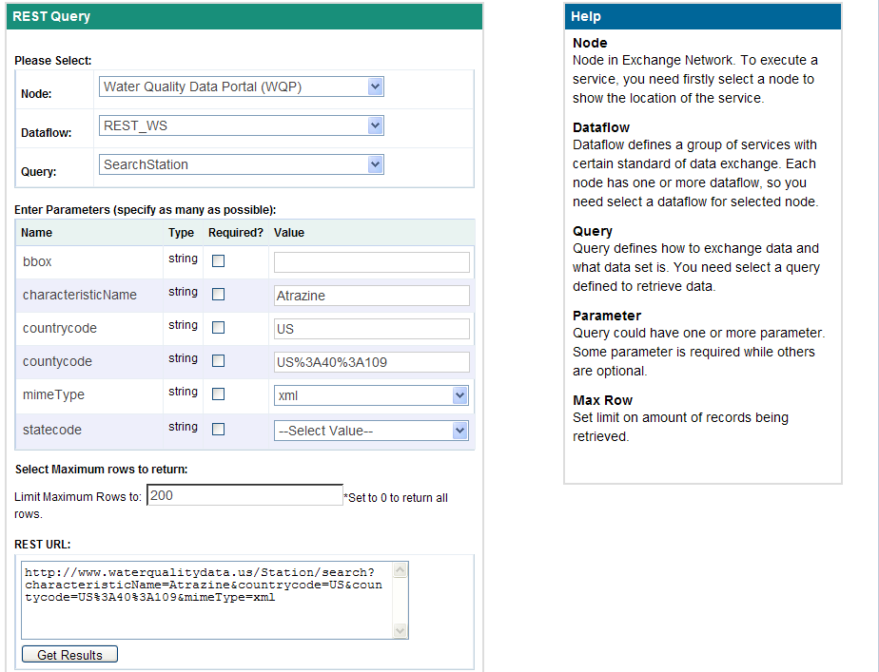
REST Query Builder Prototype

Slide 11
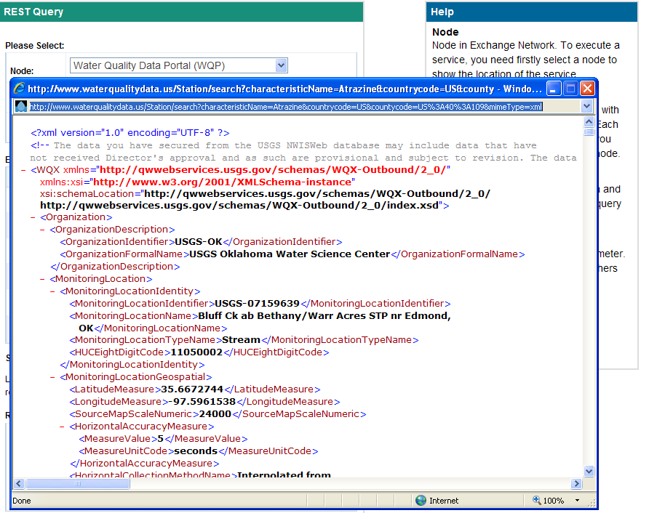

Slide 12
EN REST Service (proxy)
REST URLs for are translated into SOAP queries and sent to the appropriate Node.
This is a shared EN service that is available in CDX on the .NET Node
Maximizes reusability for data publishing by making query services on the Network available from REST

Slide 13
EN REST Service
EN Node
EN Node
REST
REQUEST
SOAP
REQUEST
EN Node
REST
Service
Proxy
SOAP
Response
REST
Response
Browser
User

Slide 14
REST Service Architecture

Slide 15
SOAP and REST
REST complements and extends our Exchange Network architecture
REST
  Adds a new dimension to the Exchange Network
  Is an important mechanisms for data publishing
  Is best for user interfaces
SOAP
  Services lay out a heavy duty framework for complex business processes
  Can automate any data exchange including asynchronous ones
  Is best for programming interfaces
The Exchange Network should :
  Promote technologies both in different application scenarios
  Avoid pushing either technology too far - beyond their limitations

Slide 16
Next Steps
Finalize the REST URL standard format
Create Best practices guidance for REST services
Simplify REST registration by adding a public site for registering REST Services
Recommend support for all easily returned formats
Recommend Format/File type Parameter e.g. mimetype=JSON

