Slide 1

Introduction to the Exchange Network
January 9th, 2012

Slide 2
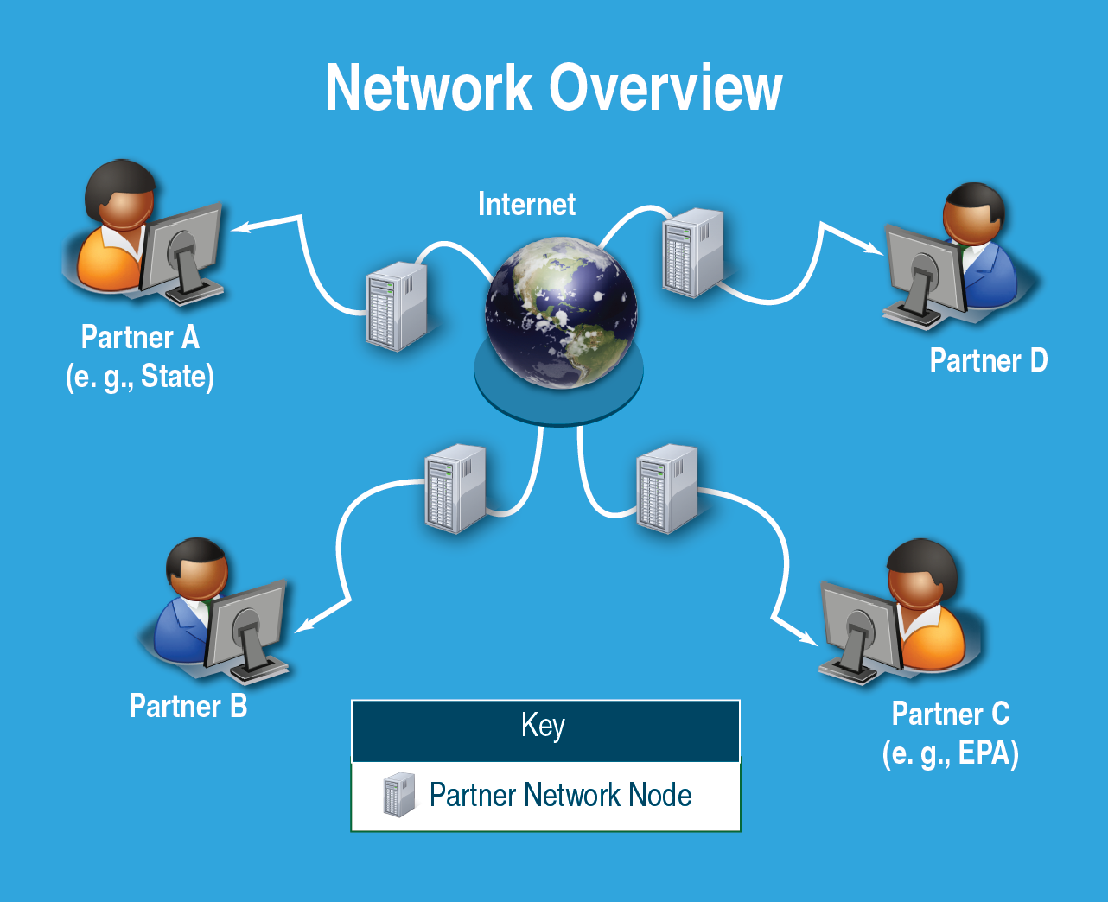
What is the Exchange Network?
A partnership to support better environmental decisions through improved exchange of and access to environmental information.
Notes:
ORIGINAL

Slide 3
What is the purpose of the Network?
The Exchange Network is a system that enables:
Automated and efficient data sharing
Higher data quality through standardization
On-demand access to timely environmental information
Integration of information across environmental interests and jurisdictions
Better decisions about protecting the environment and human health

Slide 4

What does the network do?
Comprehensive Internet-based data system for securely exchanging environmental and public health information among partners.
Enables EPA’s partners to automate data reporting to the Agency
Allows partners to access each other’s data
Allows agencies to have better data available to support decision making and improve environmental quality.
Key Elements

Slide 5
Network Building Blocks
Data and Technology Standards
Tools and services
Secure data exchanges
Notes:
Notes:
Data and Technology Standards that allow for data to be shared regardless of the technology
Tools and services that help integrate, analyze and report data
Secure data exchanges over the Internet

Slide 6
Why are EPA and its Partners building the Network?
Eliminates paper-based, manual processes thereby saving resources and time
Simplifies data entry and eliminates redundancies
Provides quick, real-time, and valid data

Slide 7
Network Development
Phase 1
Focus on reporting by EPA’s partners to Agency priority systems
Phase 2
Exploring ways to expand the network
Notes:
Notes:
Optimize the Network:
Expanded data publishing
Inter-partner data exchanges
Cross-media data integration
Regional data sharing (watersheds and air sheds)
Reduce costs and complexity of being a network partner
Move to cloud

Slide 8
Business Value of the Network
Improves data validity, timeliness, security and accessibility
Provides shared services and improves communication among EN partners and their systems
Empowers program staff and managers by making data more accessible and easy to integrate and analyze
Supports open government and transparency efforts

Slide 9
What is an EN node?
Nodes
Requests and responses use eXtensible Markup Language (XML)
Software allows nodes to communicate to each other without human intervention
Use standardized tools and technology neutral components
The Central Data Exchange (CDX) is EPA’s node on the Exchange Network
A partner’s point of presence though which it exchanges data
Sends and responds to requests via the Internet
A computer (technically known as a web server)

Slide 10


Who Participates in the EN?
Exchange Network Partners:
Other Federal Agencies
National Congress of American Indians
Environmental Council of the States
EPA
50 states/ 87 Tribes/ 5 Territories
Program Offices
Regions
OEI

Slide 11
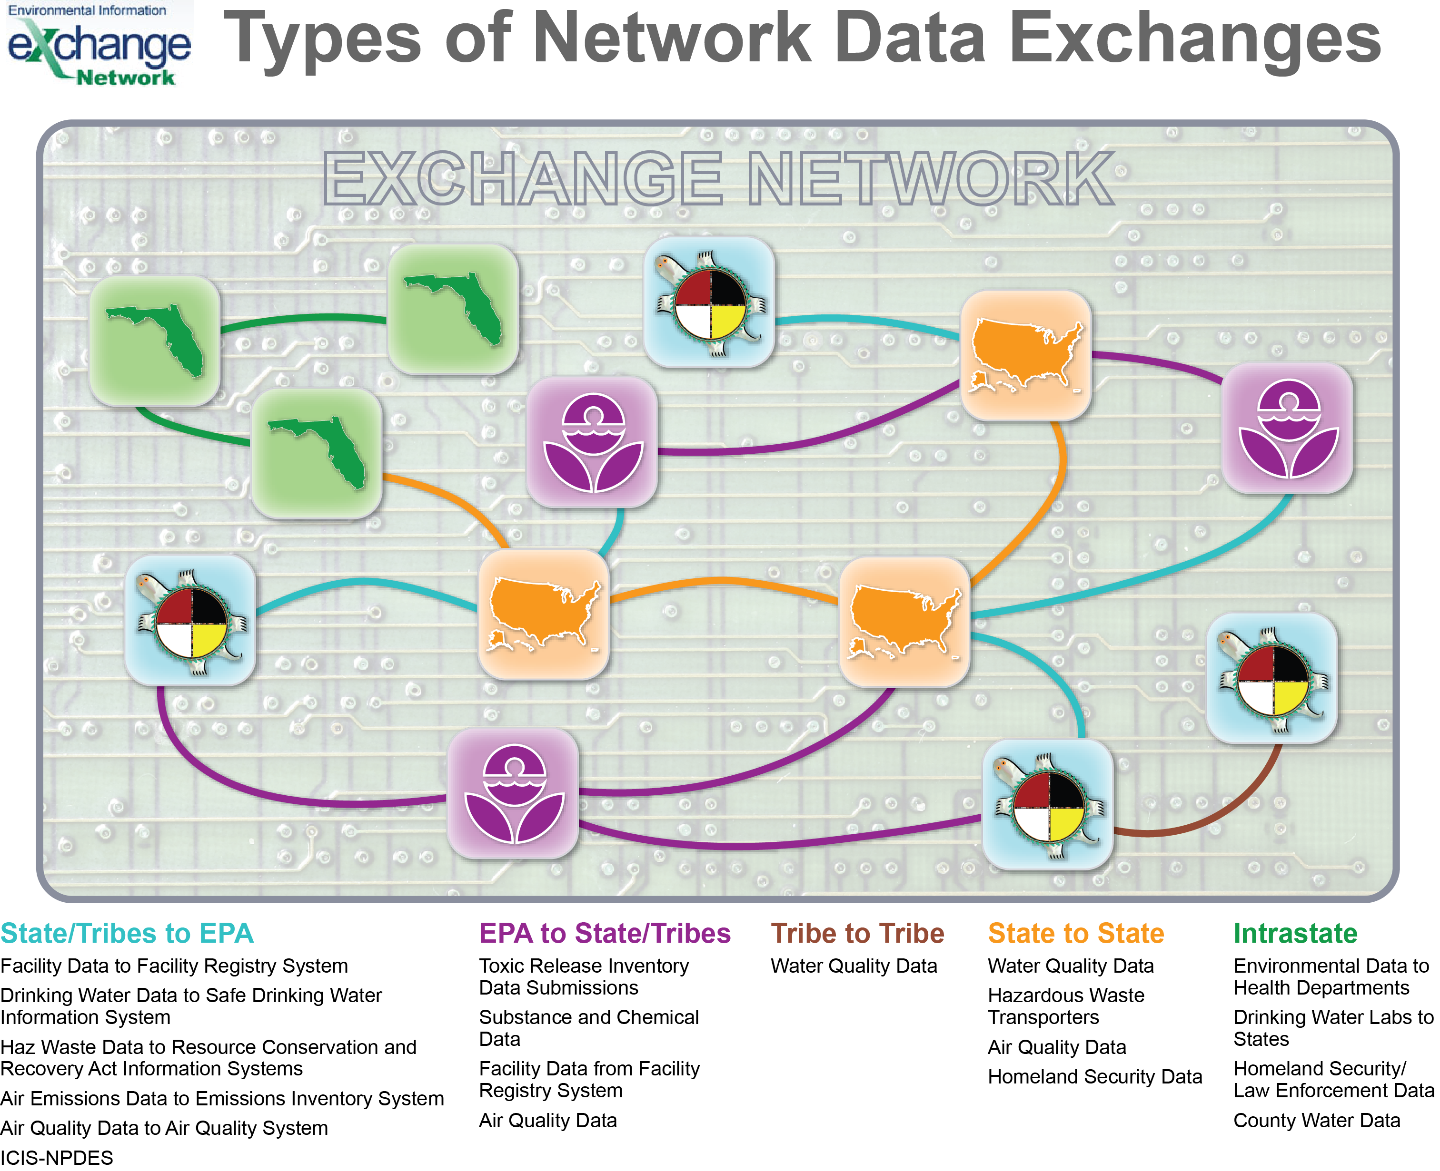

Slide 12
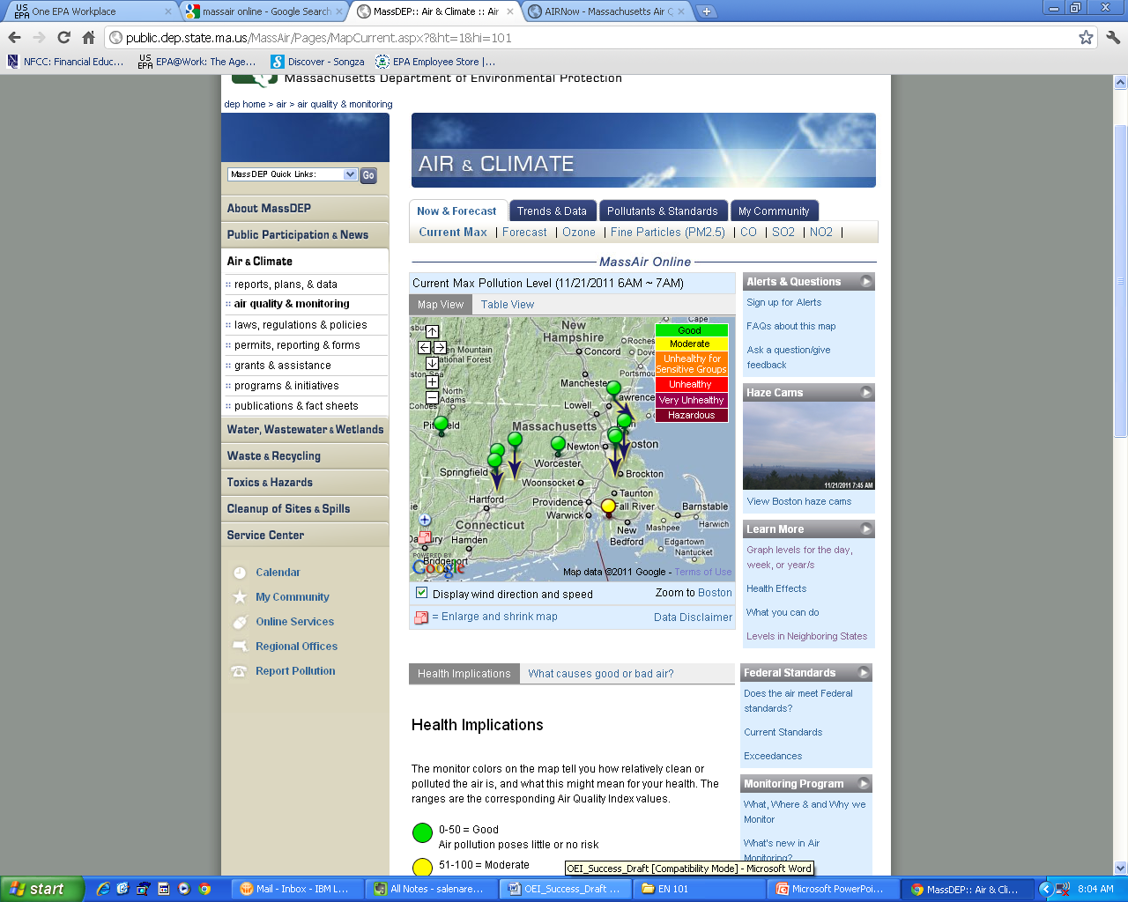
Examples of Success
MassAir Online
  Near real time access to data (1 hour delay)
  Automated QA
  Services that can be reused by other partners
Notes:
Look up photos from thesis.

Slide 13

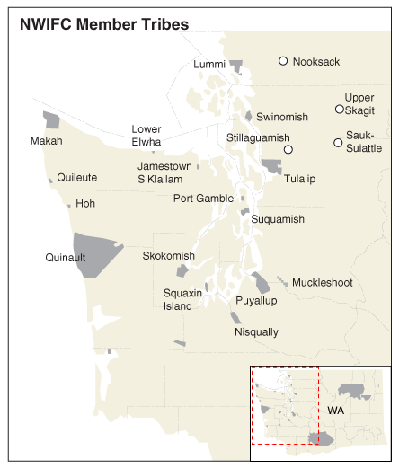
Examples of Success
Northwest Indian Fisheries Commission
  Regional water quality network
  Reporting water quality data from 20+ tribes
  Regional “supernode” model that can be reused by other tribal consortia

Slide 14
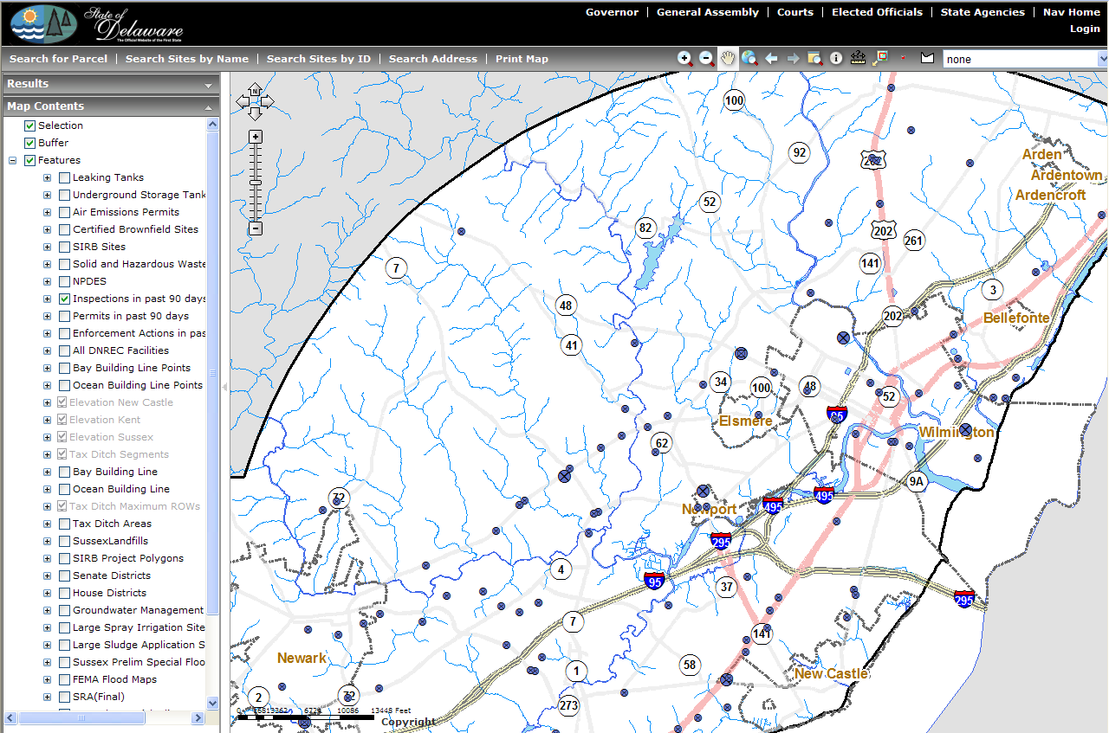
Examples of Success
Delaware UIC
  Created Delaware Environmental Navigator (DEN) to house environmental data on class V wells
  Users can perform queries and map data
  Promotes transparency and supplies quality assurance

Slide 15

Committing Resources to the EN
Since 2002, 574 grants worth $165 million
399 awards worth $132 million to states
132 awards worth $22 million to tribes
13 awards worth $2.4 million to territories
ECOS award for associated program support $8 million
Awarded 56 grants worth $9.6 million in FY 2011
42 awards worth $7.4 million to states
12 awards worth $1.8 million to tribes

Slide 16
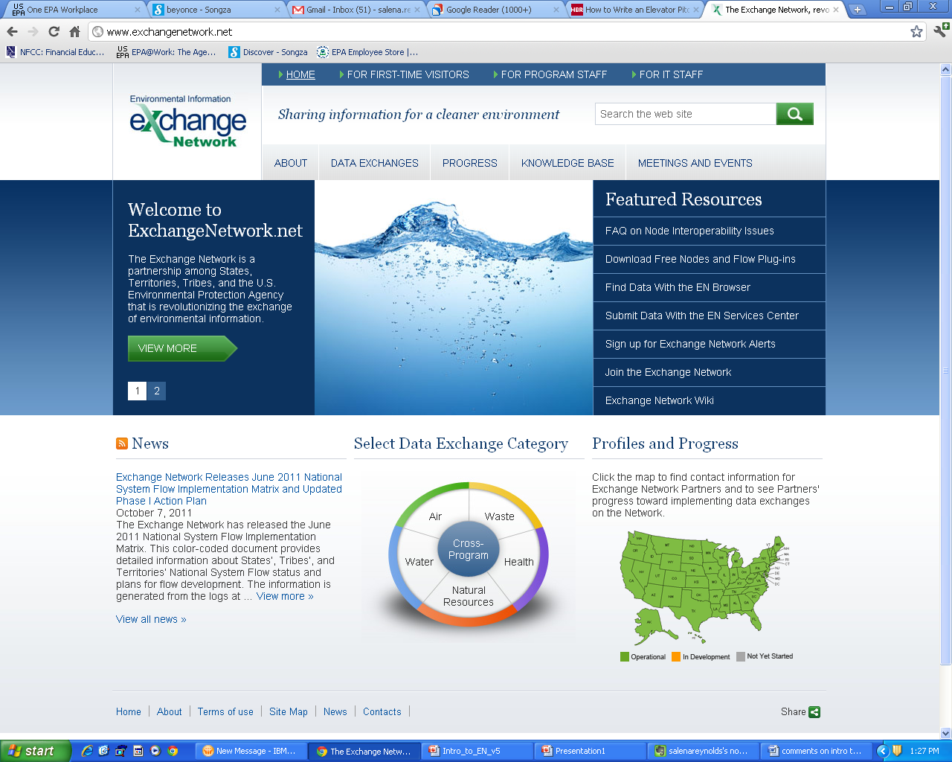
For more information on the EN
www.exchangenetwork.net
News
Policies
Documentation
Technical specifications
Success stories
Governance Information
Sign up for Exchange Network Alerts
www.epa.gov/exchangenetwork
EN Grant information
http://www.exchangenetworkwiki.com/wiki/index.php/Main_Page
Exchange Network Wiki

Slide 17
EN Contacts
Regional Coordinators
Ken Blumberg, Region 1
(617) 918-1084
Bob Simpson, Region 2
(212) 637-3335
Virginia Thompson, Region 3
(215) 814-5755
Rock Taber, Region 4
(404) 562-8011
Glynis (Gigi) Zywicki, Region 5
(312) 886-4571
Zenny Sadlon, Region 5
(312) 886-6682
Headquarters
Connie Dwyer, Director
Information Exchange and Services Division
(202) 566-1691
Jonathan Jacobson, Chief
Information Exchange Partnerships Branch
(202) 566-1984
Exchange Network Coordinator
Kurt Rakouskas
(301) 531-5186
Laurie Carter, Region 6
(214) 665-6566
Maryane Tremaine, Region 7
(913) 551-7430
Josie Lopez, Region 8
(303) 312-7079
Christine Vigil, Region 8
(303) 312-6992
Patricia Eklund, Region 9
(415) 972-3738
David Tetta, Region 10
(206) 553-1327

