Slide 1
Exchange Network Essentials II
Exchange Network National Meeting
Philadelphia, PA
5/30/2012

Slide 2
Agenda
Network Terminology
  Alphabet soup
Network Technology
  XML
  Web Services
Tools for Using the Network
  Software and services
Practical Examples of Using the Exchange Network

Slide 3


Network Alphabet Soup
The Exchange Network
is Mmm Mmm Good!
Yep. But all these
letters are killin’ me…

Slide 4
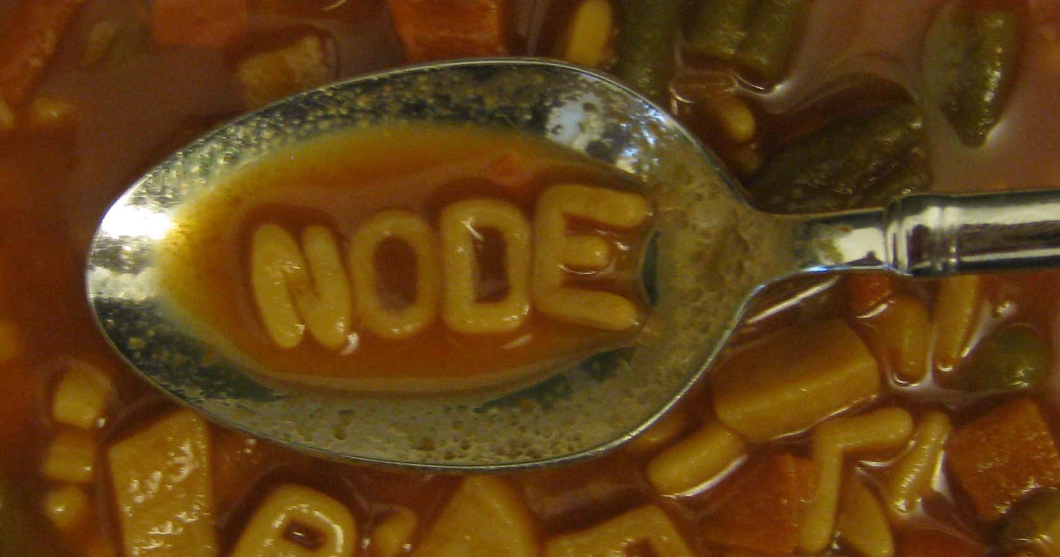
Network Terminology
Node
A partner’s portal for providing and receiving information via the Exchange Network.
A Node is just a piece of software running on a web server.
The Exchange Network Node Functional Specification defines how a Node must make and respond to requests for information.
Required for automated data sharing or data publishing
Several flavors of Node software are available for free download on the Exchange Network website

Slide 5
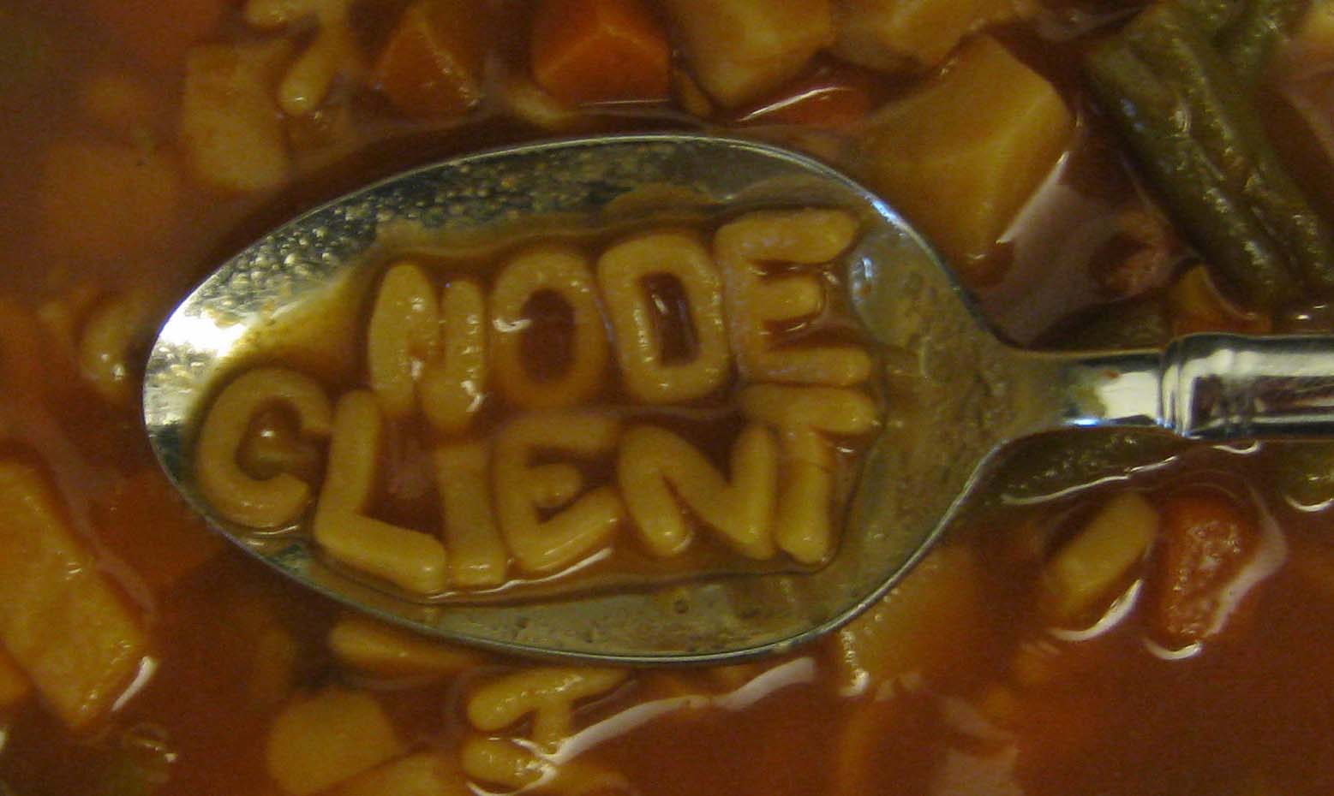
Network Terminology
Node Client
Software that can interact with a Node by submitting data, requesting data, or receiving results.
Node Clients can initiate conversations on the Network but they can’t respond to requests.
  A Node is to a Home Phone as a Node Client is to a Pay Phone
Node Clients can be standalone desktop clients, web-based, or built into other software applications.
Often appropriate for partners with less complex data sharing needs or a desire to make manual submissions.

Slide 6
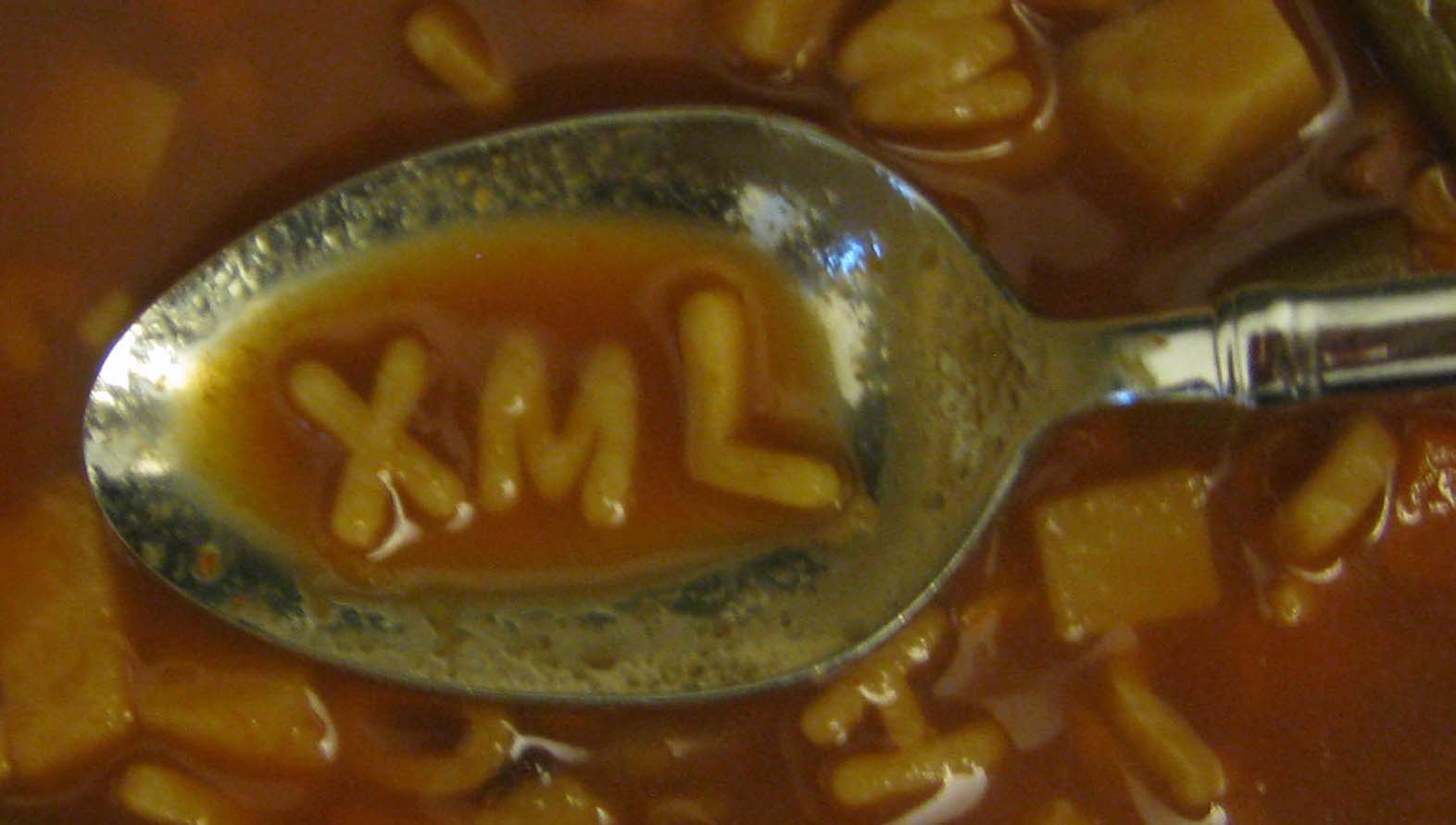
Network Terminology
eXtensible Markup Language
XML is a text-based format for representing data in a flexible and structured way.
XML is the primary format for data sharing on the Exchange Network
Data are tagged with descriptive names and structured to enable automated, machine-to-machine exchanges
Data exchanges have a schema that defines the proper structure of an XML file
More on XML later…

Slide 7
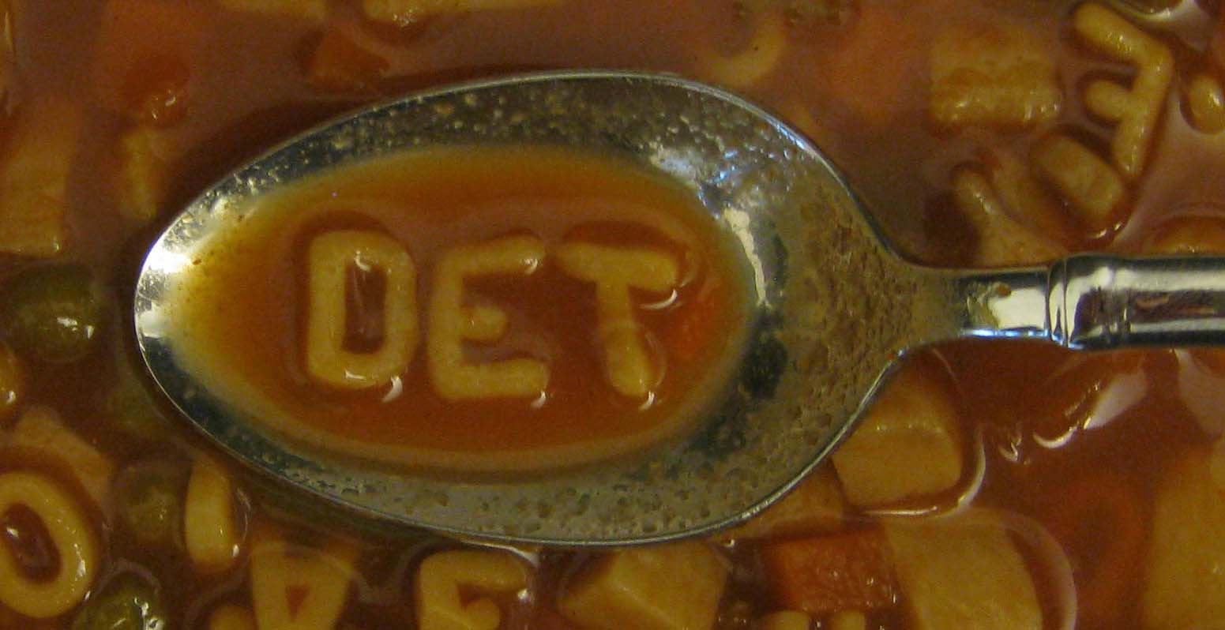
Network Terminology
Data Exchange Template
Document that lists the data elements included in a data exchange along with their definitions and validation rules.
DETs are more human-readable representations of XML schema
Useful for helping partners map information in source databases to the schema
DETs are required documentation for any Exchange Network data exchange
A standard template for DETs is available on the Exchange Network Website.

Slide 8

Network Terminology
Flow Configuration Document
The document that identifies and standardizes a data exchange’s technical configuration and business processes.
Defines available web services and allowable query parameters
Basic instruction manual for exchanging data on the Network
FCDs are required documentation for any Exchange Network data exchange
A standard template for FCDs is available on the Exchange Network Website.

Slide 9
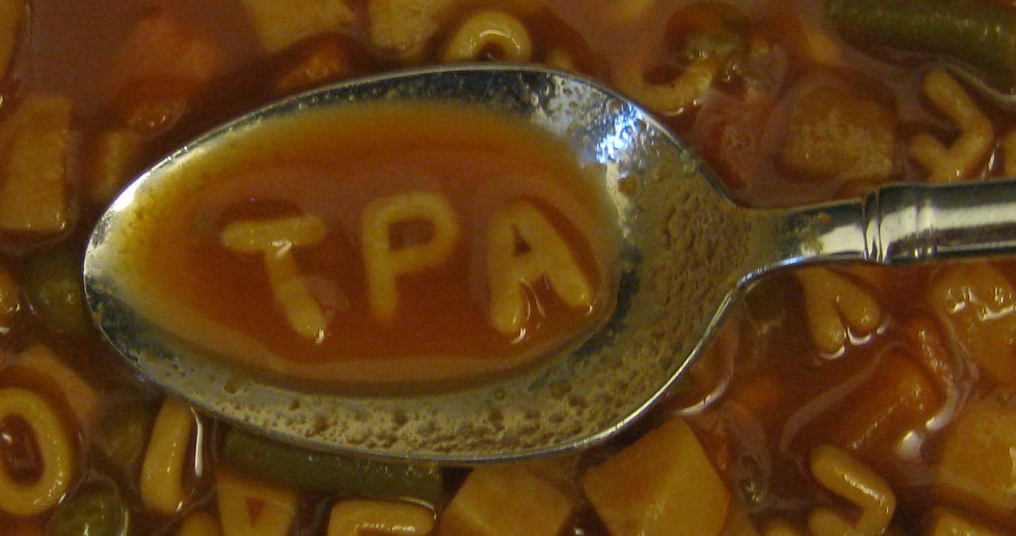
Network Terminology
Trading Partner Agreement
Defines responsibilities in data stewardship, security, and other items for the effective exchange of information
Intended to encourage partners to clarify the use, ownership, type, quality, and frequency of data exchanged.
Used in the absence of other written agreements that define a data sharing relationship
  (Performance Partnership Agreements/Grants, Cooperative Agreements, etc.)
Guidance on creating TPAs is available on the Exchange Network Website

Slide 10
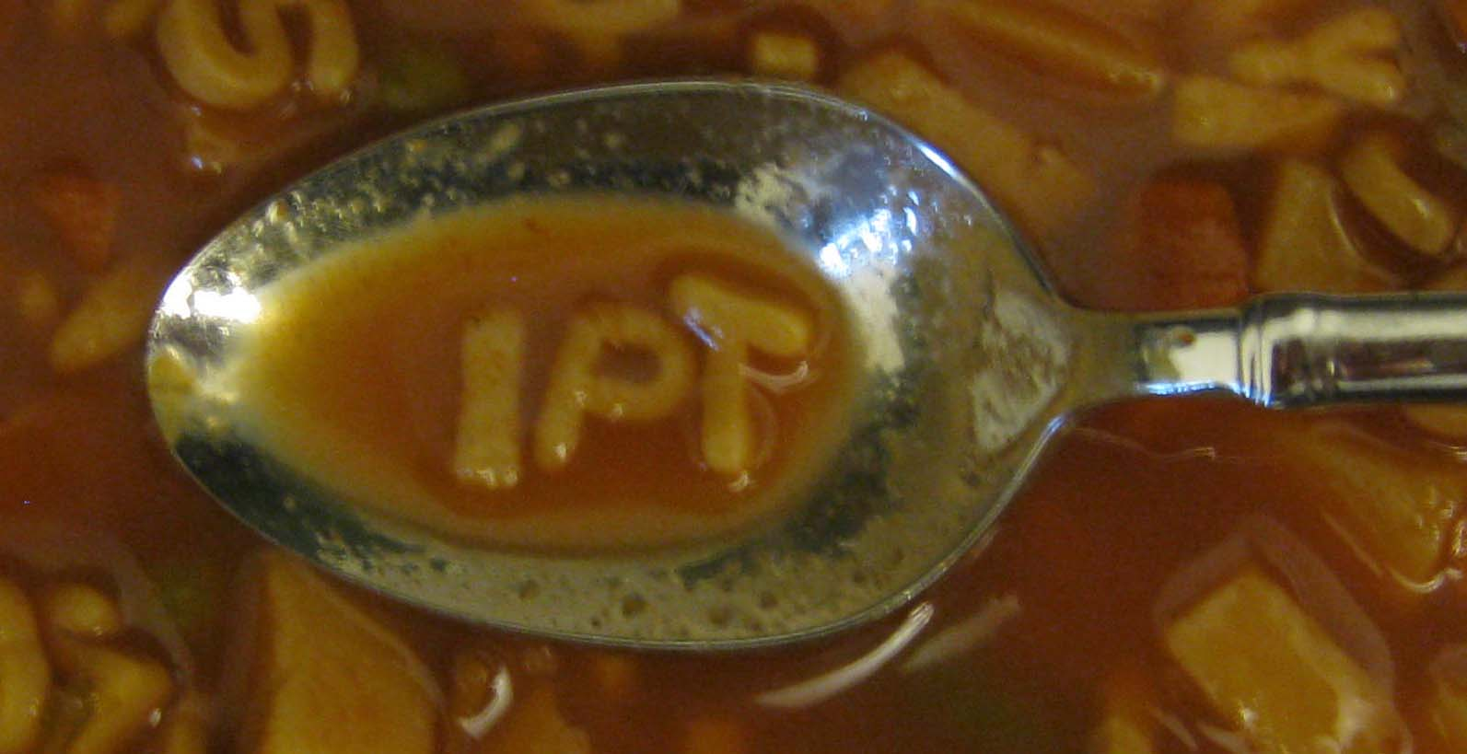
Network Terminology
Integrated Project Team
A cross-disciplinary group of individuals organized to design and implement a specific data exchange.
Successful IPTs include individuals with a mix of business and technology skills that represent multiple stakeholders
May be initiated by anyone with an idea
IPTs currently exist for Drinking Water, Water Permit Compliance Data, Greenhouse Gas Emissions, others…

Slide 11
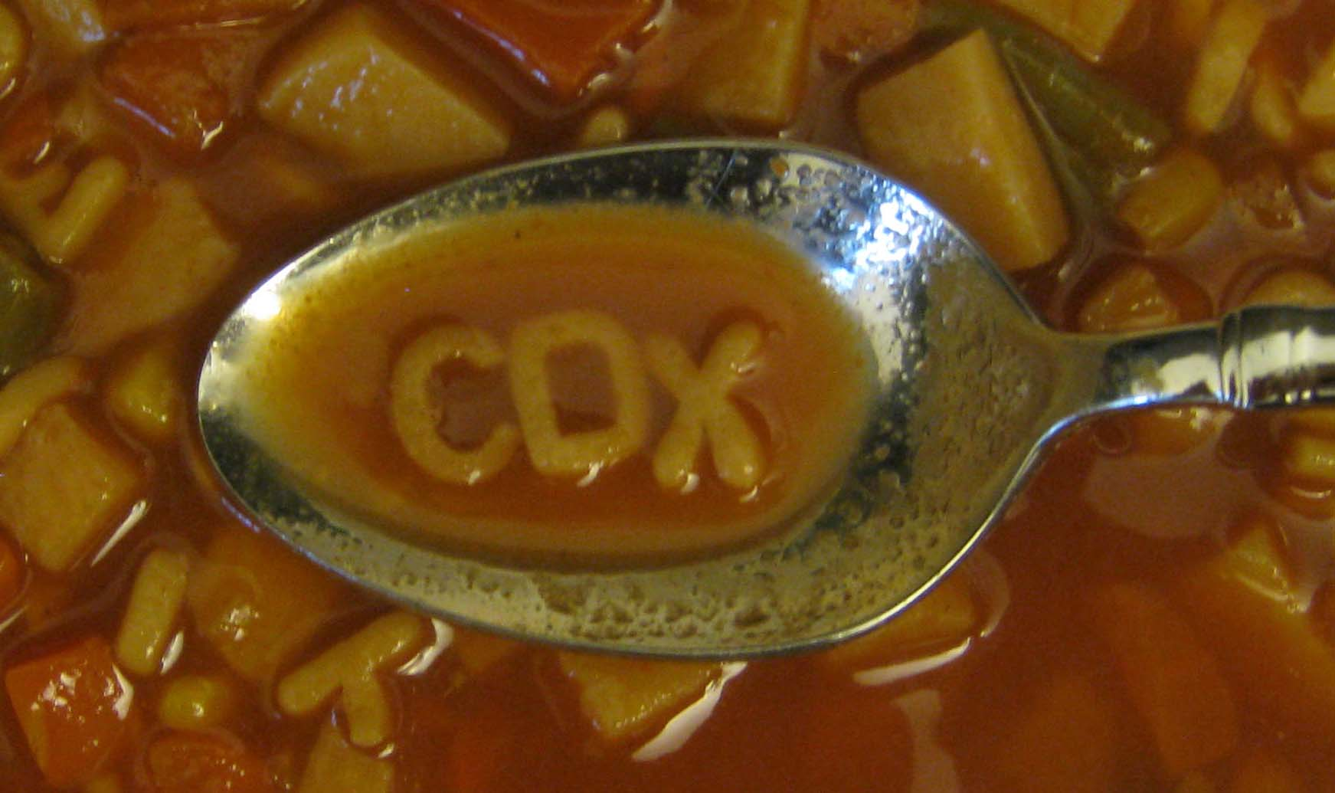
Network Terminology
Central Data Exchange Node
Node which manages information coming into and out of U.S. EPA on the Exchange Network.
CDX Node addresses (URLs) vary by flow
  A complete list is available on the Exchange Network website
CDX Node should not be confused with CDX Web

Slide 12
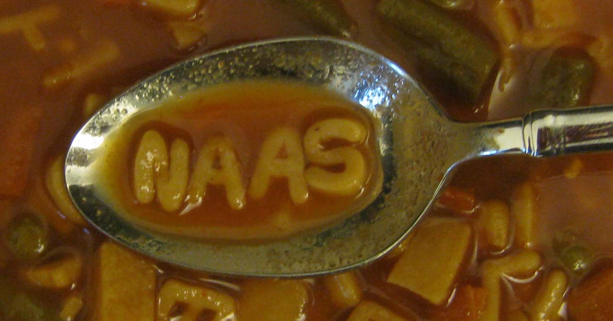
Network Terminology
Network Authentication & Authorization Service
Security service that partners can use to authenticate and authorize data users.
Central service managed by U.S. EPA for the entire Network
Allows partners to control access to their data
  Node administrators can decide who to friend
Many Node software products allow you to administer NAAS accounts and policies

Slide 13

Network Terminology
Exchange Network Discovery Service
Provides an automated system for describing, cataloging, and discovering Exchange Network data services
Central service managed by U.S. EPA for the entire Network
Acts as a phonebook for the Network
  Who has what data?
  How can I access it?
Powers tools such as the EN Browser and the EN Services Center

Slide 14




Network Terminology
Exchange Network Leadership Council
Establishes strategic direction and provides the Network with political support and leadership. The Honchos.
Network Operations Board
Oversees the day-to-day operations of the Exchange Network. Establishes and maintains procedures, standards, and guidance.
Network Partnership and Resources Group
Subgroup of the NOB responsible for communications, outreach, and resource planning.
G
Network Technology Group
Subgroup of the NOB provides direction for the management of Network technology and infrastructure. Implements technical and operational decisions made by the NOB.
G

Slide 15

Network Terminology
Cross-Media Electronic Reporting Rule
Rule that sets standards for systems that receive electronic reports from facilities regulated under EPA-authorized programs
States and tribes with electronic reporting systems must receive CROMERR approval from US EPA
Most, if not all, transactions on the Exchange Network are not subject to CROMERR
More opportunities to learn about CROMERR throughout the meeting

Slide 16
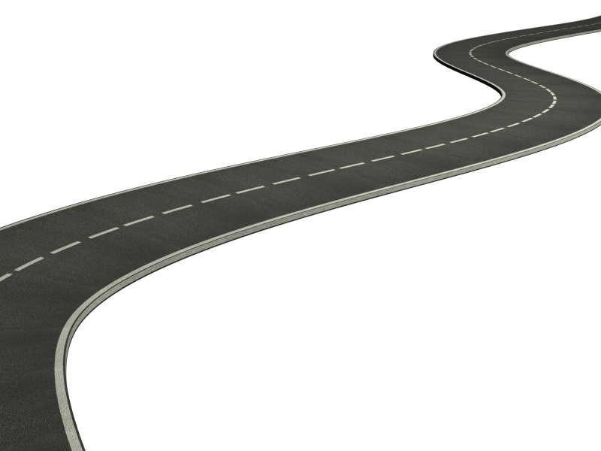
Network Technology
It starts with the Internet
  A generic foundation that
  supports a variety of transport
  options
  “Traffic” can come in a variety of vehicles
  - Web Browsers
  - Mobile Apps
  - Exchange Network data…

Slide 17
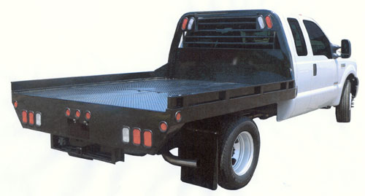

Network Technology (cont’d)
  Web Services are the trucks
Data Express
                XML documents are the cargo
Nodes implement Web Services
Flows define the XML documents and the workflow (driving directions)

Slide 18
Network Technology (cont’d)
Nodes are the trucks
  Think of a node as a generic tool to transport the data to/from partners
Flows or Exchanges are the cargo
  Flow documentation defines:
    The cargo (in specific XML file formats)
    the driving directions (the workflow)

Slide 19
XML (eXtensible Markup Language)
PermitNumber | IssuedDate | PermitStatusText
WA000111 | 6/23/2003 | Expired
WA000222 | 1/23/2009 | In Effect
WA000333 | 5/12/2010 | Pending
Nothing more than a text file
A format for representing data in a flexible, structured way
Consider a list of permits:

Slide 20
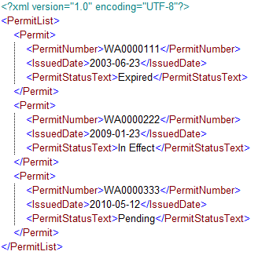
XML (eXtensible Markup Language)
Same list of permits as XML:

Slide 21
XML (eXtensible Markup Language)
Tags wrap data:
<PermitNumber>WA0000111</PermitNumber>
Tags can be empty:
<PermitNumber/>
Tags can wrap other tags to create a group:
  <PermitList>
  <PermitNumber>WA0000111</PermitNumber>
  <PermitNumber>WA0000222</PermitNumber>
  <PermitNumber>WA0000333</PermitNumber>
  </PermitList>

Slide 22
XML Schema
A schema describes the structure of an XML file
Can be used to prove an XML file is valid
Enforces element data types
  (string, date, integer, boolean, etc.)
Can limit an element to a list of allowable values (lookups), patterns (e.g. email address), etc…
Cannot do cross-field validation!
  Other technologies needed
An XML schema is itself an XML document

Slide 23
XML Schema (cont’d)
“Well formed” vs. “Valid” XML files
  Well Formed
    Every element has an opening and closing tag
    Do not need a schema to check that an XML file is well formed
  Valid
    Means an XML file conforms to the structure prescribed in the schema

Slide 24
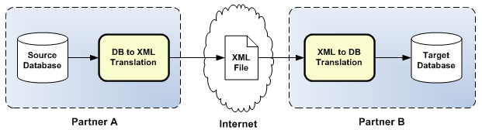
XML on the Exchange Network
XML is almost exclusively used on the EN to copy data between partner databases

Slide 25

Creating XML files
There is a multitude of tools to create XML
  Developers:
    Directly from database query
    Software development toolkits
    Altova MapForce
  Business Users:
    Purpose-built software
      EIS Bridge
      Beach Notification Access Database
New projects will likely require a
technical person to design and build
Open source nodes have canned software to create XML for various Exchange Network flows

Slide 26
What are Web Services?
A web service defines how two pieces of software communicate over the internet
A series of protocols and rules for interoperating
  A Server provides the data
  A Client consumes the data
Each node on the Exchange Network is both a server and a client.
  Can request data from another node
  Can make data available for
  other partners to come and get

Slide 27

Web Services (Cont’d)
Two dominant web service technologies:
  SOAP and REST
SOAP
  The chosen technology of the Exchange Network
  Uses formally defined and adopted protocols
  Good at supporting very large messages
  Enforces a formal contract between sender and receiver
  Mostly used for enterprise integration of
  two or more systems over the web

Slide 28

Web Services (Cont’d)
REST
  Not officially supported by the Exchange Network (yet)
  Very simple to implement, just need a web address (URL) to request data from a partner
  Far less structure/rigor compared to SOAP conventions
  REST is the #1 web service technology in use for pulling data from a third party and integrating it into an application (“mashups”)
  Not really ideal for submitting data
    http://www.waterqualitydata.us/portal.html

Slide 29
Exchange Network Tools
Demo of Exchange Network Browser
Preview of Exchange Network Services Center
Accessing Open Source Nodes and Node Clients

Slide 30
Data Exchange Scenario #1:
Submitting Data to a Partner
Agency to EPA:
  EIS – Emissions Inventory System
  WQX – Water Quality Exchange
  RCRA – Hazardous Waste Data
  ICIS-NPDES – Wastewater Data
EPA to Agency:
  TRI – Toxic Release Inventory
Not just to EPA, but also regional exchanges
  PNWWQX – Pacific Northwest Water Quality
  WQX - Tribes to NWIFC
Interagency Exchanges (DEQ to DOH)

Slide 31
Submitting Data over the Exchange Network
Sender
Receiver
1. Prepare XML
2. Submit XML
Submit Response
3. Get Status
Get Status Response
4. Download
Download Response

Slide 32
Data Exchange Scenario #2:
Querying Data from a Partner
Requesting data from a partner can be done in two ways: Query or Solicit
Query
  Immediate response is returned
  Ideal for getting smaller data sets
Solicit
  Request the data, but come back later to download it
  Server provides a Transaction ID to track the request
Both Query and Solicit support parameters for passing in criteria

Slide 33
Querying Data over the Exchange Network
Requester
Data Provider
1. Query
Query Response
Request:
“Get Facility By Name”
Parameters:
Facility Name: “ACME”
<FacilityDetails>
<Facility>
<FacilityName>ACME, Inc.</FacilityName>
<Address>123 Main St.</Address>
<CityName>Denver</CityName>
. . .

Slide 34
Soliciting Data over the Exchange Network
Requester
Request:
“Get Facility By Name”
Parameters:
Facility Name: “ACME”
Receiver
1. Solicit
Solicit Response
3. Get Status
Get Status Response
4. Download
Download Response

Slide 35
Contact Information
Bill Rensmith
Windsor Solutions
bill_rensmith@windsorsolutions.com
503.675.7833
Kurt Rakouskas
Network Coordinator
kurt@exchangenetwork.net
301.531.5186

Slide 36
Questions?

