Slide 1
Using Direct WQX Synchronization to Avoid WQX Submission
(Open Source) Water Quality Data Management with Embedded WQX Synchronization
Rebecca ColemaN – Muscogee (Creek) Nation
FRANK HARJO – Muscogee (Creek) Nation
Doug Timms – Open-environment.org
May 31, 2012

Slide 2
Presentation Outline
Muscogee (Creek) Nation WQX Solution
Project Background
Project Requirements
Review of Existing Solutions
Open Waters - How we address these issues
Demo
Current Limitations / Lessons Learned
Open Source Publishing:
Best Practices
Recommendation for Exchange Network

Slide 3
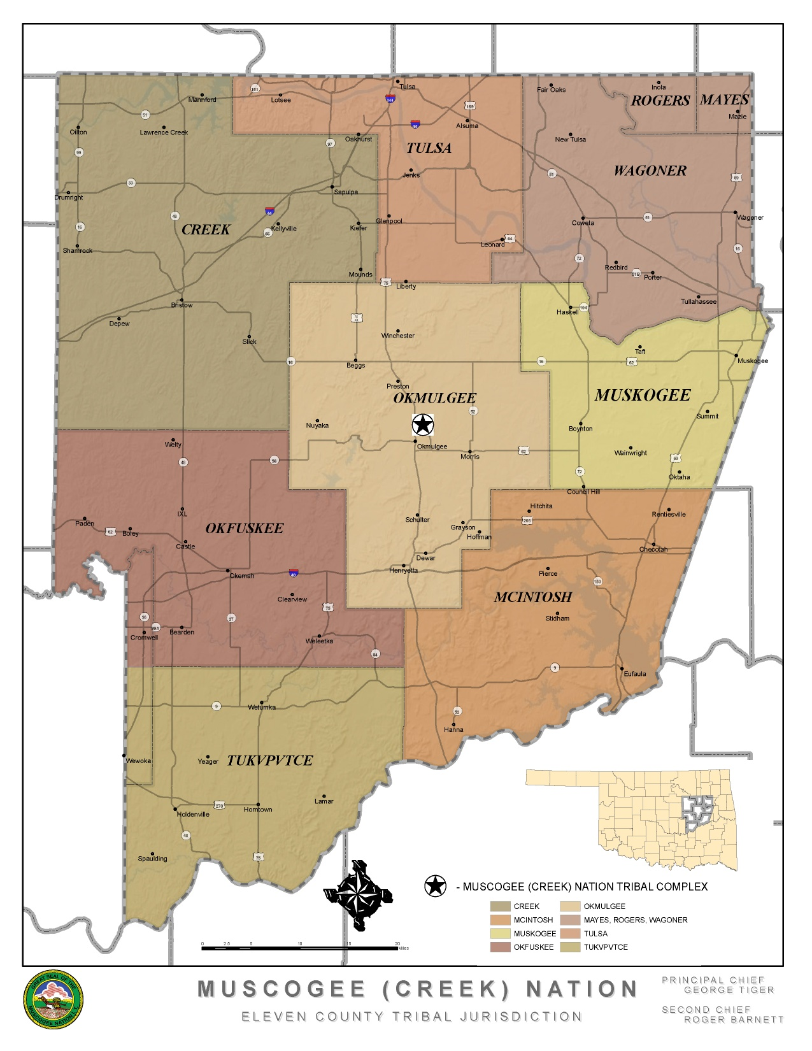
Muscogee (Creek) Nation
Okmulgee, OK located 30 miles south of Tulsa, OK
Over 70,000 Tribal Citizens
Tribal Jurisdiction covers 4,867 sq miles
Tribal Jurisdiction includes parts or all of 11 counties

Slide 4
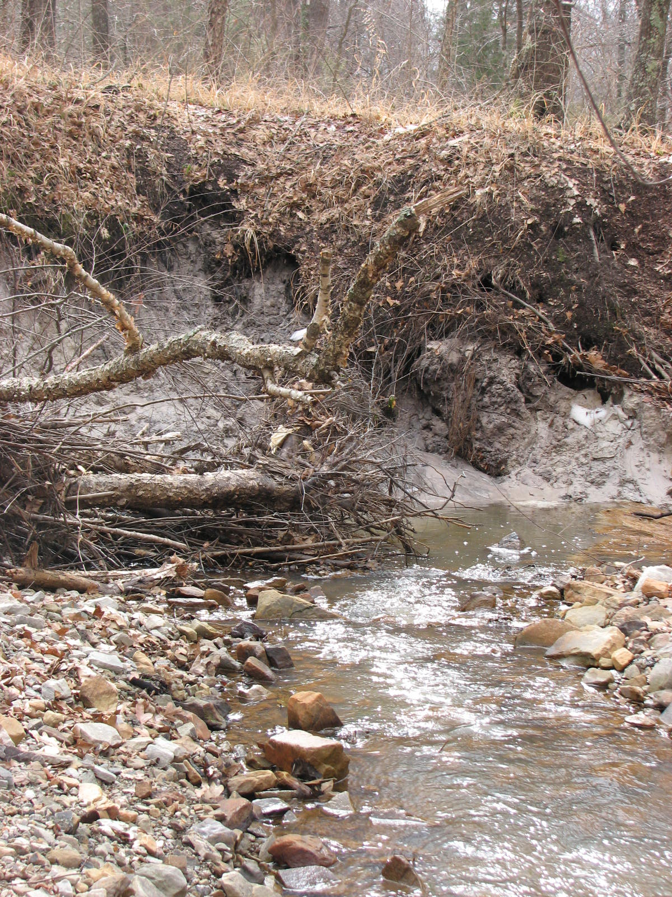
Muscogee (Creek) Water Quality Program
Began monitoring with Clean Water Act, Section 106 EPA funding
Program has expanded to include eight different sites & biological testing
In the process of developing in-house laboratory for water quality parameters
Working on expanding the water program to include analysis and other types of sampling

Slide 5
Past Data Challenges
No centralized data repository or sharing outlets within the tribe
Data management is handled through excel files
Data is not submitted on a regularly scheduled basis
Submission of data to EPA through the WQX web tool is cumbersome and complicated for non-technical users

Slide 6
Meeting the Tribe’s Needs
Ability to share information with tribal decision makers
A need to archive or search past records easily
A solution the end user can easily operate without being too technical
Incorporate geographic information systems (GIS) to allow the overlay of other tribal data with water quality data

Slide 7
What’s Being Developed
Data management application that integrates data synchronization
Flexible solution that will allow the water program to expand
An application that will allow other tribes that don’t have the infrastructure to submit their own data to EPA, could possibly submit it through our application

Slide 8
Review of Existing Solutions
Multi-step WQX Submission process: requires user to interact with 2 or more systems
Data management system + Node
Data management system + WQX Web
Delayed Data Validation: User isn’t notified of WQX submission validations until WQX submission is made, which may be months after data collection
One-size-fits-all-itis: Screens littered with many data fields to satisfy a large user base, but many data fields of no interest to MCN
Cost / Inflexibility: Proprietary solutions with either licensing costs or inflexible to tailoring to MCN’s needs (closed source)
Not Web Based: needed for future support of tribal towns that don’t want to install any software

Slide 9
Open Waters Features (1 of 2)
Data Management for Different Data Types
Field sampling
Lab chemical sampling
Biological monitoring w/ metrics & indices
Automated bi-directional synchronization with EPA
Pulls EPA WQX domain values to populate drop-downs
Data submitted to EPA WQX when user adds/updates/deletes records
EPA WQX validation retrieved and original data updated
All happens “behind the scenes” while user continues to manage data
Complete log of all submission attempt and validation feedback is stored
Only 1 application needed for WQ Data Management + WQX submission

Slide 10
Open Waters Features
Bulk data import (Excel/CSV)
Data export (Excel/XML)
Data charting module
Configurable System Complexity
Users define which columns appear on each screen
Remove data fields that are of no interest to agency to streamline data entry

Slide 11
Demo

Slide 12
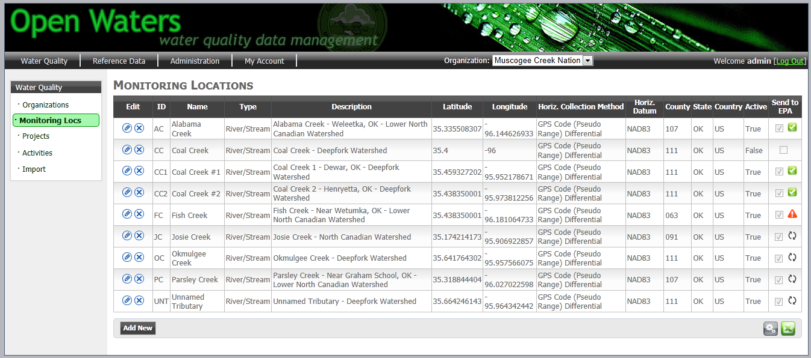
Open Waters
Latest WQX submission is refreshed
User can specify which columns to appear on each page
Filtered results can be exported to Excel

Slide 13
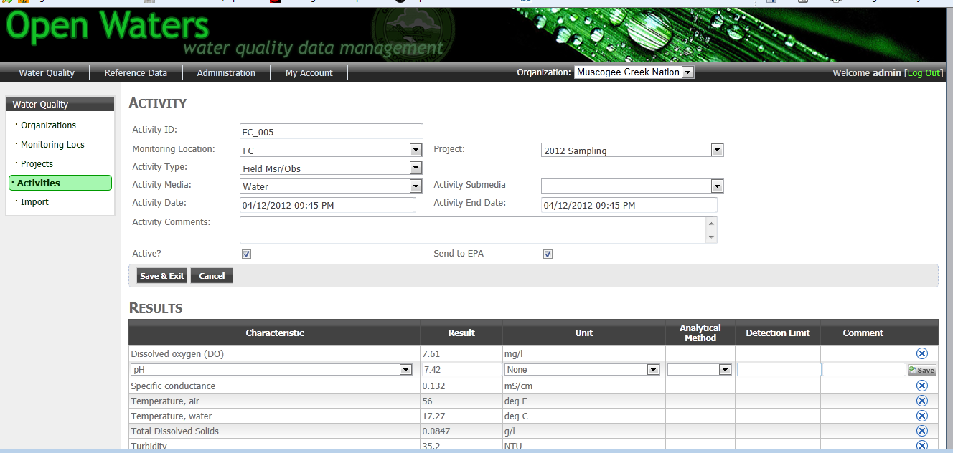
Activity / Results
User defines which data goes to EPA
Inline data editing for speedier data entry

Slide 14
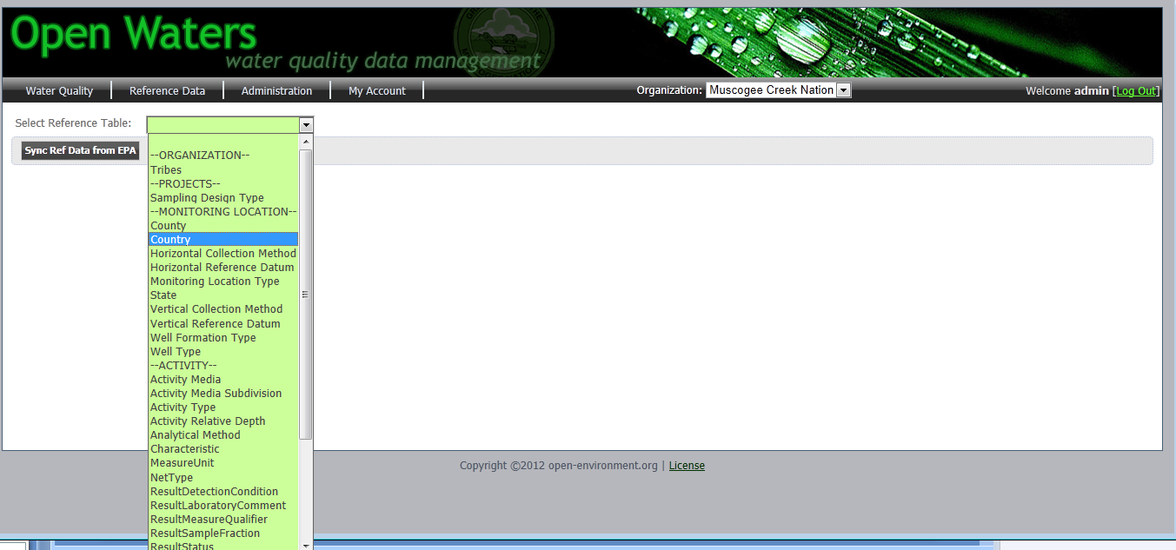
Reference Data Synchronization

Slide 15
Submission Transaction Logging
Manual submission option available
Complete submission history stored and associated with updated data

Slide 16
Lessons Learned

Slide 17
Lessons Learned
Exchange Network isn’t designed for granular data synchronization
Submitting 1 tiny little result = 1 minute round trip
Submitting 20 bytes of information = tens of thousands of bytes of request/response files
WQX Flow isn’t optimized for machine-to-machine automation:
Validation results come back in two different formats (schema validation errors in 1 XML format, business validation errors in different XML format – zipped)
Validation errors not the most machine-readable:
<LogDetail>
<Type>Error</Type>
<Text>When Result Detection Condition Text is &apos;Not Detected&apos; , &apos;Present Above Quantification Limit&apos; or &apos;Present Below Quantification Limit&apos;, then the Detection Quantitation Limit Type Name and Detection Quantitation Limit Measure must be reported.</Text>
<Context>Result (Line 13)</Context>
</LogDetail>

Slide 18
Open Source
The Open Source Definition*:
Free redistribution: don’t restrict any party from giving away or selling the software
Source code: must be a well publicized means of obtaining source code…preferably downloading via the Internet without charge
Derived works: must allow modifications and derived works, and allow them to be distributed
No discrimination: license must be available to all (e.g. don’t restrict license to only government users or prevent competitors from using)
Open Waters:
License: GPL v3 (http://www.gnu.org/licenses/gpl.txt)
Available at: http://code.google.com/p/open-waters
* source: www.opensource.org

Slide 19
Recommendations
Data Synchronization Support:
When modernizing existing Exchange Network Data flows, EPA should consider supporting the option of more granular data synchronization
Open Source:
When software is advertized as Open Source, check against the open source criteria
Consider TCO (Total Cost of Ownership) versus initial license fee (upgrades, locked-in-maintenance)
Consider where is the “sweet spot” of buy-vs-build, and then be there
Open Source software promotes collaboration and sharing among partners to build top-notch solutions
(sounds like the Exchange Network…)
* source: www.opensource.org

Slide 20
Questions?
fharjo@muscogeenation-nsn.gov
RColeman@muscogeenation-nsn.gov
Doug.timms@open-environment.org

