Slide 1
Institutional Controls (IC) Data Flow Webinar
XML Schema and Data Services Overview 7/8/2013

Slide 2
Agenda
About ICs and the IC Data Challenge
Review IC IPT Project Goals
History of Exchange Network IC-related Efforts
IC XML Schema Overview
IC Data Services
Path Forward: Ohio EPA, Indiana DEM, Terradex, Inc.
Questions

Slide 3
The IC Data Challenge
IC data is tracked and used at different levels of government
Agencies often have overlapping and disconnected responsibilities for implementation, monitoring, and/or enforcement
A standard data format and data access mechanism can help agencies share and integrate their IC data

Slide 4
History of Exchange Network IC-related Efforts
2002
The Environmental Data Standards Council (EDSC) began conducting meetings with EPA, States, Tribes and Local Governments to develop a data standard for IC data.
EDSC ultimately developed 24 data standards, IC was one of them
May, 2003
3-day IC meeting at Hyatt in Chicago, 56 participants
Goal was to refine/settle the draft IC data standard

Slide 5
History of Exchange Network IC-related Efforts (cont’d)
2004
Published the Institutional Controls Data Standard
http://www.exchangenetwork.net/standards/IC_Data_Standard_01_06_2006_Final.pdf
http://www.exchangenetwork.net/standards/IC_FAQs.pdf
2006
California Department of Toxic Substances Control (DTSC) receives EN grant to develop IC data flow
A draft XML schema is produced but was never published or implemented
…no significant activity since then

Slide 6
EDSC IC Data Standard (2004)

Slide 7
IC IPT Project Goals
Convene an Integrated Project Team (IPT) of IC stakeholders to provide input on IC data format and data exchange services
Develop an IC XML schema
A schema defines data elements and relationships between data elements
Develop a Flow Configuration Document (FCD)
An FCD describes how data exchanged between partners
Submit the schema and FCD to Exchange Network (EN) governance for review and approval

Slide 8
IC IPT Timeline
3/12/2013 – IPT Kickoff Meeting
4/9/2013 – IPT Review of Draft XML Schema
5/7/2013 – IPT Review of Draft Data Services List
6/10/2013 – IC Flow Package Published to Exchange Network Web Site:
http://www.exchangenetwork.net/data-exchange/ic/

Slide 9
IC XML Schema Structure Overview (IC FCD Section 4)

Slide 10
EN Query and Solicit Data Services
Requesting data from a partner can by done it two ways: Query or Solicit
Query
Immediate response is returned
Ideal for getting smaller data sets
Solicit
Request the data, but come back later to download it
Server provides a Transaction ID to track the request
Both Query and Solicit support parameters for passing in criteria

Slide 11
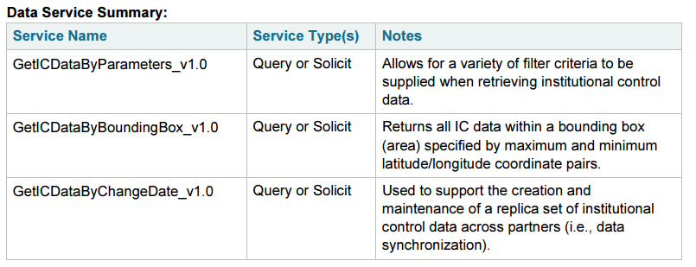
IC FCD Data Services

Slide 12
Service: GetICDataByChangeDate_v1.0
Returns all IC data added or updated since a certain date. Used to refresh a requestor’s dataset with any changes since the last inquiry.
Parameters:
ChangeDate(date, required)

Slide 13
Service: GetICDataByBoundingBox_v1.0
Returns all IC data within a lat/long box (area)
Parameters:
BoundingCoordinateNorth(decimal, required)
BoundingCoordinateSouth(decimal , required)
BoundingCoordinateWest(decimal , required)
BoundingCoordinateEast(decimal , required)

Slide 14
Service: GetICDataByParameters_v1.0
Allows for a variety of criteria to be supplied, various filtering. Supplying no criteria returns all IC records.
Parameters:
InstrumentIdentifier (text, 0 or more)
FacilityIdentifier (text, 0 or more)
FacilitySiteName (text, 0 or more)
UseRestrictionTypeCode (text, 0 or more)
BoundingCoordinateNorth/South/West/East (decimal, 0-1)
ChangeDate (date, 0-1)

Slide 15
Path Forward
Partner Implementation Plans:
Ohio EPA – Adele Vogelgesang
Indiana DEM - Greg Overtoom
Mike Sowinski/Bob Wenzlau – Terradex, Inc.

Slide 16
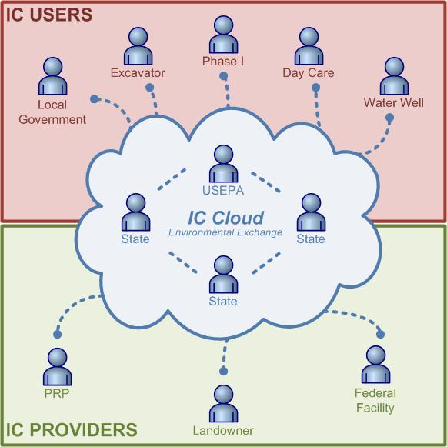
Software Solutions for IC Data Flows
IC Users
IC Cloud (Exchange)
IC Providers
IC Software Solution Providers

Slide 17
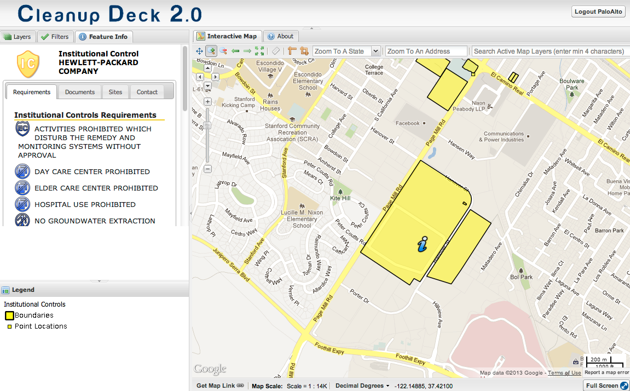
Presentation of Schema Derived Data
From CA Envirostor Repository
Fuel Leak
Closure Records
From CA RWQCB Covenants

Slide 18
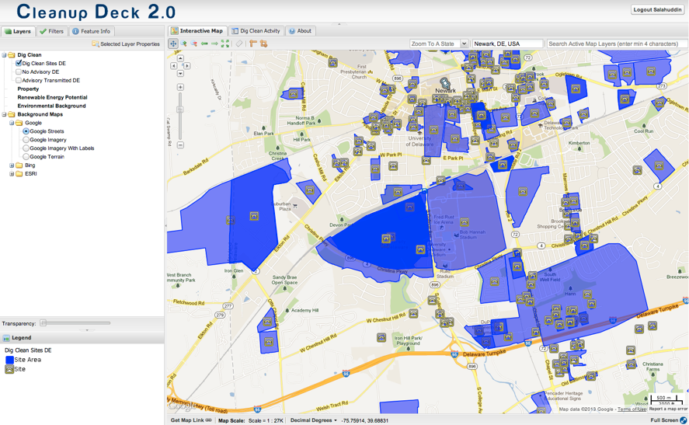
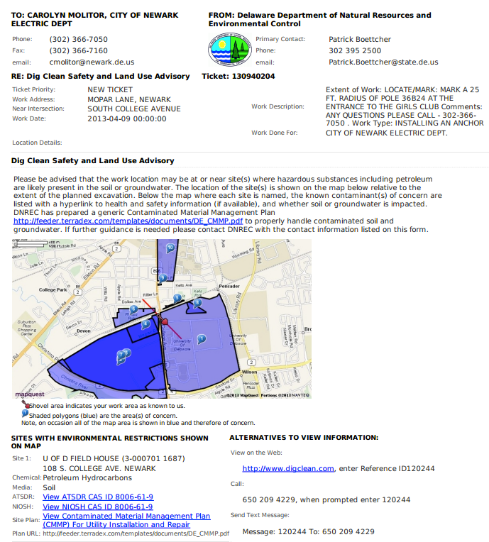
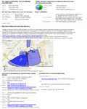
A Software Solution for Excavation Advisory IC Data Flow
IC Repository/Cloud
Delaware Dept. of Natural Resources & Environmental Control
“Duty to Inform of Environmental Hazards”
IC User
Miss Utility of Delaware
Local Government
“Newark, DE Electric Department Plans Buried Installation”
Terradex Dig Clean
Fax, Text or Email Hazard Advisory
IC Software Solution

Slide 19
Excavation Advisory from Dig Clean Software Solution

Slide 20
Questions?

